Slide 1
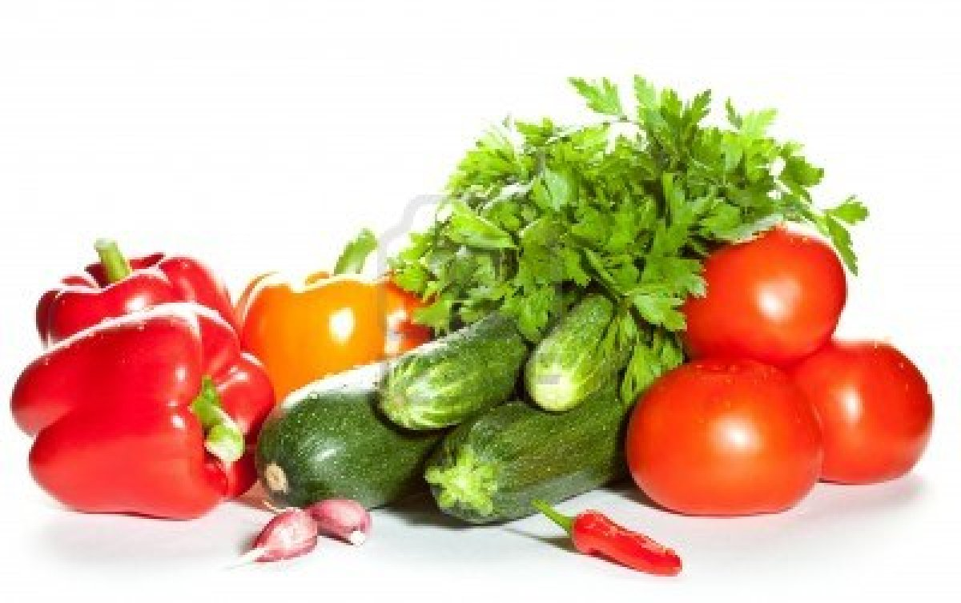
Vegetables

Slide 2
Types of Vegetables
Avocados
Cabbages
Gourds
Summer Squash
Winter Squash
Leafy Greens
Mushrooms
Onions
Green Onions
Dry Onions
Peppers
Sweet Peppers
Chilies
Pods and Seeds
Edible Pods
Inedible Pods
Root Vegetables
Shoots and Stalks
Tomatoes
Tubers
High-starch/low-moisture potatoes
Low-starch/high-moisture potatoes
Yams and Sweet Potatoes

Slide 3
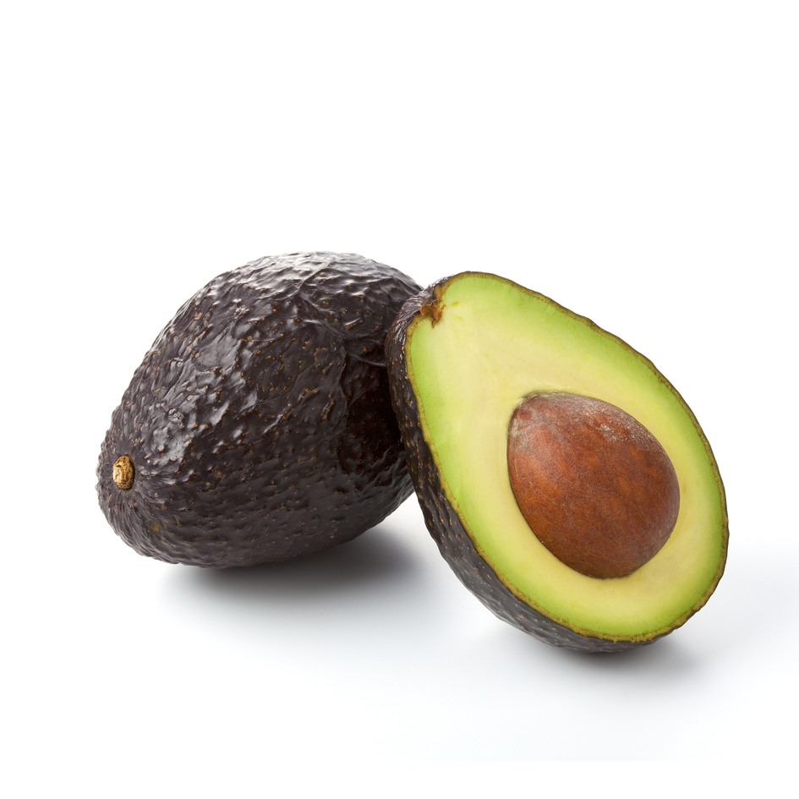
Avocados
Actually a fruit (go figure)
Contain substantial amounts of fat
Ripe avocados are soft to the touch
Fuertes and Haas are two types
Haas Avocados have almost black skins while other avocados’ skins remain green when ripe
Fuertes Avocados
Haas Avocados

Slide 4
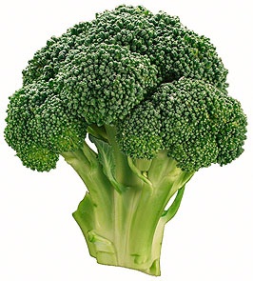
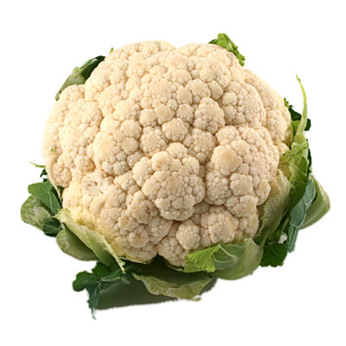
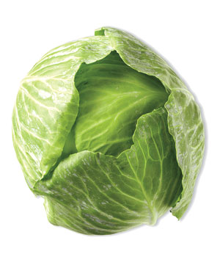
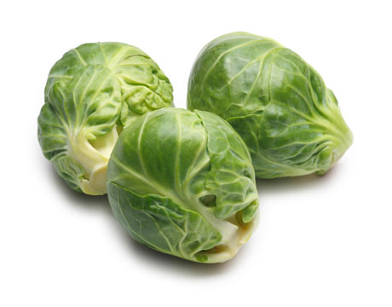
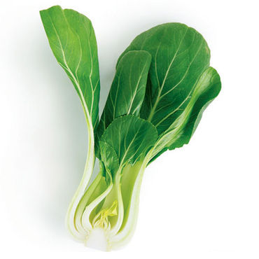
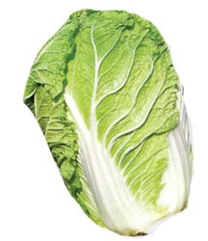
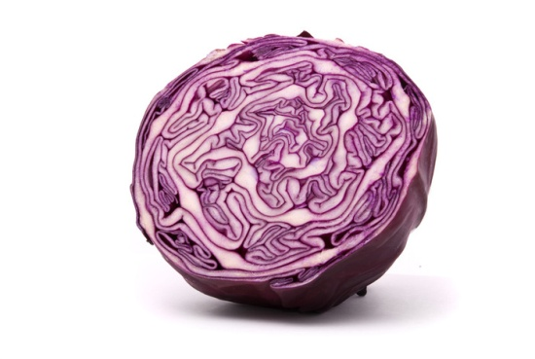
Cabbages
Cauliflower
Red and green
Look for good uniform color, stems that are not split and leaves that are not dried out
Green Cabbage
Broccoli
Brussels Sprouts
Bok Choy
Napa Cabbage
Red Cabbage

Slide 5
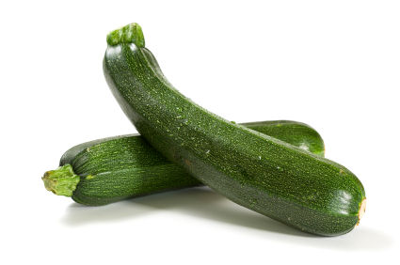
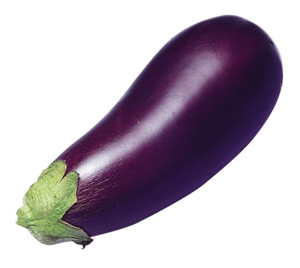
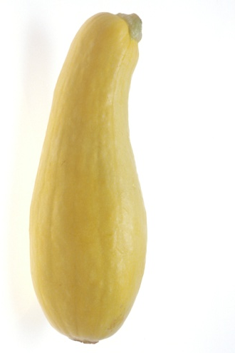
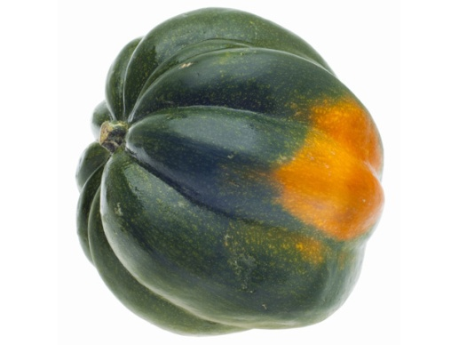
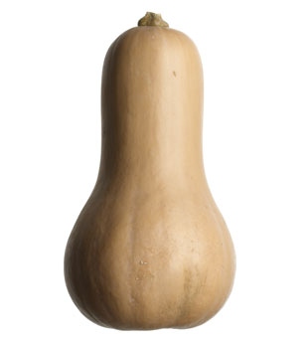
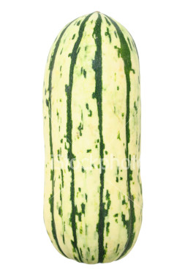
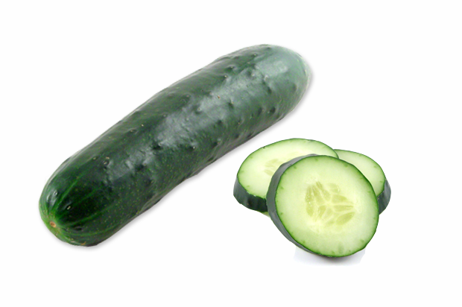
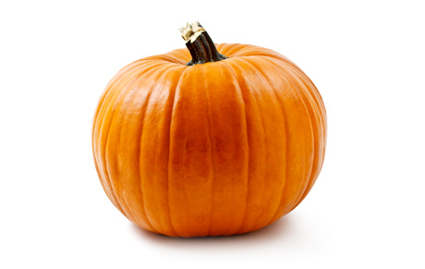
Gourds
Eggplant
You can typically eat all parts of them
Summer Squashes are zucchini, yellow squash, and pattypan squash
Winter Squashes include butternut, pumpkins, and acorn. Their skins are inedible and the seeds must be removed before eating.
Zucchini
Yellow Squash
Butternut
Acorn Squash
Pumpkin
Cucumber
Delicata

Slide 6
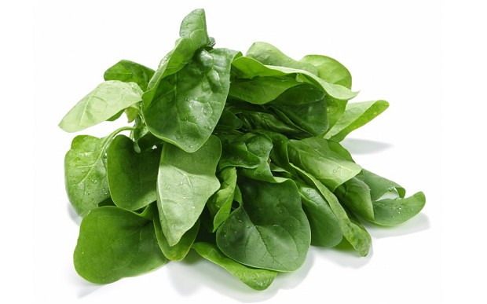
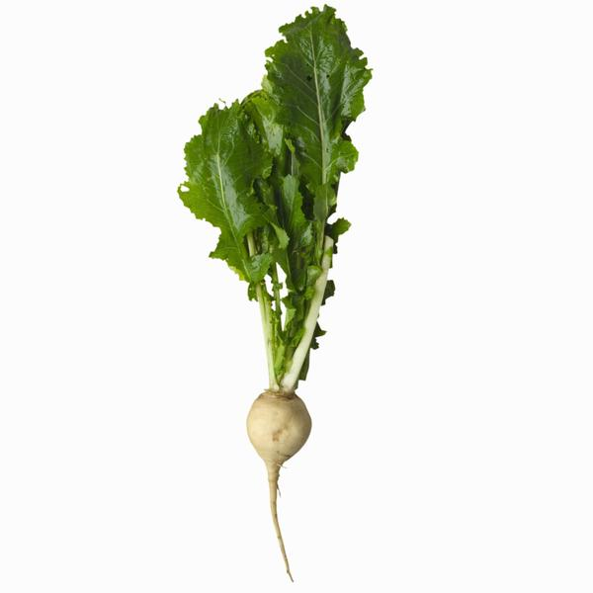
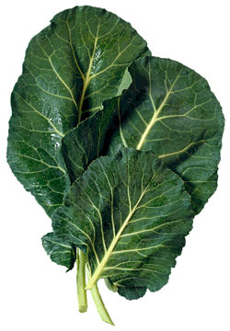
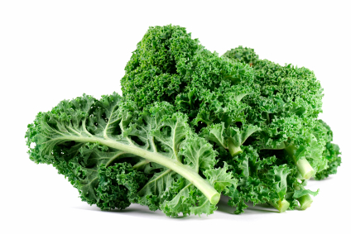
Leafy Greens
Includes salad greens
Often sauteéd, steamed or braised
Turnips
Spinach
Collards
Kale

Slide 7
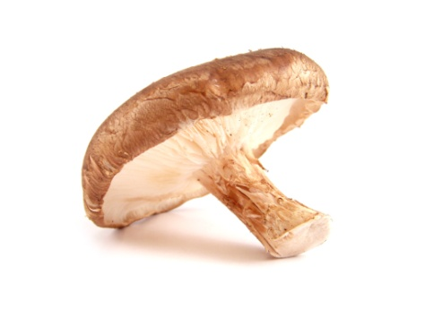
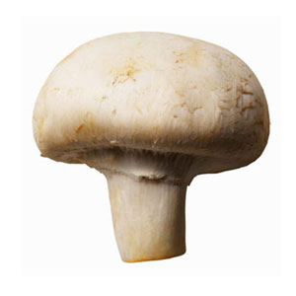
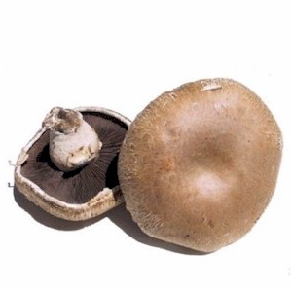
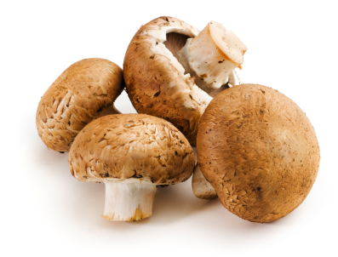
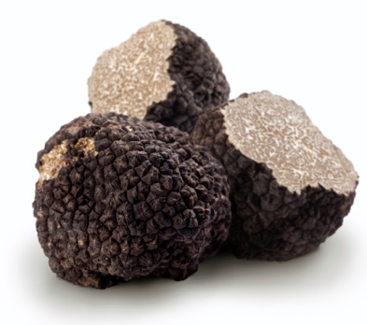
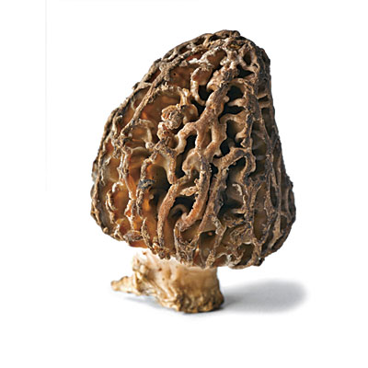
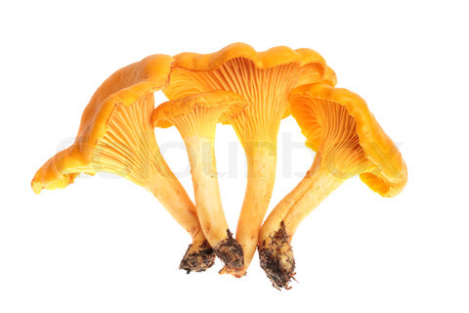
Mushrooms
Shiitake
There is a great variety in size, color and shape
“Wild” types are usually grown on farms
Mushrooms should be firm, without soft spots, blemishes or breaks in the caps or stems
Refrigerate them, keep covered with a dampened paper towel but dry until ready to cook
Button
Cultivated varieties
Cremini
Portobello
Morels
Truffles
“Wild” varieties
Chanterelles

Slide 8
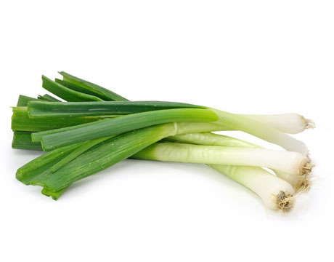
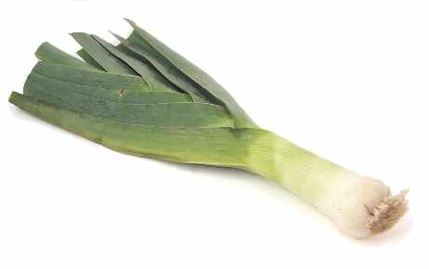
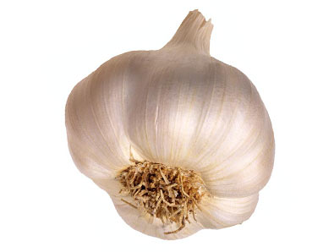
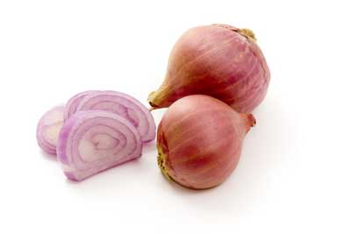
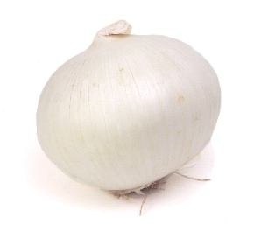
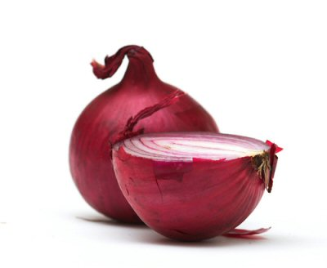
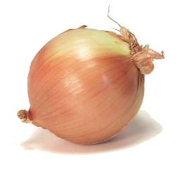
Onions
Dry onions includes garlic, shallots and leeks
Green onions have a tender white bulb that is edible in scallions and discarded for leeks
Roots should be flexible but firm, rinse before cooking
Dry onions range in size, have papery skin, they are heavy for their size and have tight fitting skins
Scallions
Green Onions
Leek
Garlic
Shallots
White Onion
Dry Onions
Red Onion
Yellow Onion

Slide 9
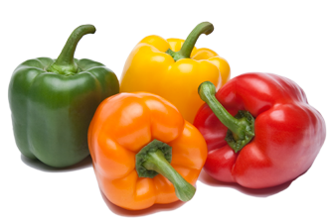
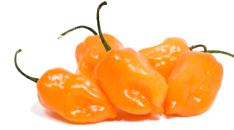
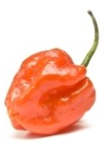
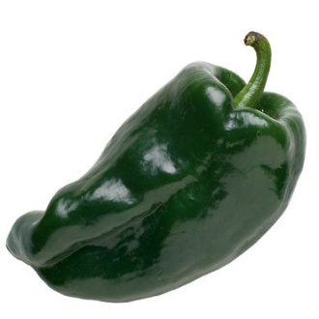
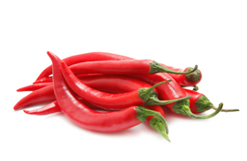
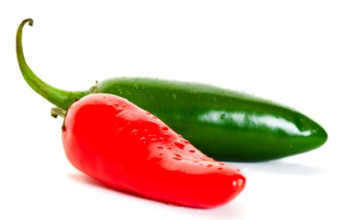
Peppers
Yellow Bell
Green Bell
Peppers should be firm, and heavy for their size, thick, crisp, glossy skin
Sweet peppers:
Known as bell peppers
All start out green but certain varieties ripen to other colors
All have similar tastes except red and yellow tend to be sweeter
Chilies:
Capsaicin is a compound that gives chilies their heat, potent on the white ribs on the inside
Smaller chilies are generally hotter
Red Bell
Sweet Peppers
Orange Bell
Anaheim
Habanero
Poblano
Scotch Bonnet
Chiles
Cayenne
Jalapeno

Slide 10
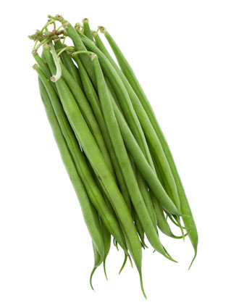
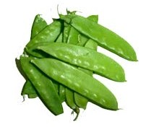
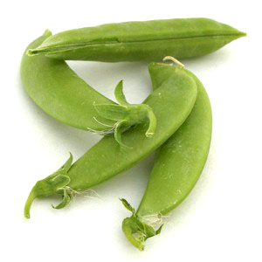
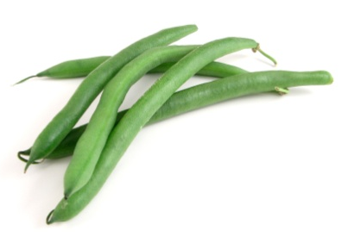
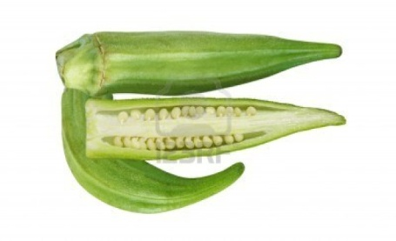
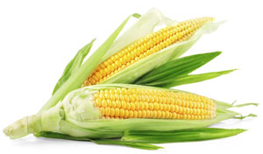
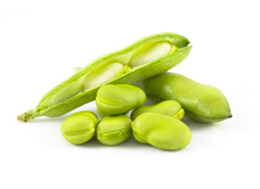
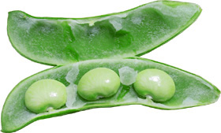
Pods and Seeds
Snow Peas
Haricot Vert
Includes peas, beans, bean sprouts, okra, and corn
Should be crisp, firm and colorful
Taste best when young when they’re sweeter and tender
Edible are picked when fleshy and tender enough to eat
Inedible have to be removed from their pods before eating
Okra
Sugar Snap Peas
Edible Pods
Green Beans
Corn
Green Peas
Inedible Pods
Fava Beans
Lima Beans

Slide 11
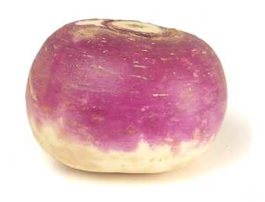
Roots
Grow underground
They are rich in sugars, starches, vitamins and minerals
The leafy green tops (if still attached upon arrival) serve as a good indicator or the quality
The actual vegetable should be firm and dry
Beets
Turnip
Carrots
Radish
Parsnips

Slide 12
Shoots and Stalks
With artichokes, only the lower part of the leaves and the “heart” (the part attached to the stem) are eaten
Asparagus should be firm, fleshy, full stalked, with no browning or wilting, the buds on the top should be closed
Artichoke
Asparagus
Celery
Fennel

Slide 13
Tomatoes
Hundreds of varieties, varying in size, shape, color, flavor and texture
All have juicy flesh, edible seeds and smooth, shiny skin
Beefsteak are good slicing tomatoes, cherry and pear work well with salads and the tomatillo and are typically used in sauces and other cooked dishes
Beefsteak
Pear
Tomatillo
Cherry
Plum/Roma

Slide 14
Tubers
A tuber is the fleshy portion of a certain plant that grows underground
Potatoes are the most common tuber
High-starch/low-moisture are used for baking, frying, pureeing and mashing and are dry and granular after cooking
Low-starch/high-moisture potatoes are more “all-purpose,” they are good for soups, steaming, sautéing, stewing, braising, etc.
High-starch/low-moisture
Russet/Idaho
Yukon Gold
Purple Potato
Red Potatoes
Low-starch/high-moisture

Slide 15
Tubers
Sweet Potatoes
cont.
Sweet potatoes and yams are also tubers
Sweet potatoes use low-starch/high-moisture cooking methods while yams use high-starch/low-moisture methods
True yams are starchy, dry, have rough skins and are blocky
Sweet potatoes are dense, sweet, smooth and thin
Yams

Slide 16
Selection and Storage
All veggies, excluding tomatoes, after being purchased need to ripen at room temperature
Vegetables are sold by weight, count, boxed, crated, canned, dried, or bagged.
Graded for quality by the AMS (Agricultural Marketing Service), a subsection of the USDA
Veggies are graded on color, shape and size and are typically marked U.S. No. 1 and either A,B, or C for their size
Vegetables should have good color, feel firm and be unblemished
When the vegetable needed is out of season, chefs often rely on frozen varieties
All vegetables (except potatoes, tomatoes, avocados, dry onions and winter squash are considered perishable and should be refrigerated
Store fresh root veggies without their leafy tops to preserve them longer and trim roots
Leave skins on vegetables until preparation, once peeled or cut, their life is shortened

Slide 17
Preparation
All vegetables must be washed before being cut or prepared in any ways, there are no exceptions. This removes contaminates both physically and bacterially.
To clean veggies, run them under cold water, there are some solutions for cleaning fruits and vegetables
Remove skins if necessary by peeling, remove woody stems, and greens that are not edible (tomato leaves, etc.)
Most vegetables are their freshest and most delicious when cut as close as possible to cook time

Slide 18
Cooking and Serving
Proper doneness of any vegetable is determined by how you plan to serve or use the vegetable, the characteristics and cultural preferences
Blanching: a precursor to other cooking methods, can be used for veggies being served cold, done by boiling for 30 seconds to one minute
Par-cooked/parboiled: cooking vegetables to partial doneness to be finished by grilling, sautéing or stewing
Tender-crisp: cooking vegetables until they can be bitten into easily but offer slight resistance
Fully cooked: retain their shape and color, can be used as a precursor to mashing or pureeing the vegetable(s)
Boiling/steaming: preserves color, texture, flavor, and nutritional value, drain the vegetables well so that remaining seasonings will stick to the veggie, the shorter the cooking time, the less liquid needed to cook

Slide 19
Cooking and Serving
Puréeing: can be used to flavor or thicken another dish, or as the basis for a soup or sauce, cook vegetables to a desired texture, purée the veggies (in a food processor, blender, food mill or sieve), taste and evaluate, add needed ingredients for taste, texture, or for another dish
Glazing: more of a finishing technique, to glaze, par-cook the veggies in water, make a glaze in a separate pan, toss the vegetables in the glaze and serve, there are other ways (such as adding butter or sugar to the tender veggies to form the glaze)
Braising/Stewing: cooking vegetables in their own juices, before you may want to par-cook or blanch the veggies, should be fork tender, these dishes hold well and some even taste better after resting
Roasting/baking: creates a deep flavor, preheat the oven (high temp/short time or low temp/long time depending on veggie), pierce the vegetables to allow steam to escape (to prevent exploding), add seasonings or marinades to improve flavor also

Slide 20
Cooking and Serving
Grilling/Broiling: the intense heat of grills gives veggies rich and bold flavors, have distinctive charred flavor and deeply browned exteriors, high-moisture vegetables can be grilled when raw but starchy or dense vegetables may require precooking, vegetables can also be marinated before hand
Frying/Sautéing: stir frying can be a preliminary, finishing or re-heating cooking method, choose the proper cooking fat (different types of oils or butter), can be breaded or coated with flour or batter before frying
Potato Purées: choose the right potato, dry the potato before puréeing and incorporate all the ingredients, you can use a masher, wooden spoon, sieve, ricer or food mill, blenders will overwork the potato
Serving methods can have a great impact on flavor, texture, color and nutritional value, can be served as appetizers, sides or entrees, they can be paired with salsas or garnishes

