Slide 1
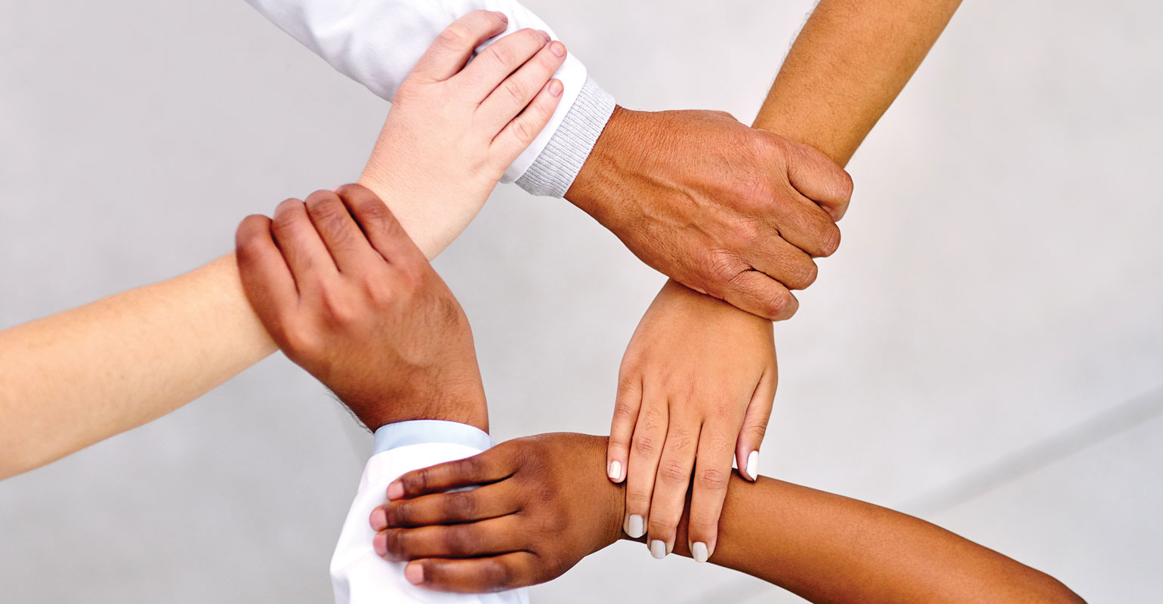
Teamwork

Slide 2
Brainstorming (write your responses in the blanks provided on your notes)
1) What team skills are helpful have at school? In the workplace?
2) What are the various roles You’ve seen in team members?
3) What are the consequences of using the strengths of team members? Of not using the strengths of team members?
4) What can you do to help a new person in your group or team feel comfortable?

Slide 3
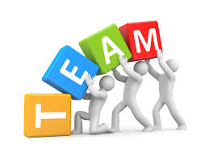
What is teamwork?
Teamwork – a cooperative effort by members of a team or group to achieve a common goal
Involves:
1. assisting others
2. requesting help when needed
3. brainstorming solutions
4. volunteering
5. doing your role’s job in order for your team to be successful

Slide 4
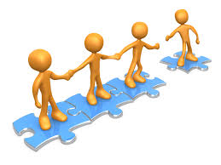
Characteristics of Great Teamwork
Cooperation
Even if you don’t like them, be professional!
Means you’re sharing responsibilities
Contribute
your own ideas, your effort, and suggestions
Work
with others to create projects and plans, use their strengths, assist them in improving their weaknesses
Communication
understand the goals and directions; state things clearly
Responsibility
all members take ownership of the assignment
Respect
make sure you respect your team members even if you don’t agree with them
Participation
A successful team is one where everyone gives 100%!

Slide 5
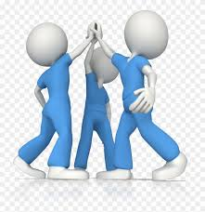
Characteristics of Good Team Players
Must be an active participant!
Come prepared to help the team
Listen and participate in team discussions
Fully engaged in the team’s task
Do not sit on the sidelines doing nothing
“Can-do” attitude
Volunteer for assignments
Take the initiative to help
Can communicate clearly, directly, and honestly
Accept criticism without reacting defensively

Slide 6
Facts About Teamwork
Ethnically diverse teams have the potential to generate more creative ideas and solutions due to the nature of their unique culture and life experiences
Sometimes a leader is needed to help make decisions and cut back on wasted time debating
When does a group become a team?
When they have a common relationship and develop a joint purpose and mission

Slide 7
Personal Roles Within A Team: Which one are you??
The thinker – creative, imaginative, free-thinking; generates ideas and solves problems; presents new ideas and approaches
Resource investigator – outgoing, enthusiastic, communicative; explores opportunities and develops contacts with others
Weakness: losses interest once initial enthusiasm has passed
Coordinator – mature, confident, clarifies goals, delegates effectively; acts as a chairperson

Slide 8
Roles, Continued:
Teamworker – cooperative, perceptive, diplomatic, listens and averts friction, encourages cooperation
Weakness: indecisive and avoids confrontation
Shaper – dynamic, thrives on pressure, has drive and courage to overcome obstacles, challenges team to improve
Monitor-evaluator – strategic, sees all options and judges accurately
Weakness: lacks drive, can be overly critical

Slide 9
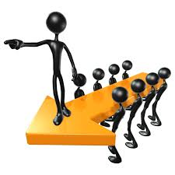
Roles, Continued:
Implementer – practical, reliable, efficient, turns ideas into action, organizes work to be done
Weakness: inflexible and slow to respond to new possibilities
Finisher – conscientious, anxious, searches out errors, and polishes and perfects, ensures thorough and timely completion
Weakness: reluctant to delegate
Specialist – single-minded, self-starting, dedicated, provides knowledge and skills, provides specialized skills
Weakness: dwells on technicalities

Slide 10
Categorizing These Roles
The 9 roles fit into 3 categories:
Action Oriented Roles
Shaper, implementer, finisher
People Oriented Roles
Coordinator, teamworker, resource investigator
Thought Oriented Role
Thinker, monitor-evaluator, specialist

Slide 11
Steps for Developing a Team
Forming
Who are we? What are our roles? Who leads?
Storming
We are different, we may disagree
Norming
Set goals, assign tasks, develop routines, manage conflict, hold each other accountable for their tasks
Performing
Members coordinate, trust each other and care
Renewing/readjusting
Learn, revisit goals, thank each other, learn from mistakes
Forming, Storming, and Norming working Together
When it’s determined how the workload is divided, when goals are set, and plans for meeting the goals are formed

Slide 12
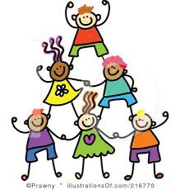
5 Ways to Become a More Effective Team
Set ground rules for behavior and expectations
Make sure everyone is participating at all times
Don’t assume others know what you know
Share, analyze, and decide
Share what you already know about the problem, analyze alternatives, then make decisions using the teams input

Slide 13
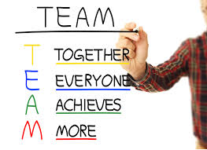
Benefits of great teamwork
Builds creativity, skills and knowledge
Teaches how to trust and be trustworthy
Builds strengths and diminishes weaknesses
Builds leadership qualities
Promotes ownership and pride
Teaches conflict resolution
Improves communication skills
Teaches time management

Slide 14
Describe a Time when you……
Describe a situation you’ve been in or seen where teamwork was clearly evident. What behaviors in the situation made it teamwork instead of “just a group working together” and why? (write your example on the lines provided in your notes)

