Slide 1
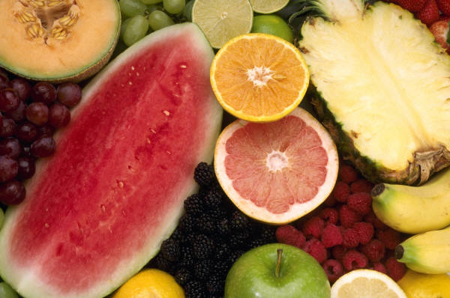
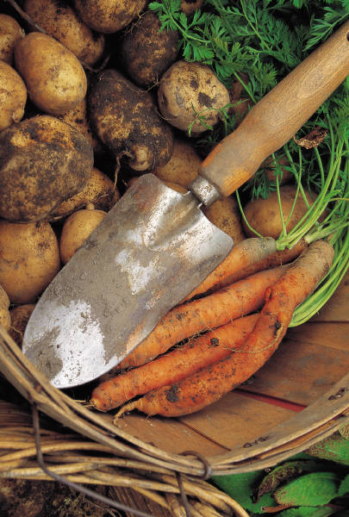
Name that Fruit or Vegetable

Slide 2
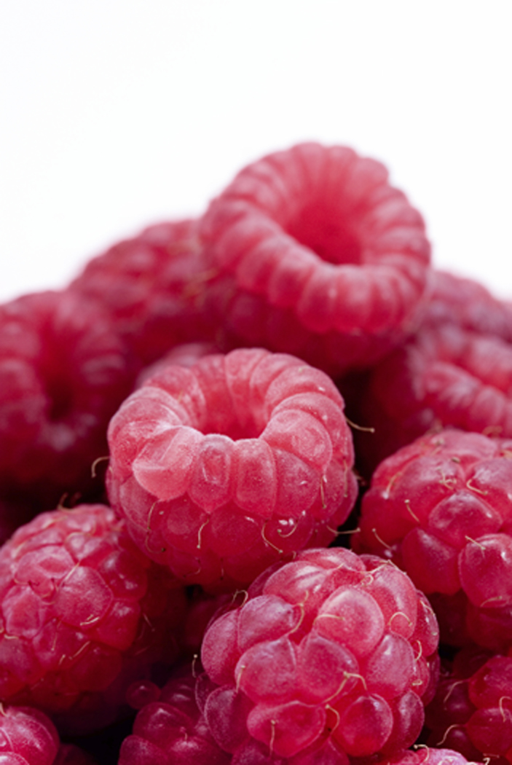
1. What am I?
Raspberry

Slide 3
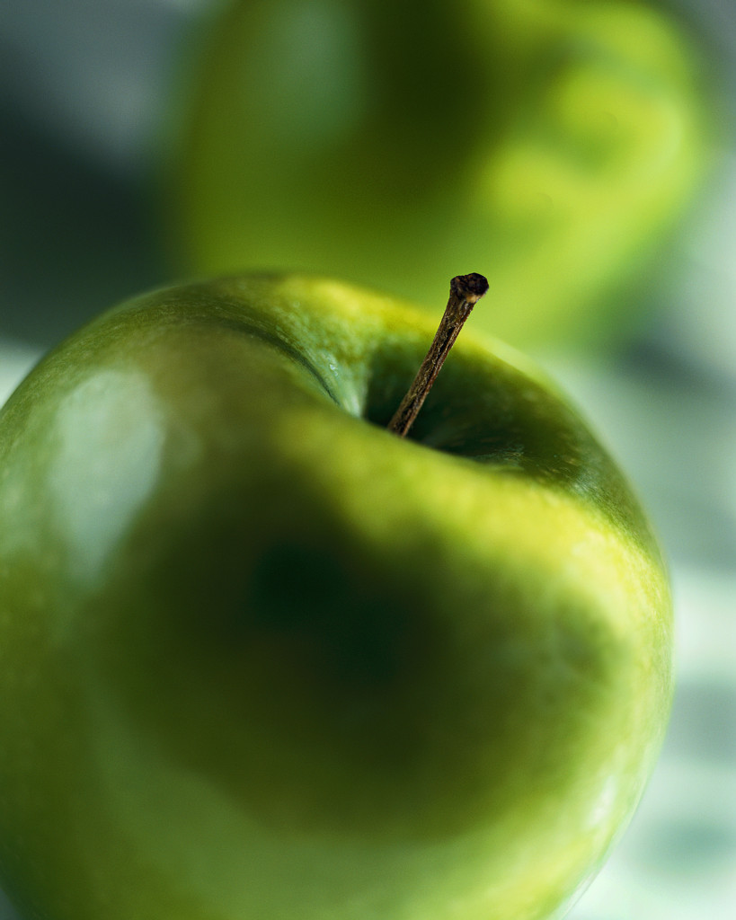
2. What am I?
Green Apple

Slide 4
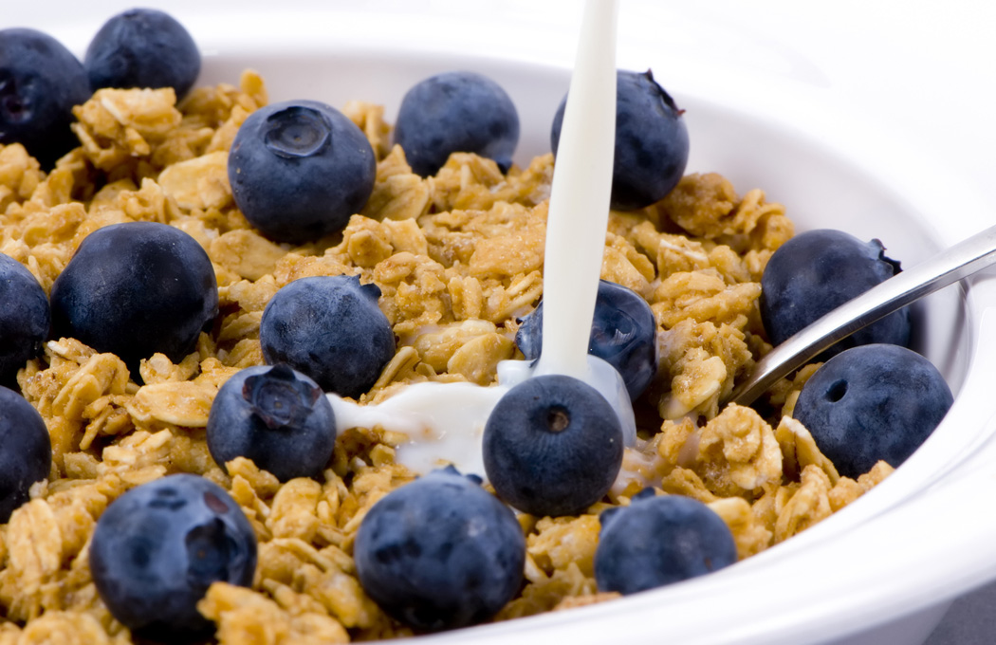
3. What am I?
Blueberry

Slide 5
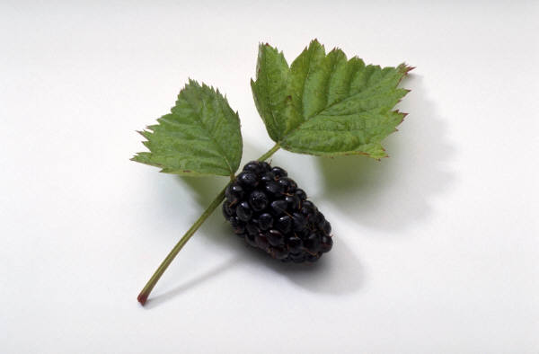
4. What am I?
Blackberry

Slide 6
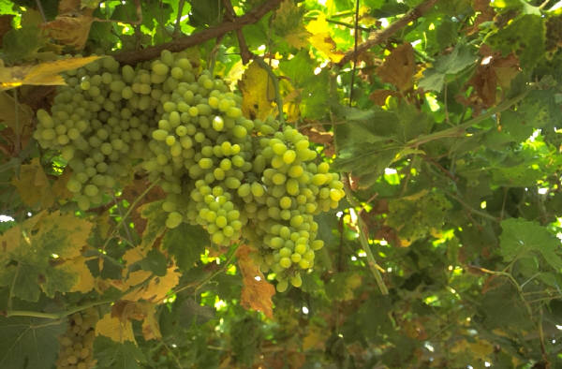
5. What am I?
Green Grapes

Slide 7
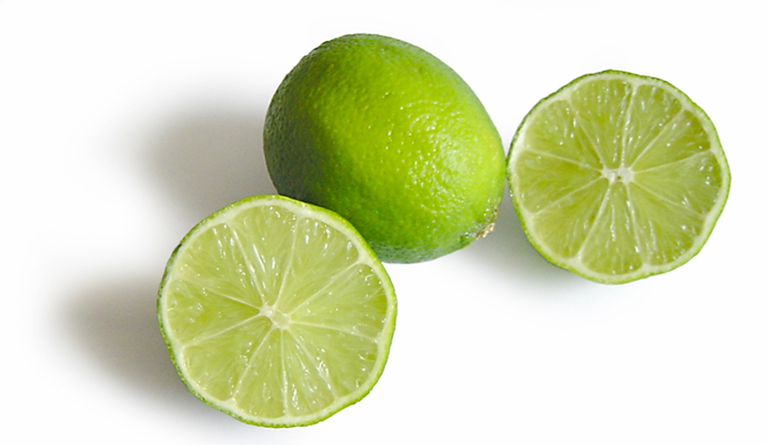
6. What am I?
Limes

Slide 8
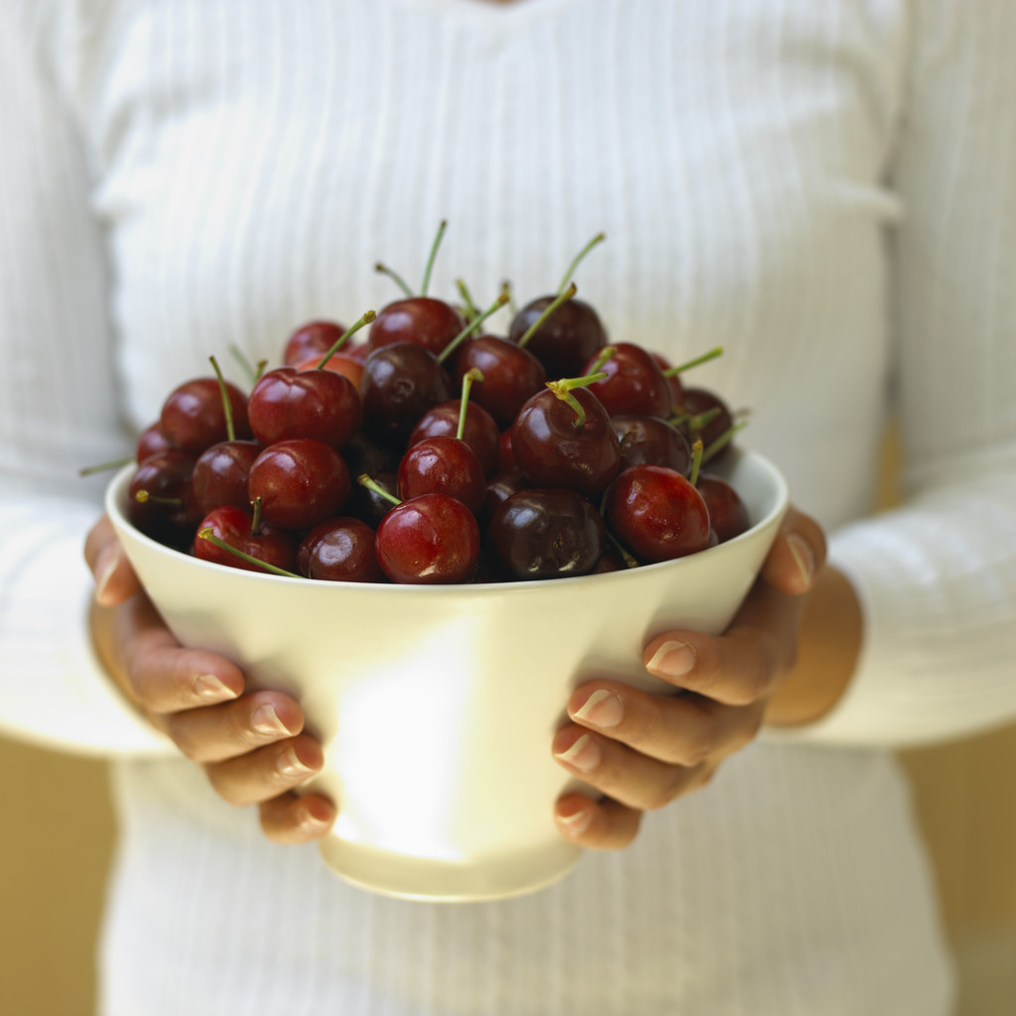
8. What am I?
Cherries

Slide 9
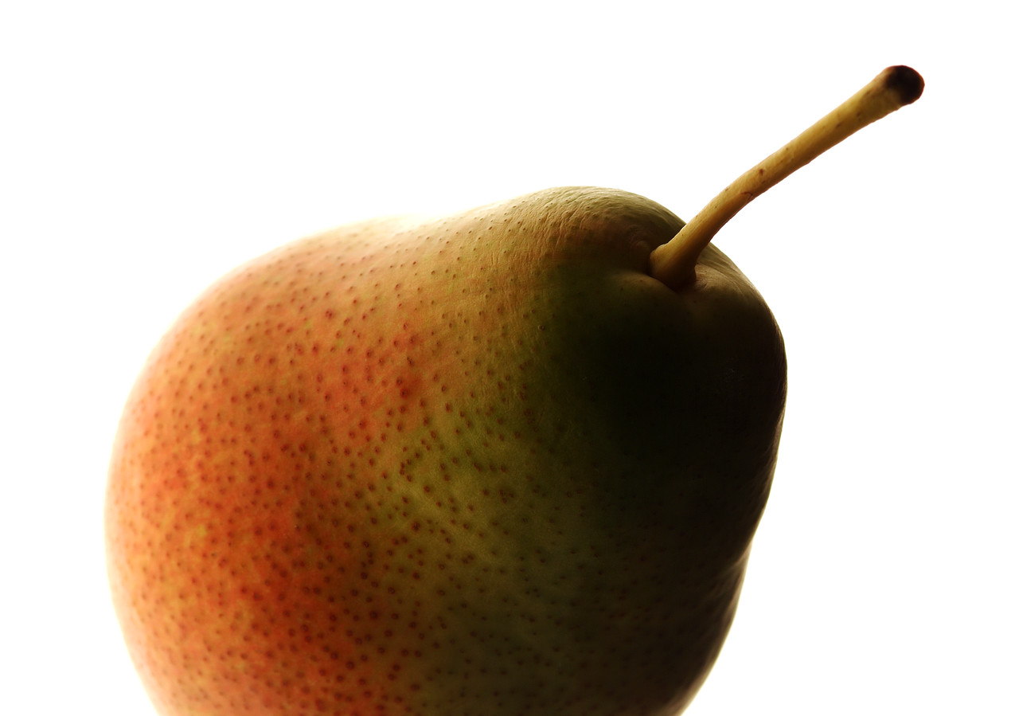
7. What am I?
Pear

Slide 10
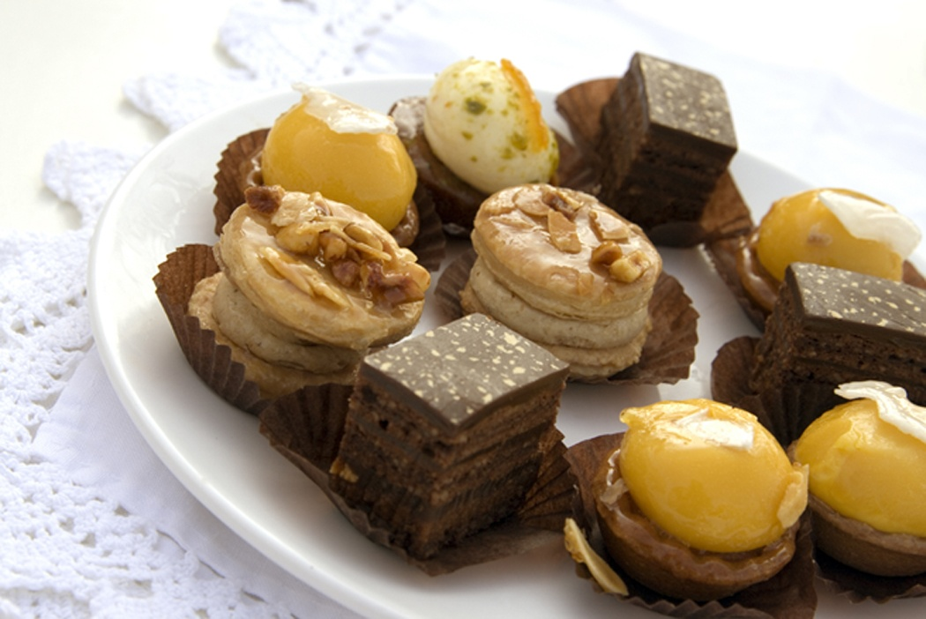
9. What am I?
Apricot

Slide 11
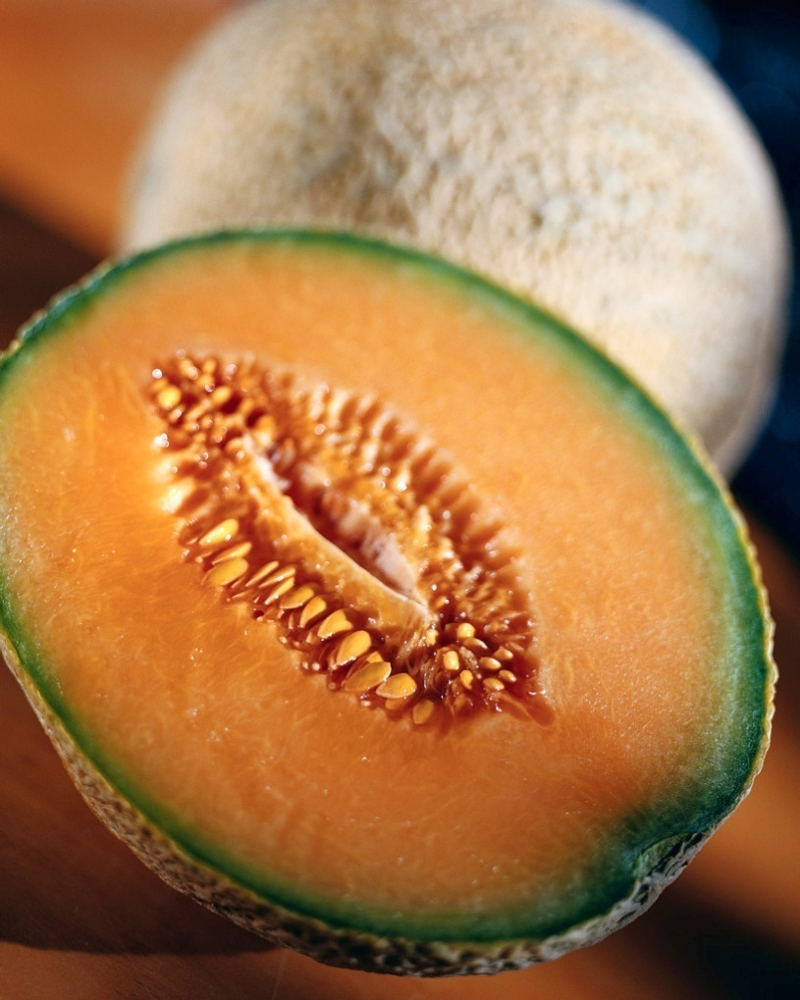
10. What am I?
Cantaloupe

Slide 12
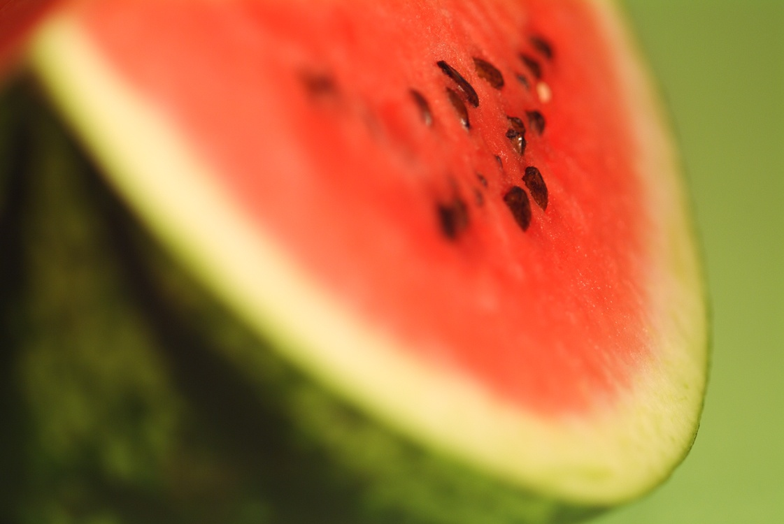
11. What am I?
Watermelon

Slide 13
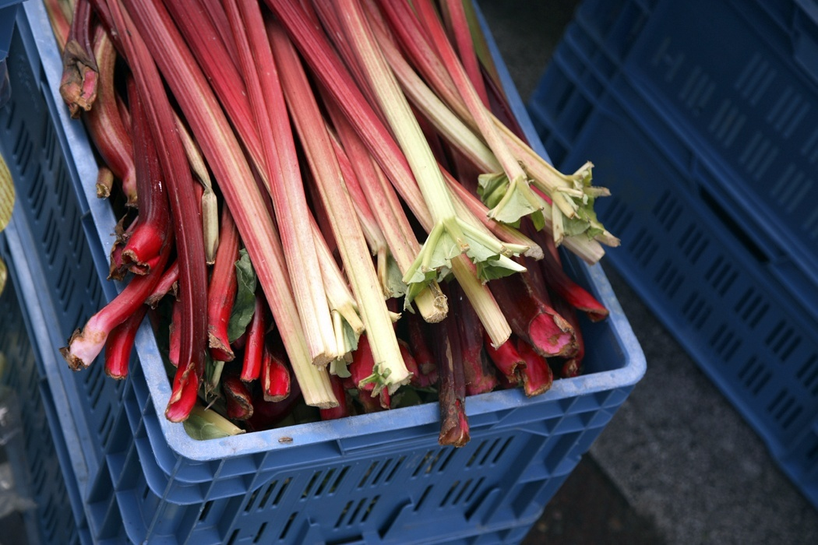
12. What am I?
Rhubarb

Slide 14
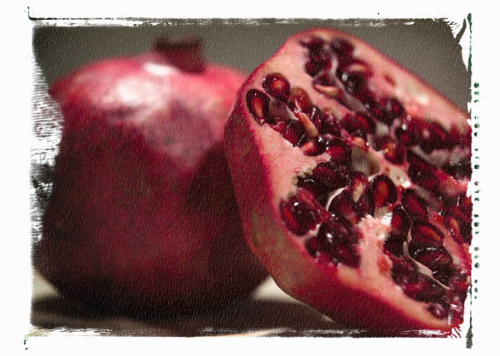
13. What am I?
Pomegranate

Slide 15
14. What am I?
Star Fruit

Slide 16
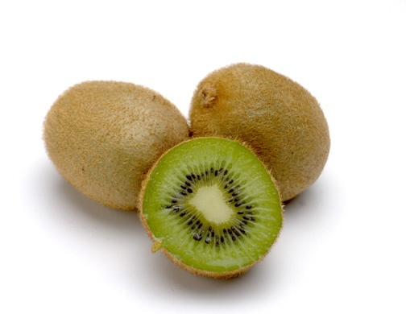
15. What am I?
Kiwi

Slide 17
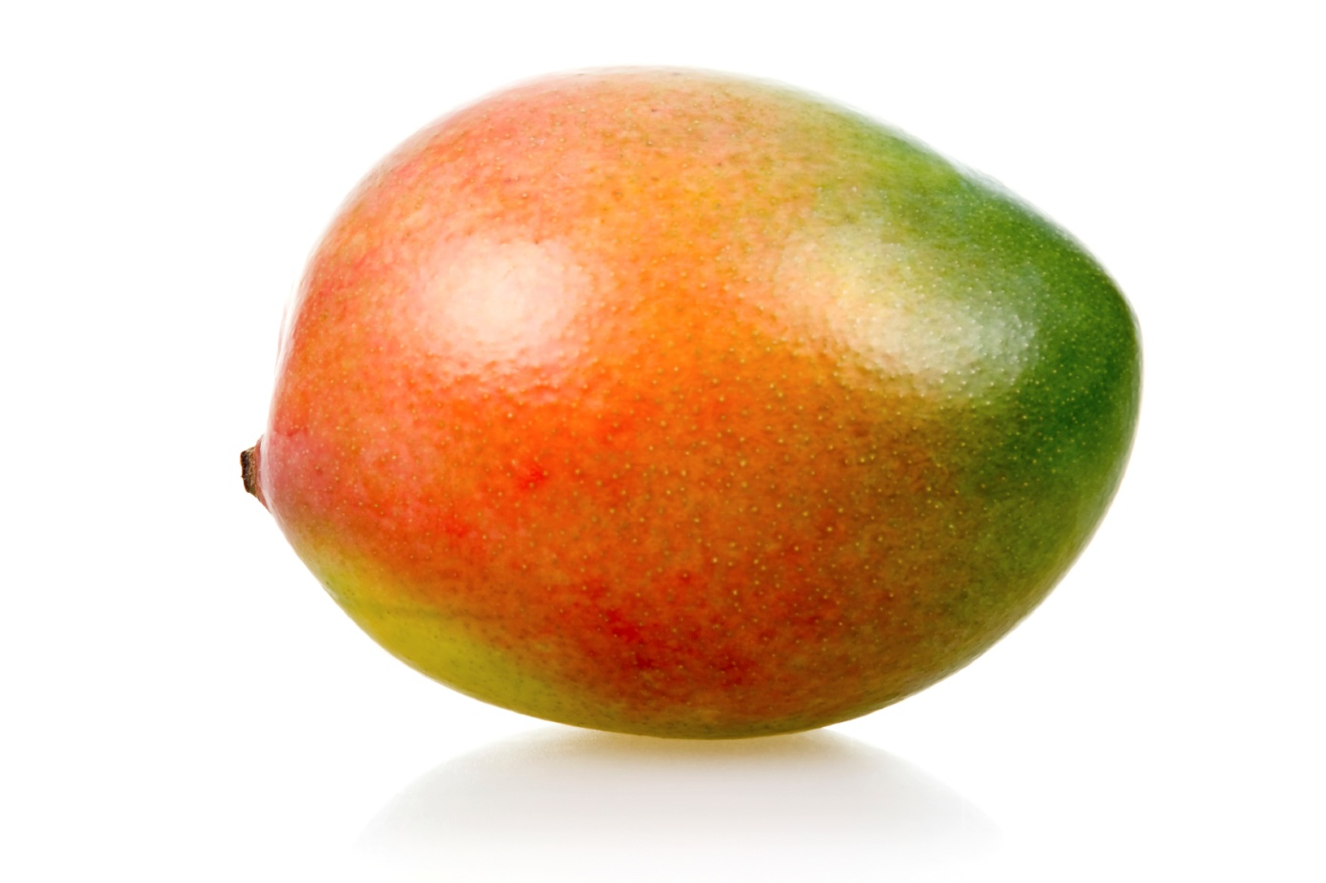
16. What am I?
Mango

Slide 18
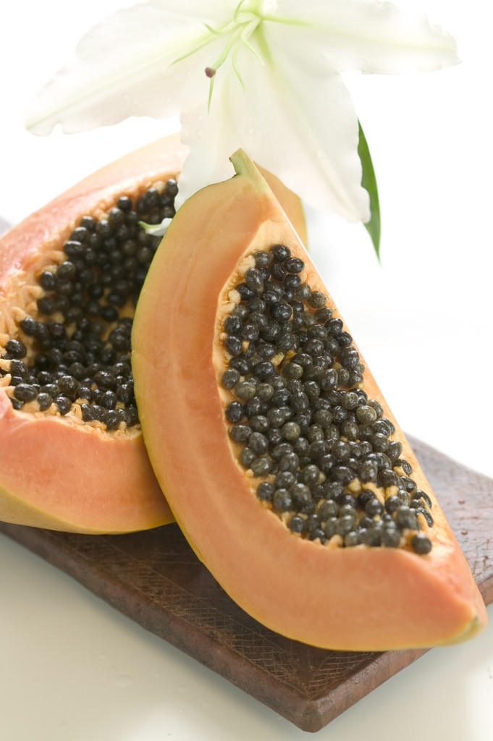
17. What am I?
Papaya

Slide 19
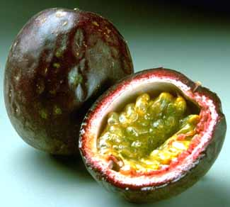
18. What am I?
Passion Fruit

Slide 20
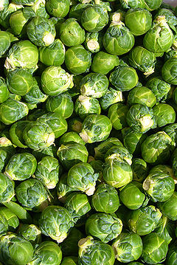
19. What am I?
Brussel Sprouts

Slide 21
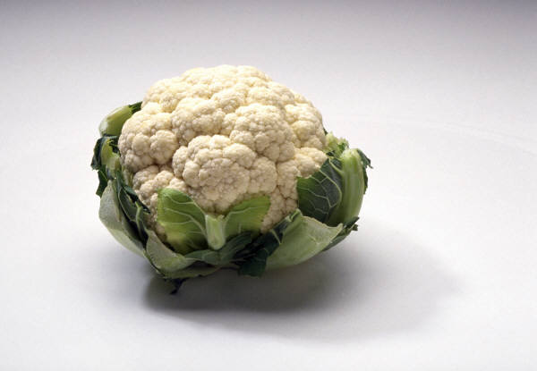
20 What am I?
Cauliflower

Slide 22
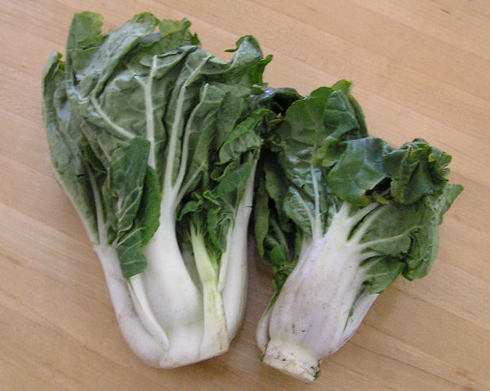
21. What am I?
Bok Choy

Slide 23
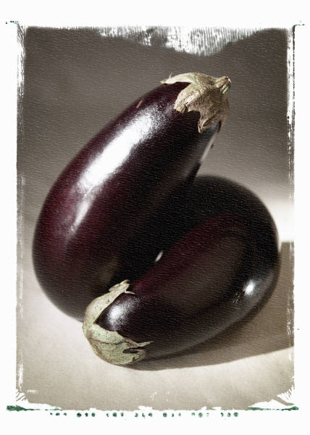
22. What am I?
Eggplant

Slide 24
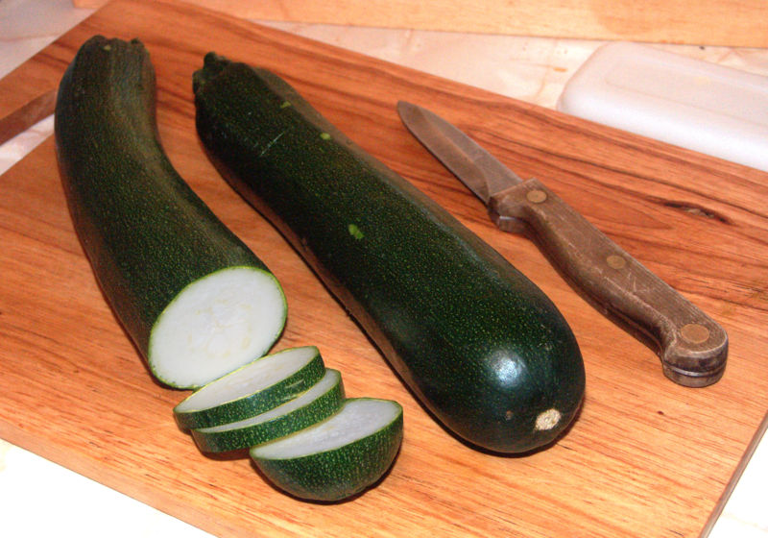
23. What am I?
Zucchini

Slide 25
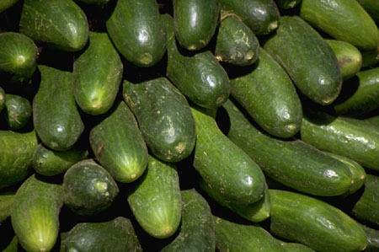
24. What am I?
Cucumber

Slide 26
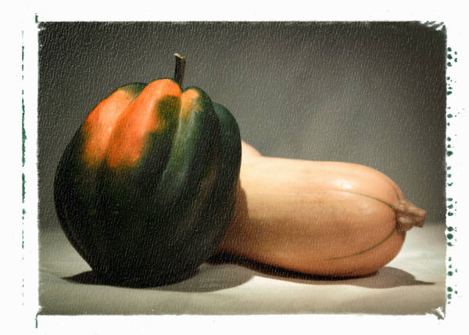
25. What am I?
←Acorn Squash & Butternut Squash→

Slide 27
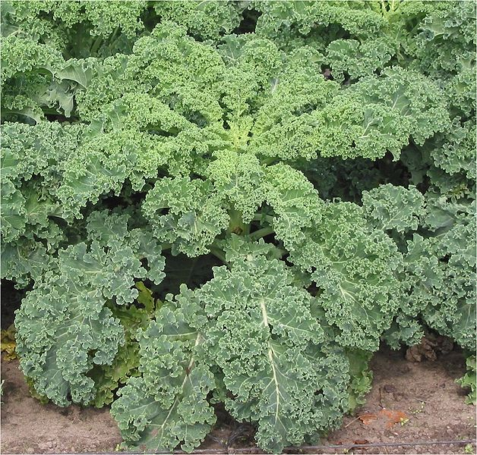
26. What am I?
Kale

Slide 28
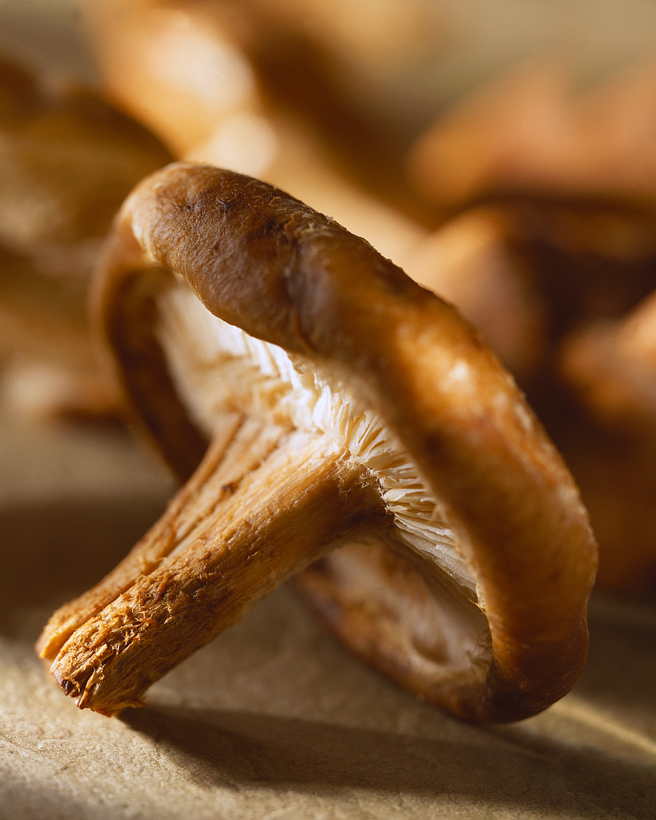
27. What am I?
Shiitake Mushroom

Slide 29
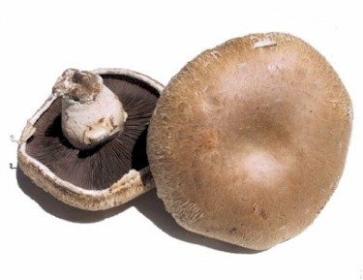
28. What am I?
Portobello Mushroom

Slide 30
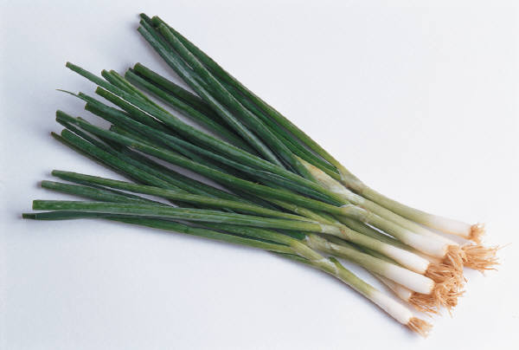
29. What am I?
Green Onions

Slide 31
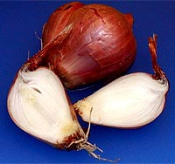
30. What am I?
Shallots

Slide 32
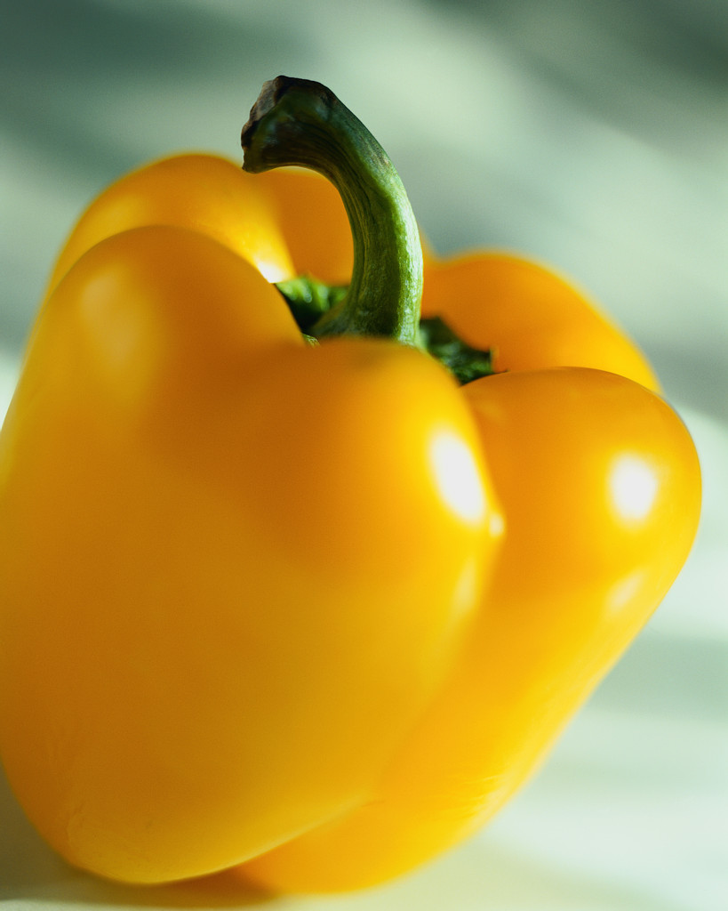
31. What am I?
Yellow Bell Pepper

Slide 33
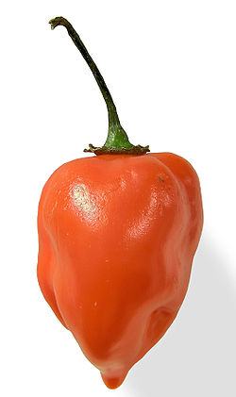
32. What am I?
Habanero

Slide 34
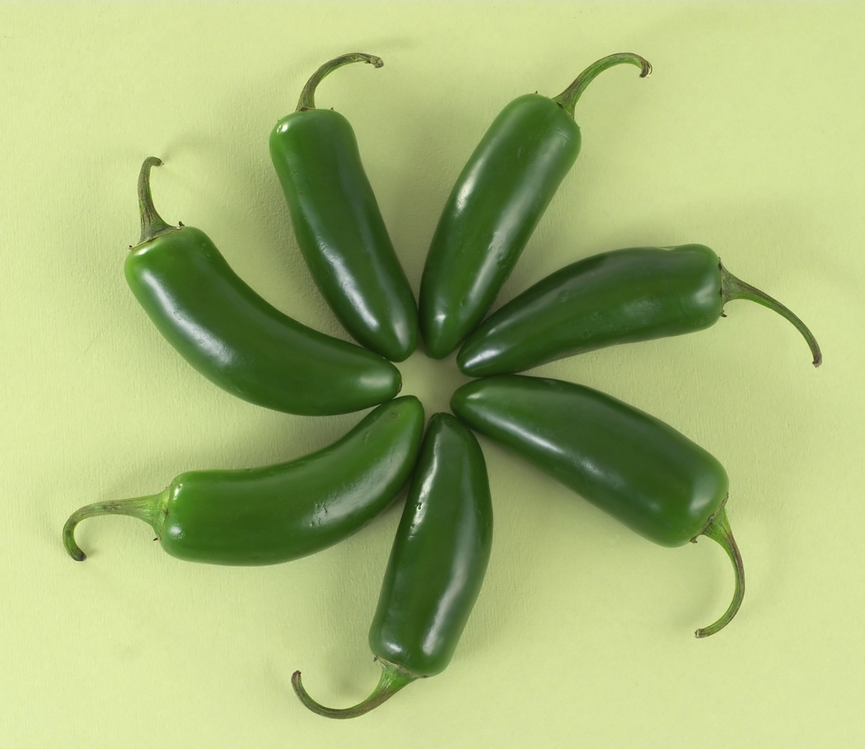
33. What am I?
Jalapeno

Slide 35
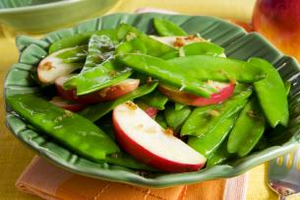
34. What am I?
Snow Peas

Slide 36
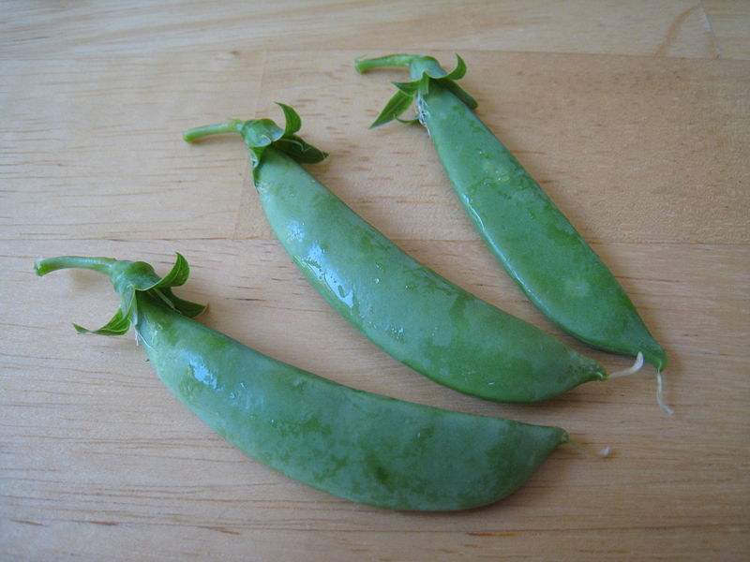
35. What am I?
Sugar Snap Peas

Slide 37
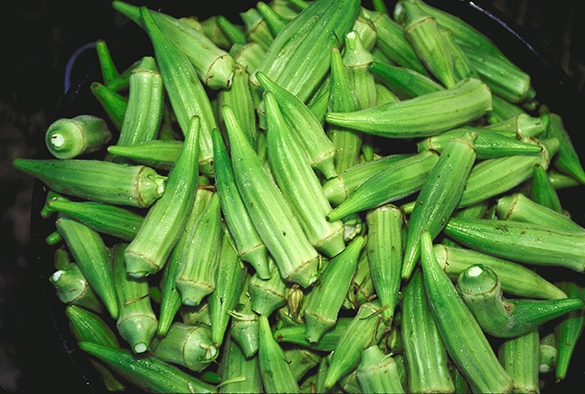
36. What am I?
Okra

Slide 38
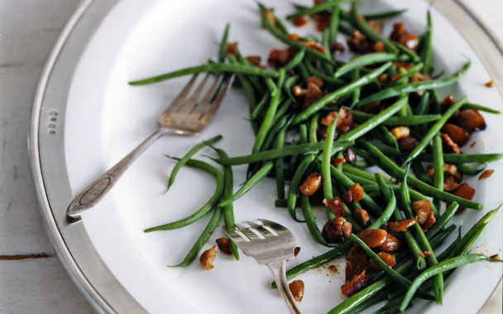
37. What am I?
Haricot Verts

Slide 39
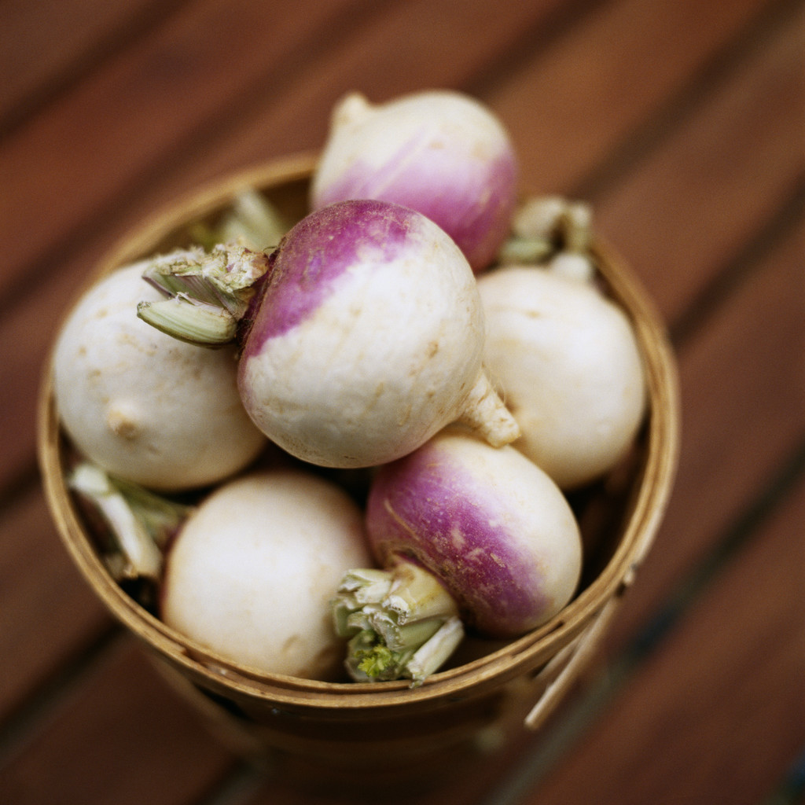
38. What am I?
Turnip

Slide 40
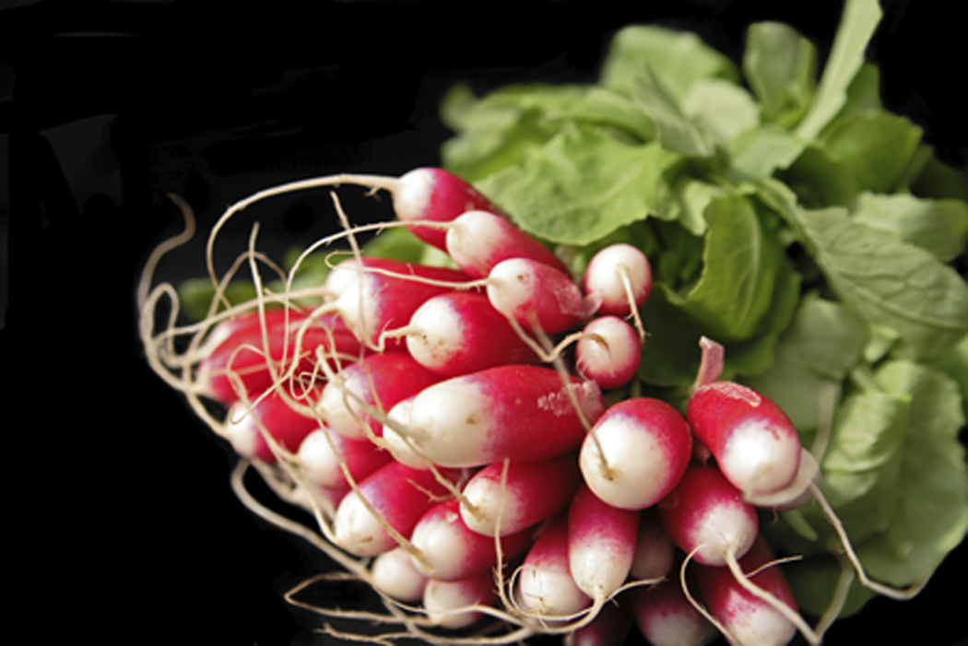
39. What am I?
Radish

Slide 41
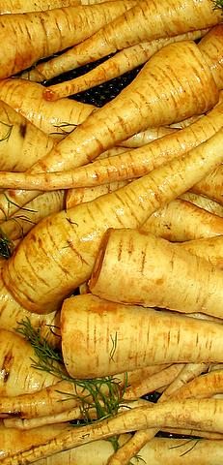
40. What am I?
Parsnip

Slide 42
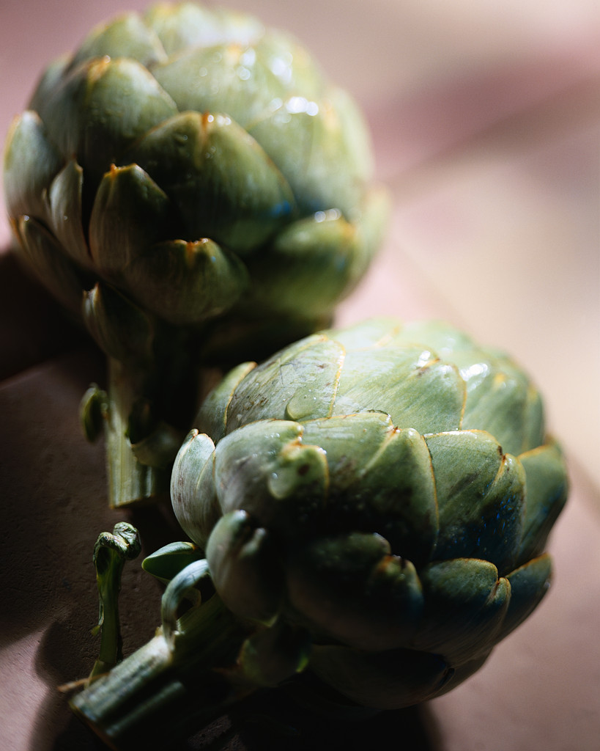
41. What am I?
Artichoke

Slide 43
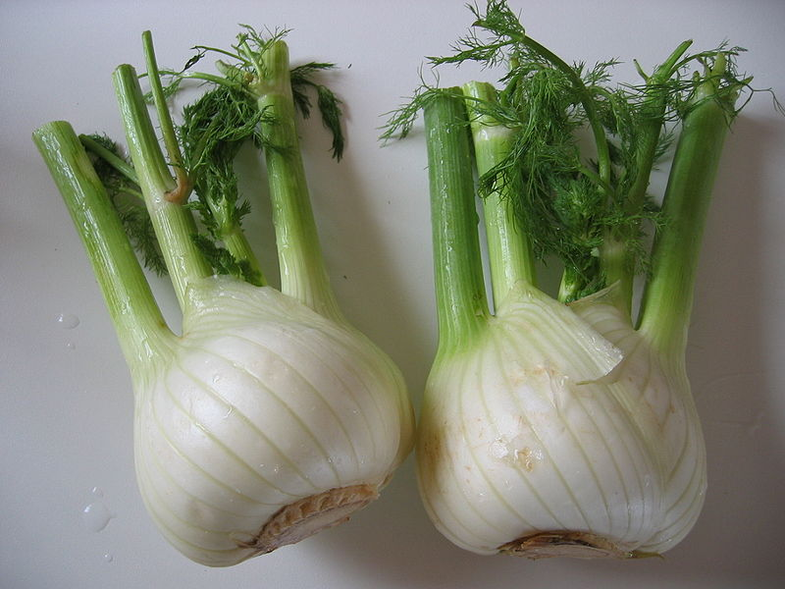
42. What am I?
Fennel

Slide 44
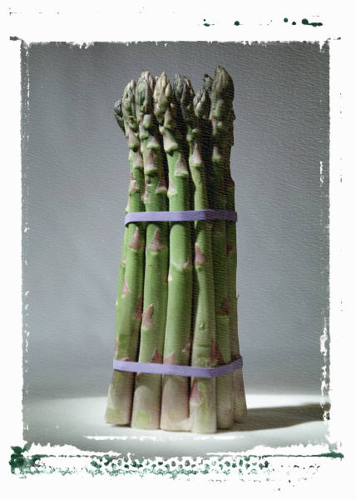
43. What am I?
Asparagus

Slide 45
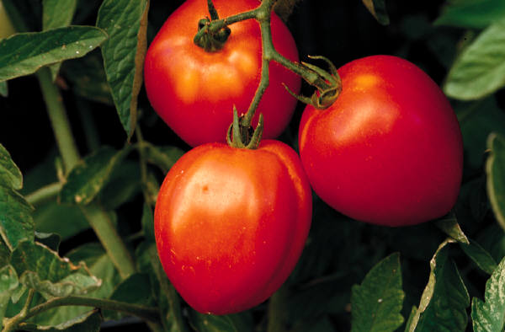
44. What am I?
RomaTomato

Slide 46
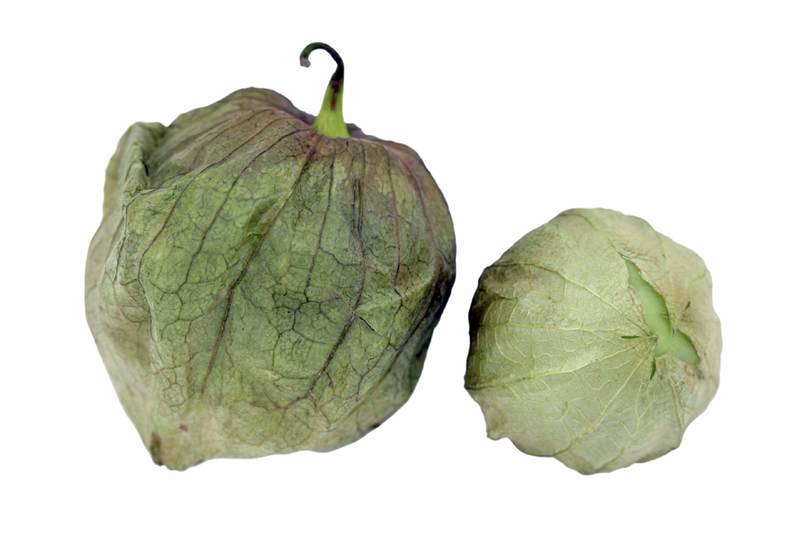
45. What am I?
Tomatillo

Slide 47
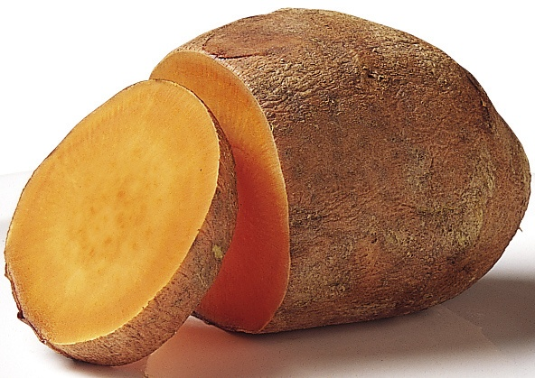
46. What am I?
Sweet Potato

Slide 48
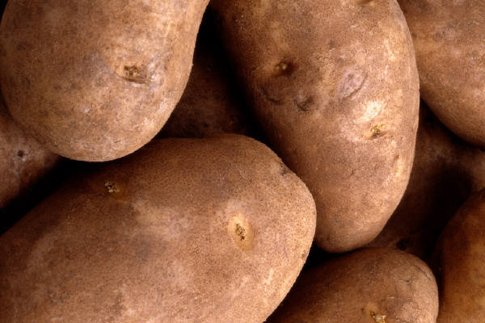
47. What am I?
Idaho Potato

Slide 49
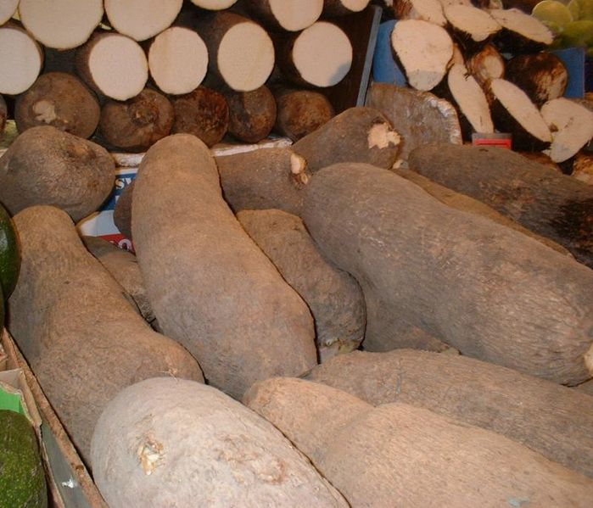
49. What am I?
Yam

