Slide 1
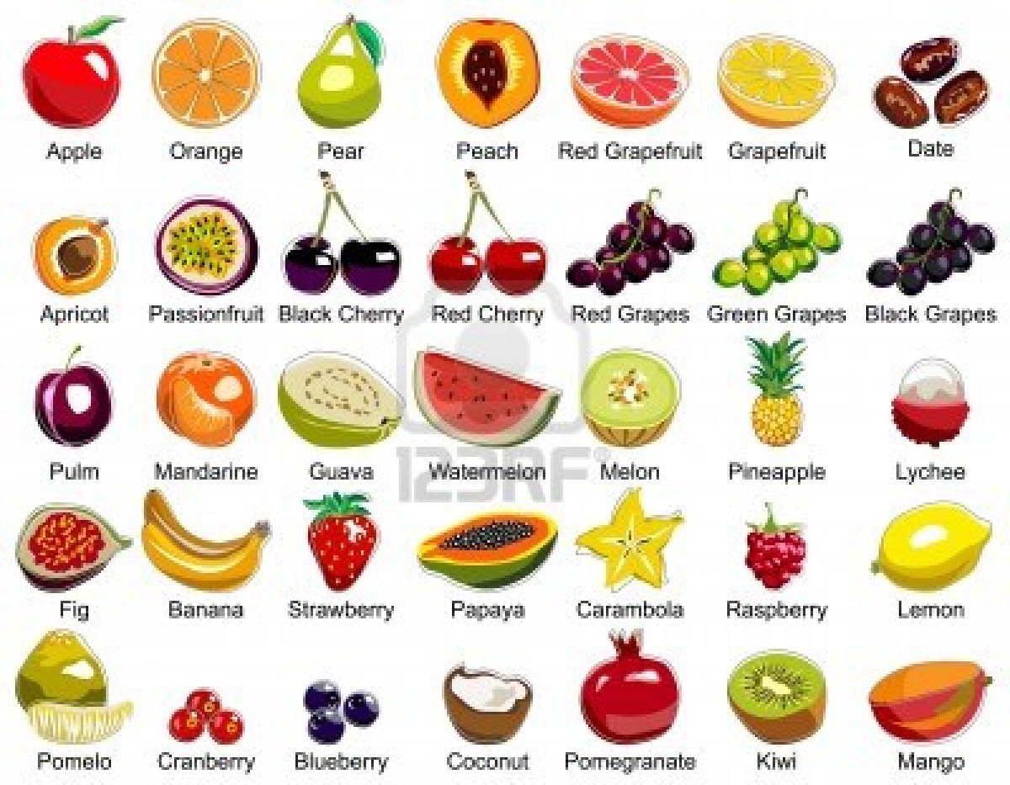
Fruits
Notes

Slide 2
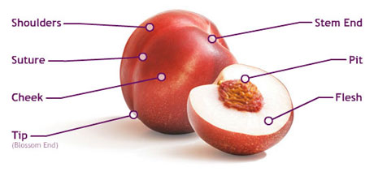
Intro to Fruit
Fruits grow on trees, bushes, or vines
There are two ends: the stem end which is attached to the tree and the blossom end which is on the opposite end

Slide 3
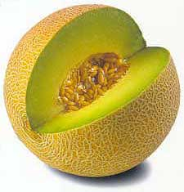
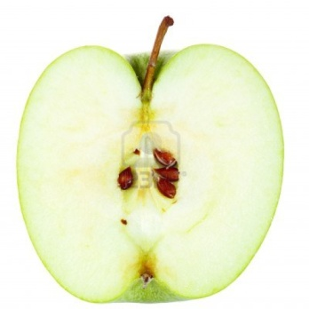
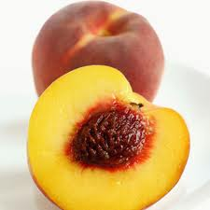
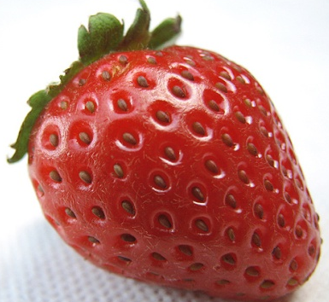
All fruits contain some sort of seed that is surrounded by the fruit’s flesh
Melons and similar fruits: lots of seeds in a center pocket
Apples and pears: few seeds located in the core of the fruit
Plum, peaches, apricots, etc.: single seed protected by a hard pit otherwise known as a stone
Strawberries are special with their seeds being on the outside of the fruit

Slide 4
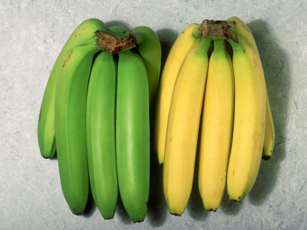
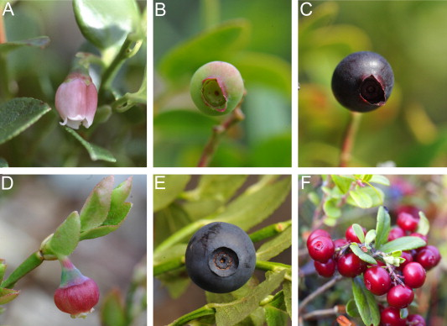
Ripe or Not?
Ripe fruits have a more vivid color
Most unripe fruits appear to have more of a green color
Kiwis, pear, avocados, etc: typically , these will have a slight give to them when you press on their skin
Unripe ones will e very firm to the touch
Overripe or “bad” ones will give to the touch and feel “squishy” or “liquidy”
When melons are ripe, you will typically hear a “dull thump” or it is hollow sounding
When buying fruits for baking, you typically want to get ripe or even overripe fruits because they will taste sweeter
Unripe fruits will usually be bitter or unsweet
Unripe vs ripe banana
1. Vaccinium × intermedium Ruthe (A) flower, (B) unripe berry and (C) ripe berry. (D) Bilberry (V. myrtillus) flower and (E) ripe berry. (F) Ripe lingonberry (V. vitis-idea) berries.

Slide 5
Apples
Widely available and the best season for apples is the fall
Red delicious, Gala, and Pink Lady are best for eating fresh
McIntosh are best for cooking because they become soft when cooked
Used in Applesauce and Apple butter
Rome Beauty apples are good for baking as they hold their shape
Golden Delicious, Braeburn, and Granny Smith are good for baking, cooking, and eating
Also known as general purpose apples
Good apples should not have any bruises or soft spots, and they should feel heavy for their size

Slide 6
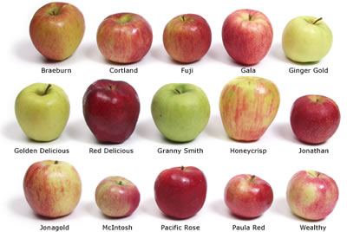

Slide 7
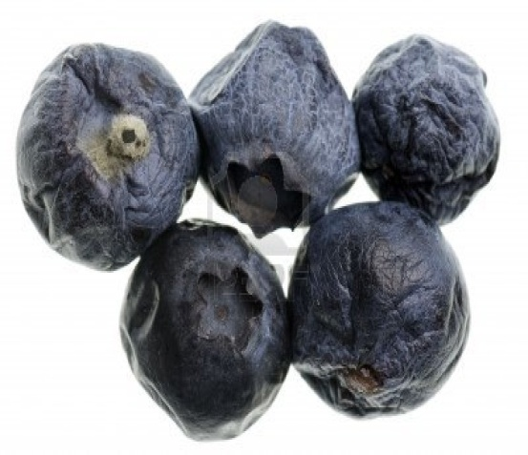
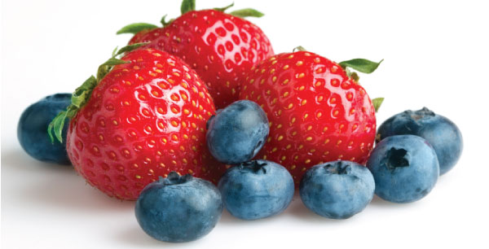
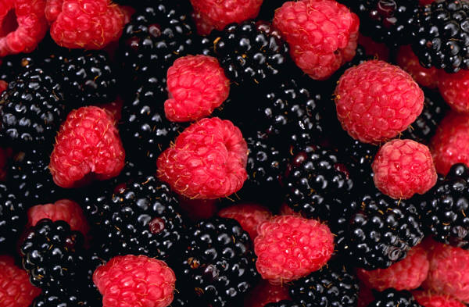
Berries
Blueberries, strawberry, raspberries, blackberries grow on bushes for a short season
Look for a good color with no bruising or mold
If the container is stained in juice, then the berries were probably damaged in delivery and should not be bought
Keep berries as dry as possible until you are ready to use them otherwise they will mold faster

Slide 8
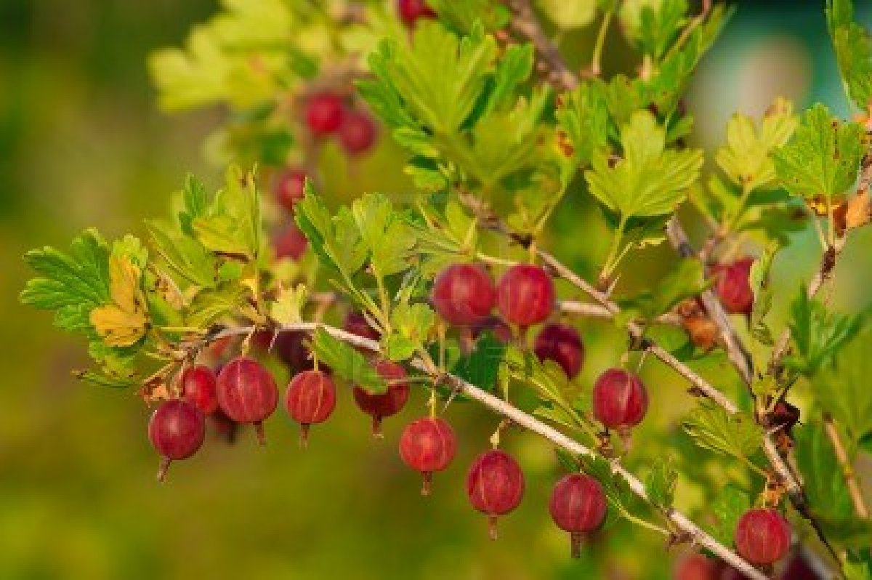
Berries Cont.
Cranberries: very firm and tart berries
Freeze well
Usually cooked before being served
Gooseberries, boysenberries, and currants share the same qualities as cranberries
Gooseberries

Slide 9
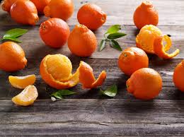
Citrus Fruits
Citrus Fruits in oranges, grapefruits, lemons, and limes
There are four-basic types of oranges
Loose-skinned oranges with easy to peel skins,
Ex: tangerines, minneolas, and clementines
Sweet oranges are large and easy to eat with few seeds
Ex: Naval Oranges
Juicing Oranges are sweet with a thin skin, lots of juice and many seeds
Bitter oranges have heavy rinds and a bitter taste. These are used to make marmalade

Slide 10
Citrus Fruits Cont.
The bright skin of citrus fruits contain their essential oils, which are the oils that give citrus their distinct smell and flavor
Just below the skin, there is a white, bitter, indigestible layer called the pith.
Ripe citrus fruits will have a bright skin, no soft or bruised spots, and no mold
Pith of an orange

Slide 11
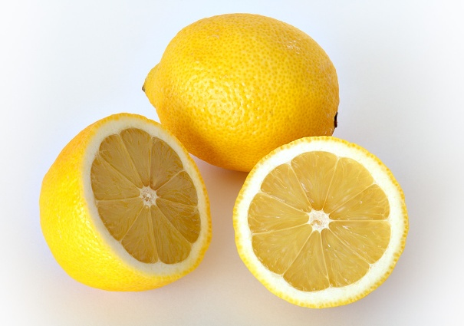
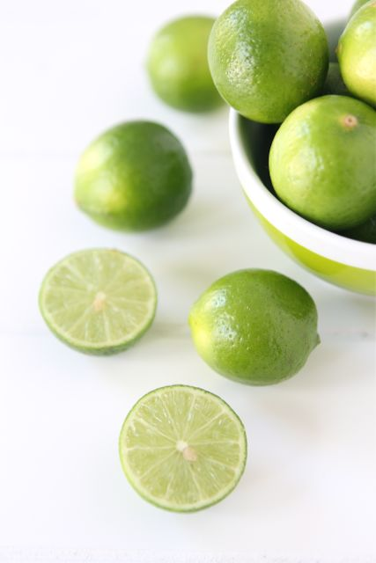
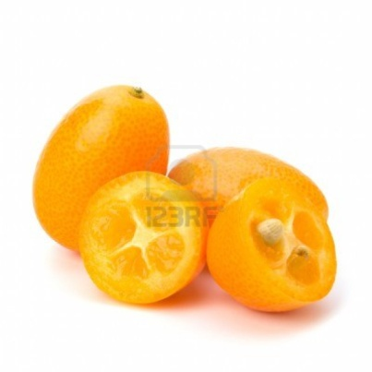
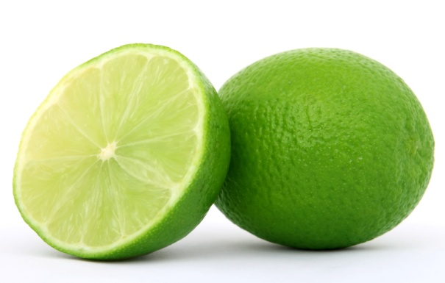
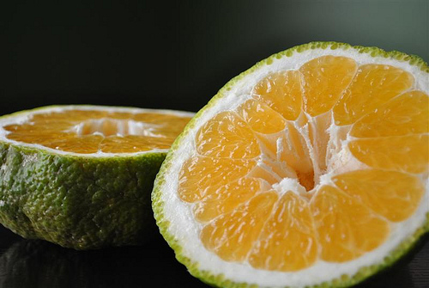
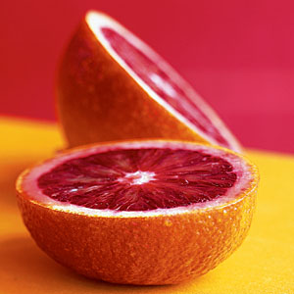
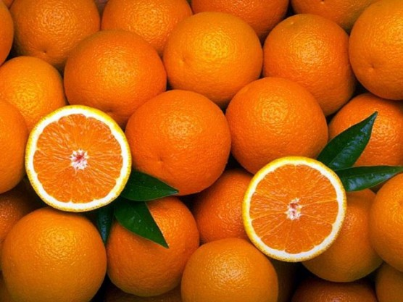
Lemon
Key Lime
Kumquat
Ugli Fruit
Lime
Blood orange
Tangerine

Slide 12
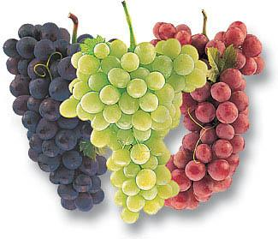
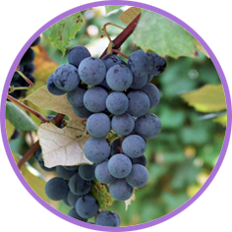
Grapes
Grown in clusters
Used for table fruits, wines, juices, etc
Table fruit grapes: Red, purple, or green with or without seeds
Concord Grapes are used in juices, jellies, and preserves
Ripe grapes should be firmly attached to the stem with no shrinking or shriveling

Slide 13
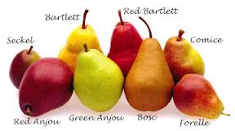
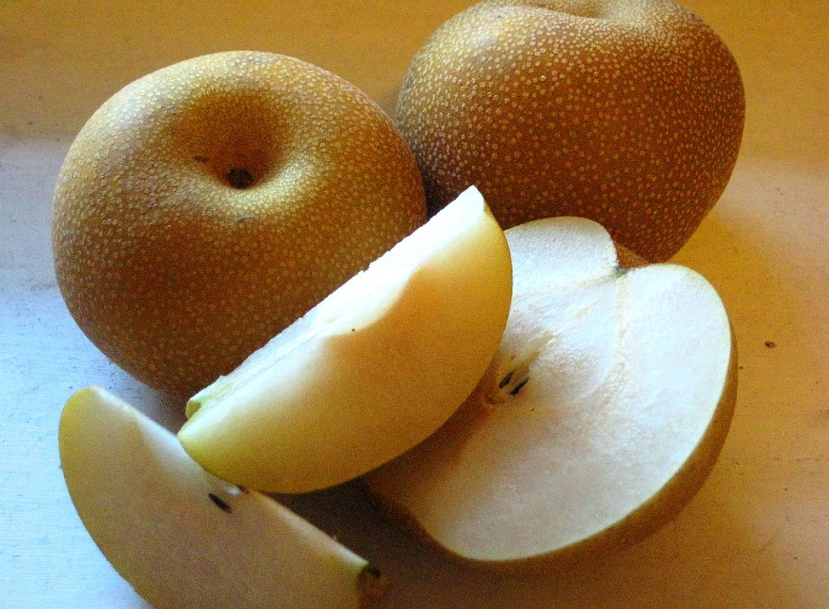
Pears
Similar to apples in that they have a core that contains their seeds, and the color of their flesh
Can be stored in cold storage for several months without over ripening or losing quality
Asian Pear

Slide 14
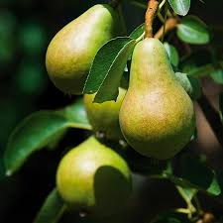
ANJOU: Anjou pears can be green or red. They're squatty, with a round shape and a thicker stem that's kind of nestled into the neck. All-purpose pears. snack on them, put them in salads, or bake with them.
ASIAN: The Asian pears we see most often are shaped like apples with an olive green skin that's usually speckled. They are crunchy; they're texture is more like an apple than a common pear, so they're great for baking or adding a crisp texture to salads.
BARTLETT: The classic pear shape and lime green to yellow skin, more golden when it's super ripe. Sweet, soft, and delicious, but you have to be careful they don't get too ripe. They can go mushy and bruise fast. Best for snacking.

Slide 15
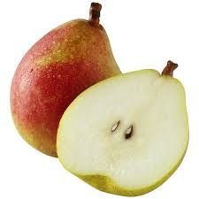
BOSC: Long, skinny necks and thick, brownish skin. Bosc pears can be tough and tasteless when they're not perfectly ripe, but they don't need to be soft to be ripe, so it can be hard to tell. Best for baking
COMICE: Fat and round with short necks and thick stems. Most comice pears are green but can have red streaks as they ripen. Their flesh is often described as "creamy.” Best for snacking.
SECKEL: Only in the markets for a short time, and they're perfectly sweet when they're ripe. Use these in some desserts that call for whole seckel pears. But usually used for eating not baking

Slide 16
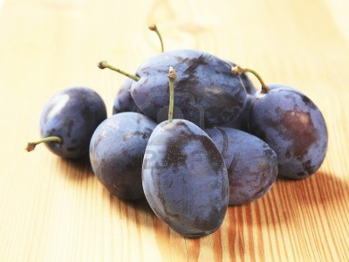
Stone Fruit
Cherries, plums, apricots, nectarines, and peaches are all stone fruits
Contain hard pits in the center that contain their seed
Peaches and apricots have fuzzy skin, which is usually removed before cooking
Plums are sold in many varieties
Purple and red plums are usually eaten as fresh fruit
Italian and Damson plums are best for cooking and baking

Slide 17
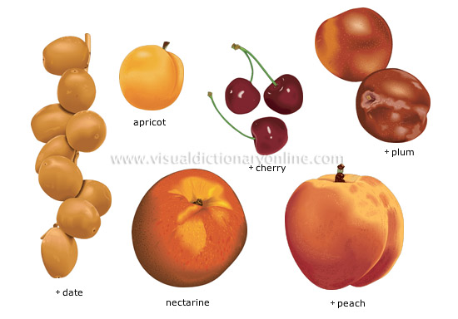

Slide 18
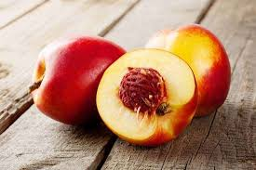
Stone Fruit
Clingstone Fruit: A fruit with flesh that clings tightly to the pit making it difficult to cut away the flesh cleanly.
Freestone Fruit: has flesh that separates easily from the pit
Peaches and nectarines are available in both forms

Slide 19
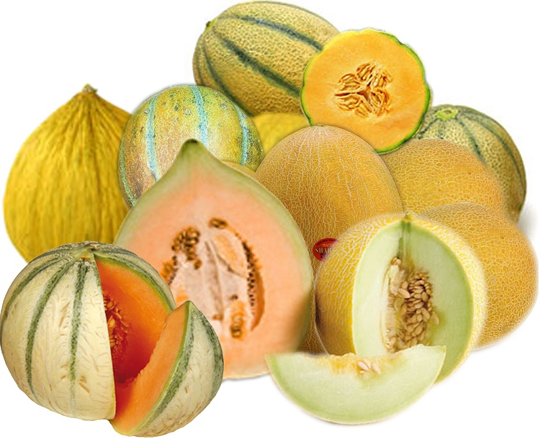
Melons
Melons grow on small shrubs and sit directly on the ground
One part of the rind is usually white because that side doesn’t get any sun
Some melons soften slightly at the stem when they are ripe
Others have a smooth stem to show that the melon is ripe and can easily slide off of the vine.
Good melons should be firm and heavy for their size and should have a sweet aroma

Slide 20
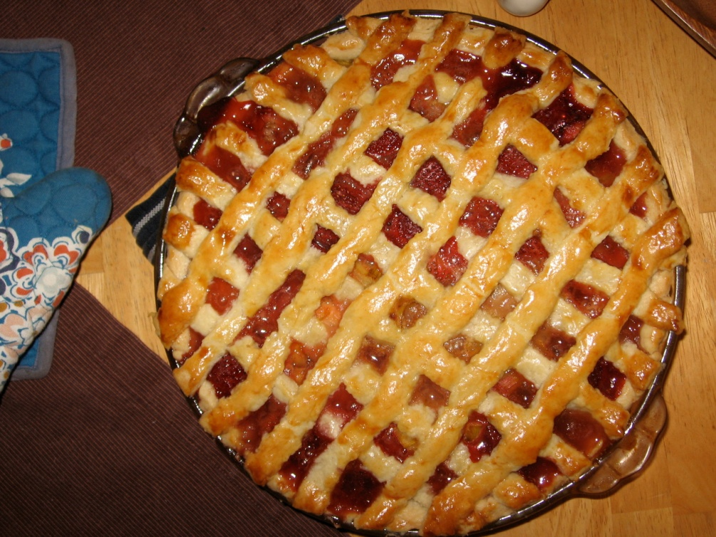
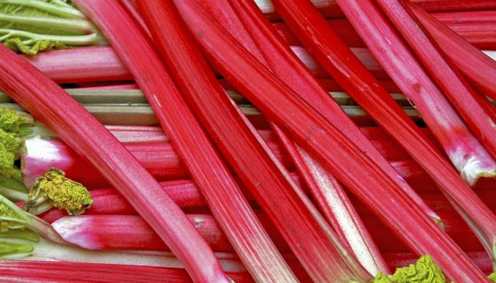
Rhubarb
Technically not a fruit, but treated like one….
Red-celery like stalks are very tart
Used primarily in pies and jams, but lots of sweetener needs to be added

Slide 21
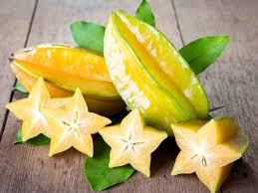
Tropical Fruits
Passion Fruit: Very tart, the tiny black seeds are edible, and it has a golden flesh just under its dark purple skin
Plantains are mild and starchy (typically cooked before eating)
Papaya: yellow skin with a tart, but slightly sweet orange flesh
Star Fruit: Waxy golden skin with a yellow flesh and a tart, but slightly sweet flavor
Mango: Deep yellow flesh that taste sweet, skin can be green, red, or orange
Coconuts, Pineapple, and Kiwi are more common and popular tropical fruits

Slide 22
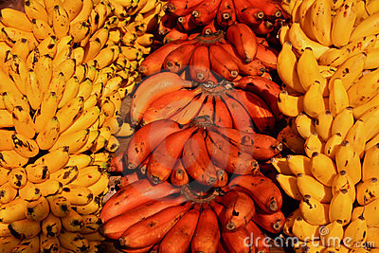
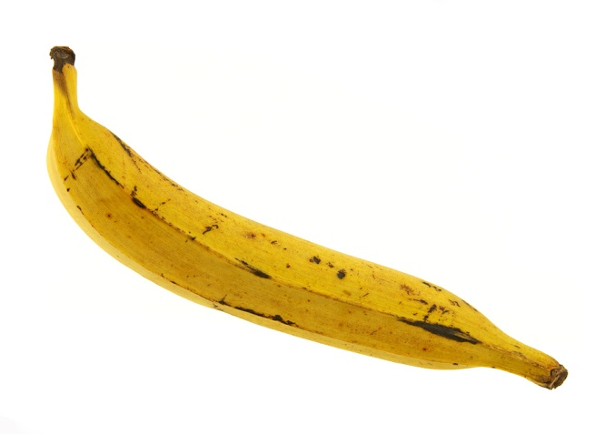
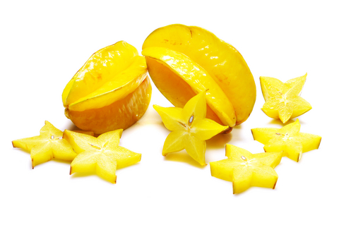
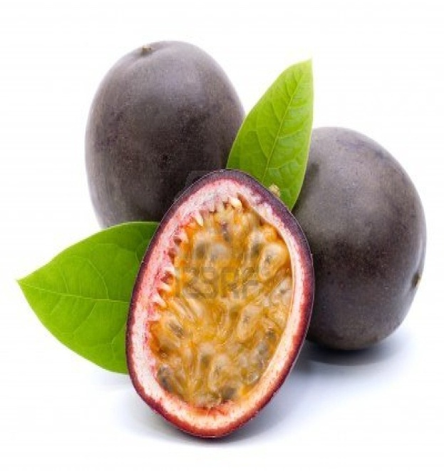
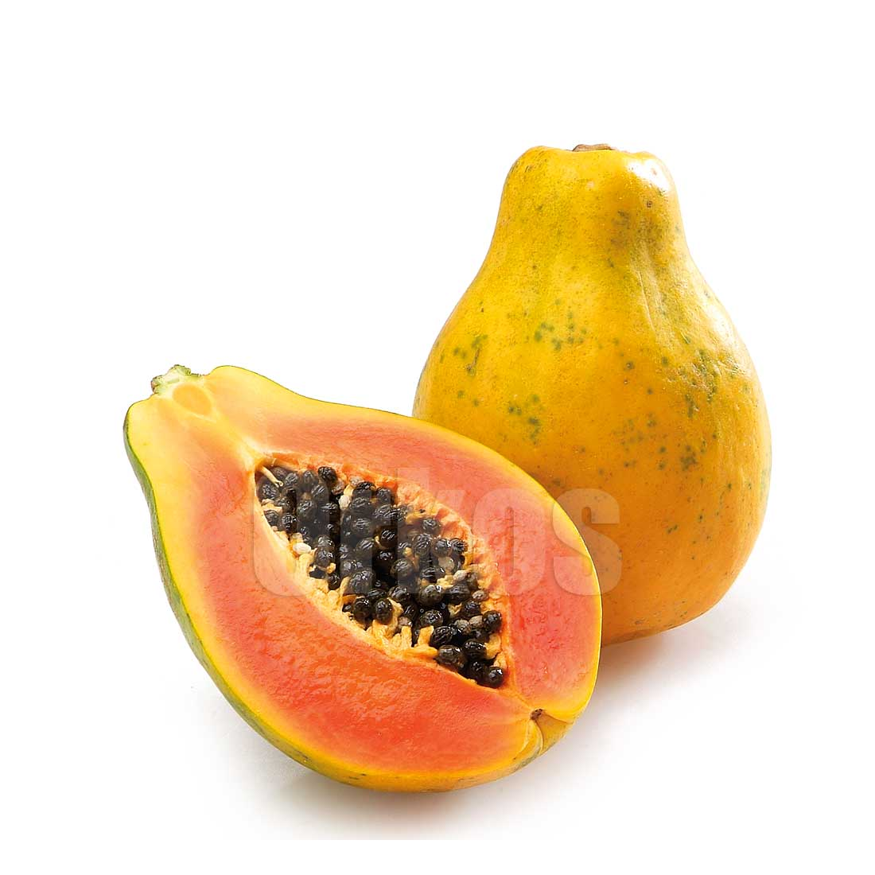
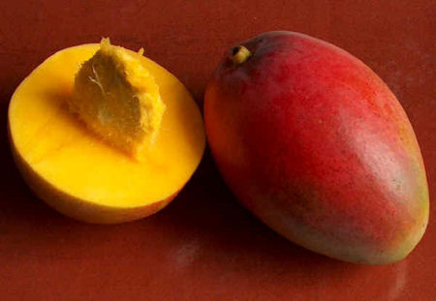
Tropical Fruits
Above: Red and yellow bananas
Below: Passion Fruit
Above: Star Fruit
Below: Mango
Above: Plantain
Below Papaya

Slide 23
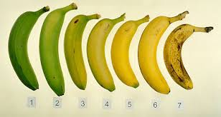
Ripening of Fruits
Ripening means that the fruit has developed its brightest color and deepest flavor, sweetness, and aroma
Some fruits, like bananas, are picked before they are completely ripe because they will continue to ripen even off the vine
Fruits like apples and peaches must be picked when they are completely ripened because they will not continue to ripen once they are removed from the tree
Fruit ripens because of the gas it gives off (ethylene)
This gas is why fruits get soft and become rotten after a period of time

Slide 24
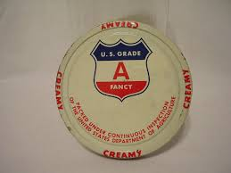
Grading Fruit
USDA grades produce after it has been harvested
Fruit is judge on its size, shape, weight, color, and presence/absence of defects such as bruises
US Fancy: Premium quality
US No. 1: Good quality, but not quite as perfect as Fancy
US No. 2: Medium quality
US No. 3: Standard quality
The grade of fruit does not determine the fruit’s flavor, the higher grades only look nicer
Higher grade would be used more often as garnishes while lower grades would be used to cook with because appearance doesn’t matter once it is cooked into a pie or cut up

Slide 25
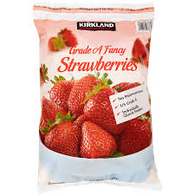
Grading Fruit
Frozen fruit is graded differently
US Grade A: Equivalent to US Fancy
US Grade B: above average quality (also known as Choice)
US Grade C: Medium quality (also known as standard)

Slide 26
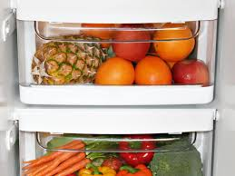
Storing Fruit
Most fruit is stored in refrigeration because it slows down ripening
Keep fruit dry while storing otherwise it will become moldy faster
Store apples and pears away from other fruits because they give off more ethylene and will cause other fruits to ripen quicker
Store frozen fruit in the freezer until you are ready to use it
Canned and dry food can be kept in a pantry
Once opened, transfer to an air-tight container to keep it from becoming over dry or attracting bugs
In some cases, it may need to be moved to the refrigerator after being opened

Slide 27
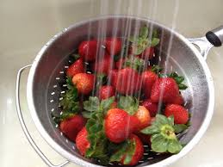
Preparing Fruit
Make sure to wash fruit with cold water and gently brush the fruit just to make sure any dirt that may be on the skin is removed
Fruit with thicker skin, like melons, may need to be scrub more vigorously with a scrub brush to remove impurities
And delicate fruit, like berries, need to be rinsed under low pressure water
Berries should not be washed too soon in advance otherwise they will become waterlogged

Slide 28
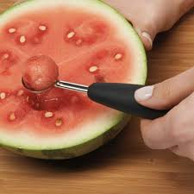
Preparing Fruit
Some skin needs to be removed before it can be used, such as bananas and oranges
The first step in preparing most fruits is removing skins, cores, seeds, and stones
A peeler or paring knife works to remove skin from most fruits
Fruits with thicker skins, like melons, need a chef’s knife to remove skin
To remove apple or pear cores, cut the fruit in half and use a melon baller to remove the core
Remove seeds from melons by cutting it in half and using a spoon
Use the tip of a spoon to remove seeds from citrus spoons
To remove the pit from a cherry, use a cherry pitter
Other stone fruits, you remove the stone by using a paring knife to cut around it

Slide 29
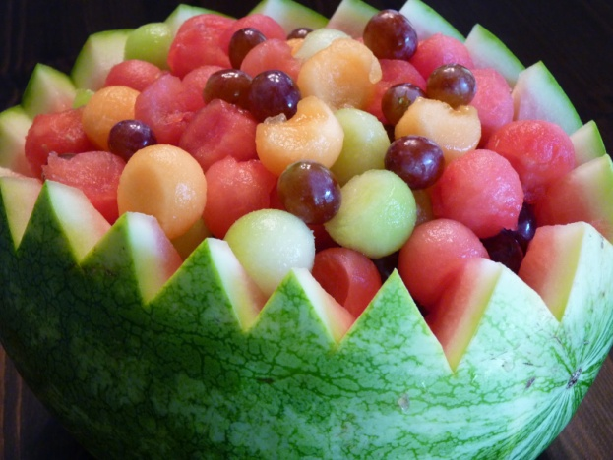
Preparing Fruit
The peel of citrus fruits can be grated or zested
The zest is just cut from the bright colorful part of the peel
The white part of the peel (the pith) is bitter and should not be used
Zest is very aromatic and can be used for seasoning or garnish
When preparing fruit for service, use a sharp knife so that the cut are clean
You can also use a Parisienne scoop or melon baller to make the fruit into small spheres

Slide 30
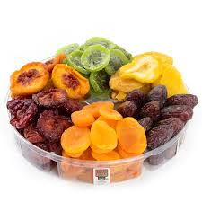
Preparing Fruit
Fresh fruit can be juiced and puréed
To make a fruit purée, use fruit that has already been peeled, trimmed, and seeded, and place it into a blender
If the fruit is soft and juicy, then extra liquid will probably not be needed
If it is hard or low in moisture, it may need to be precooked or add more liquid as you purée,
Dried fruit can be served as is unless you are adding it to a dish or baking with it
Softening dry fruit is done by soaking it in warm or hot liquid until it becomes rehydrated

Slide 31
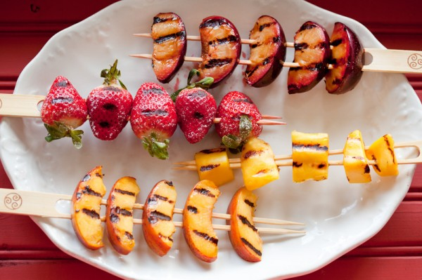
Cooking Fruit
Grilled fruit can be cut into slices or left whole, and placed directly on the grill
To protect tender fruit, you can brush it lightly with some melted butter before placing it on the grill
To give fruit a rich glaze, sprinkle it with sugar or brush it with a little honey or maple syrup
To broil fruit, arrange it on a sheet tray that has a little butter on it or is lined with parchment paper
Broil or grill fruit until it has a rich aroma and a caramel color

Slide 32
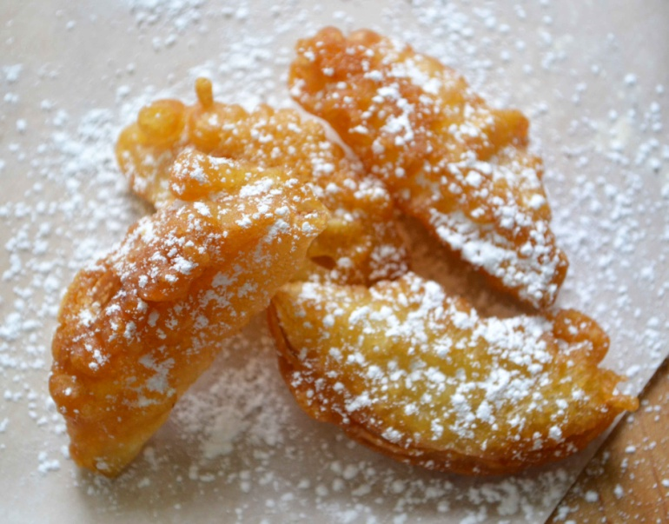
Cooking Fruit
Sautéed fruit is usually peeled and cut into pieces then cooked in medium to high heat in butter
Adding sugar produces a rich glaze on sautéed fruit
Sautéed fruit may be served on its own, as a filling for crepes, a topping for pancakes, or a sauce for ice cream
Pieces of fruit can be coated in batter and then fried to make fritters

Slide 33
Cooking Fruit
Poached fruit is usually cooked in a liquid with sugar and other flavorings until it is tender
The fruit should still holds its shape
Poached fruit can be served hot or cold with or without the poaching liquid
Poached fruit can be used for the filling of pies

Slide 34
Cooking Fruit
Fruit can also be stewed
Stewed fruit is served with its liquid
A compote is an example of a stewed fruit, which is made from slow-cooking or dried fruit

Slide 35
Serving Fruit
Fruit has the freshest flavor when served at room temperature
Fruit is sometimes paired with meats, fish, or poultry
Grapes, raisins, plums, prunes, apricots, and other fruits can be added as a filling or stuffing or added to a sauce
Fruit purée is served with savory dishes
Cranberry sauce is served with turkey
Applesauce is served with potato pancakes

