Slide 1
Active Managerial Control
Directions:
Option 1: Students are to look at the following pictures. Some of the pictures represent situations that require immediate active managerial control. Other situations are fine and would need no additional action. For each picture, students will:
decide if active managerial control is needed
tell why they think active managerial control is/is not needed
explain what should happen next in each situation
.

Slide 2
Active Managerial Control

Slide 3
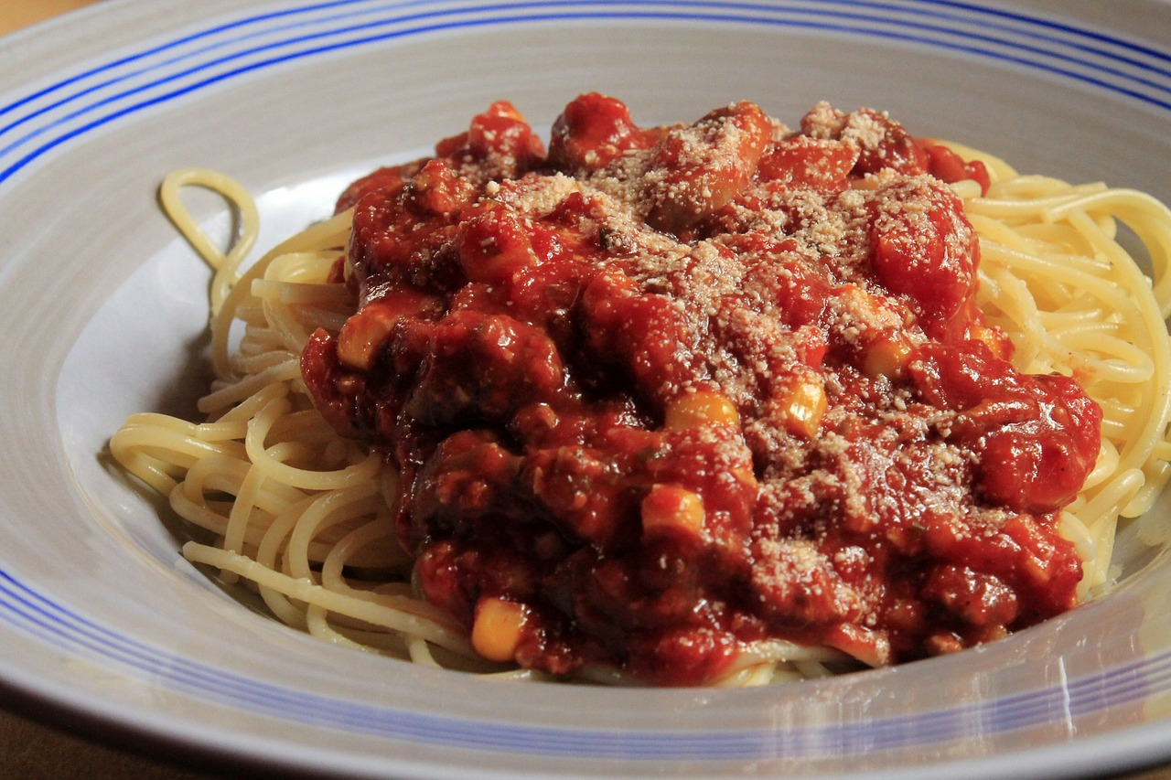
1. Microwaves are used to re-heat the sauces leftover from lunch. The sauces are heated until they are hot.

Slide 4
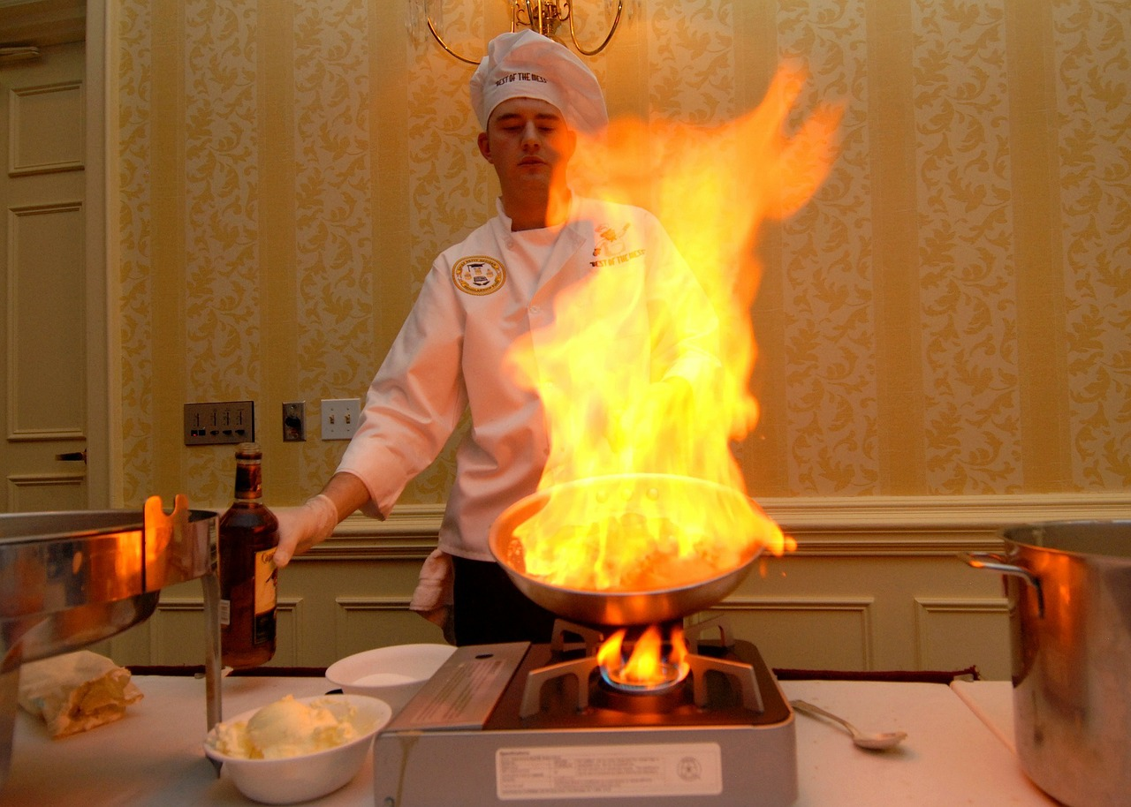
2. To save money, the manager makes everyone use their gloves for several activities before they are allowed to change the gloves.

Slide 5
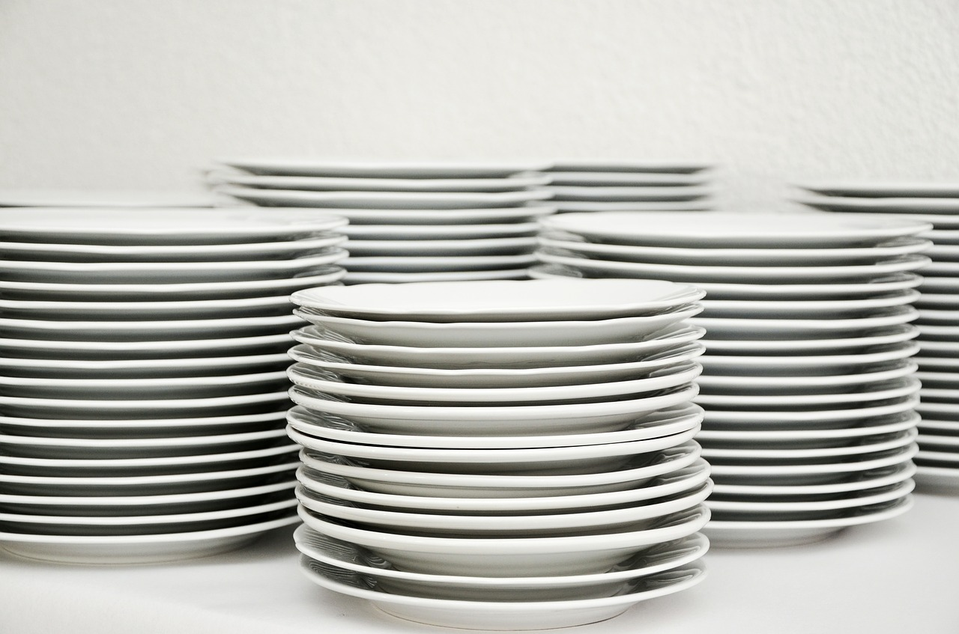
3. The cooking utensils were washed, rinsed and dried with a towel before use each day.

Slide 6
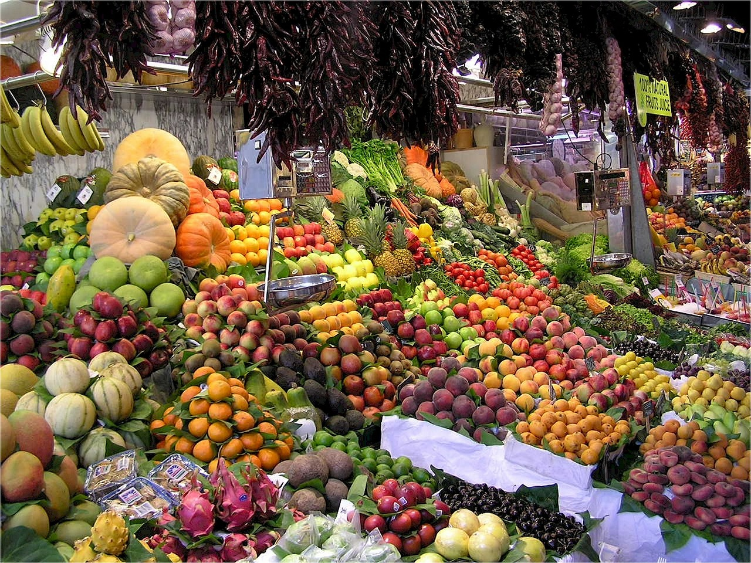
4. The manager likes to purchase produce from the local farmer’s market each week so that their vegetables are the freshest in town.

Slide 7
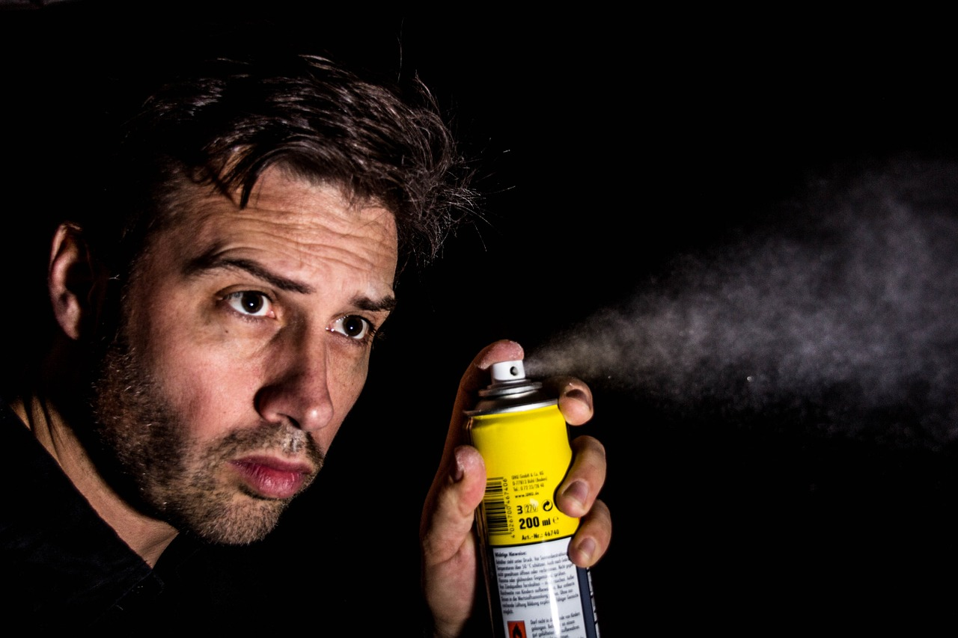
5. The manager has his cousin spray for bugs in the operation instead of using a pest control officer.

Slide 8
6. Workers rarely wash their hands but use gloves and hand antiseptics instead

Slide 9
7. All workers are ServSafe® certified
Certified

Slide 10
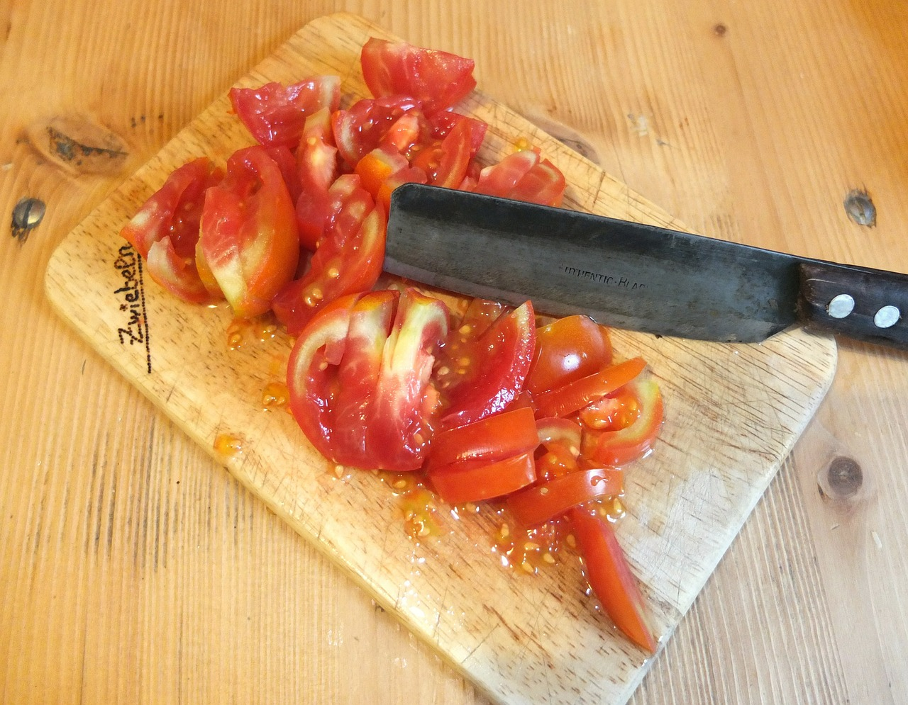
8. The cutting board has deep grooves

Slide 11
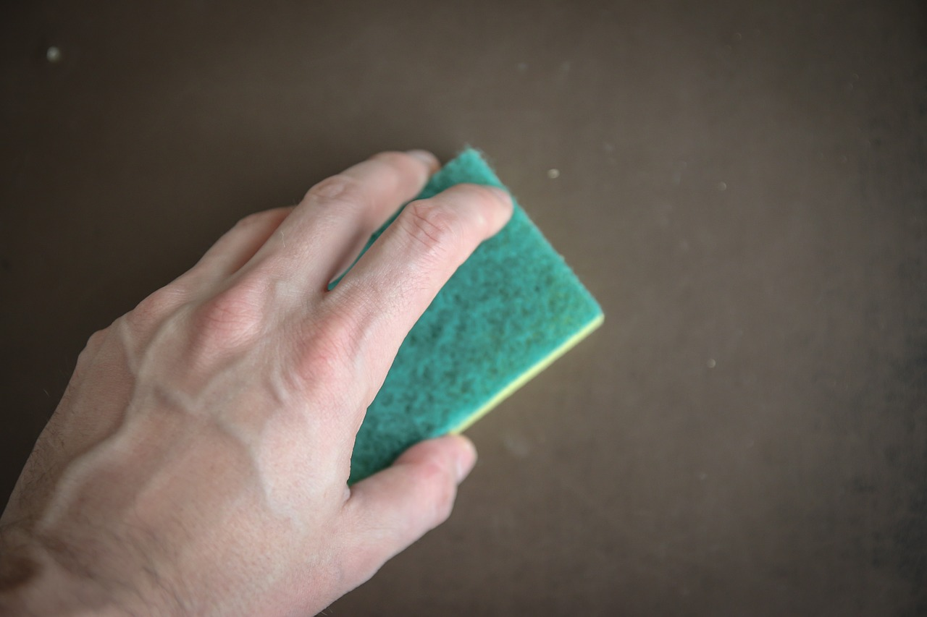
9. Worker uses a cleaning sponge that is stored in his apron pocket

Slide 12
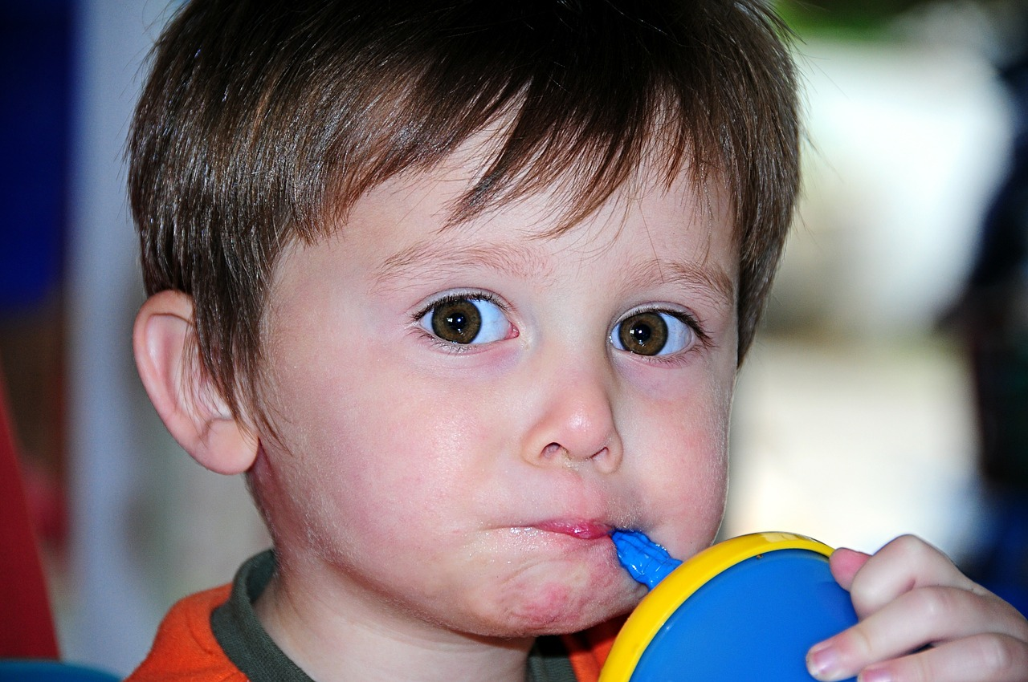
10. The prep cook is drinking from a cup with a lid

Slide 13
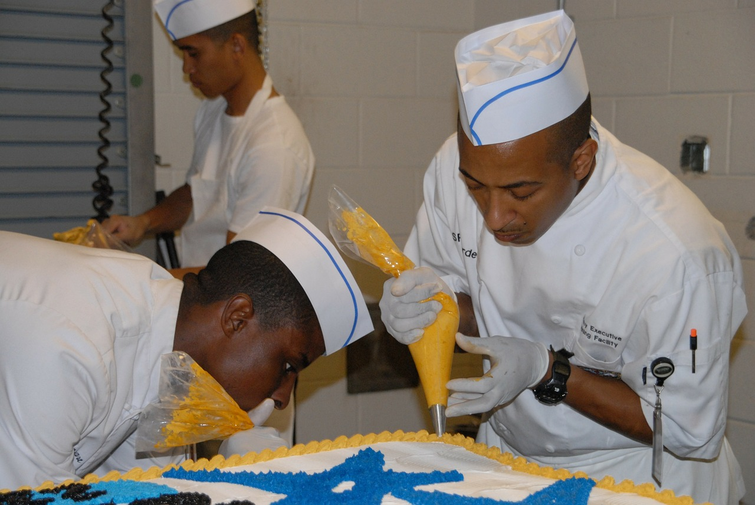
11. A pastry chef is chewing tobacco while decorating a cake.

Slide 14
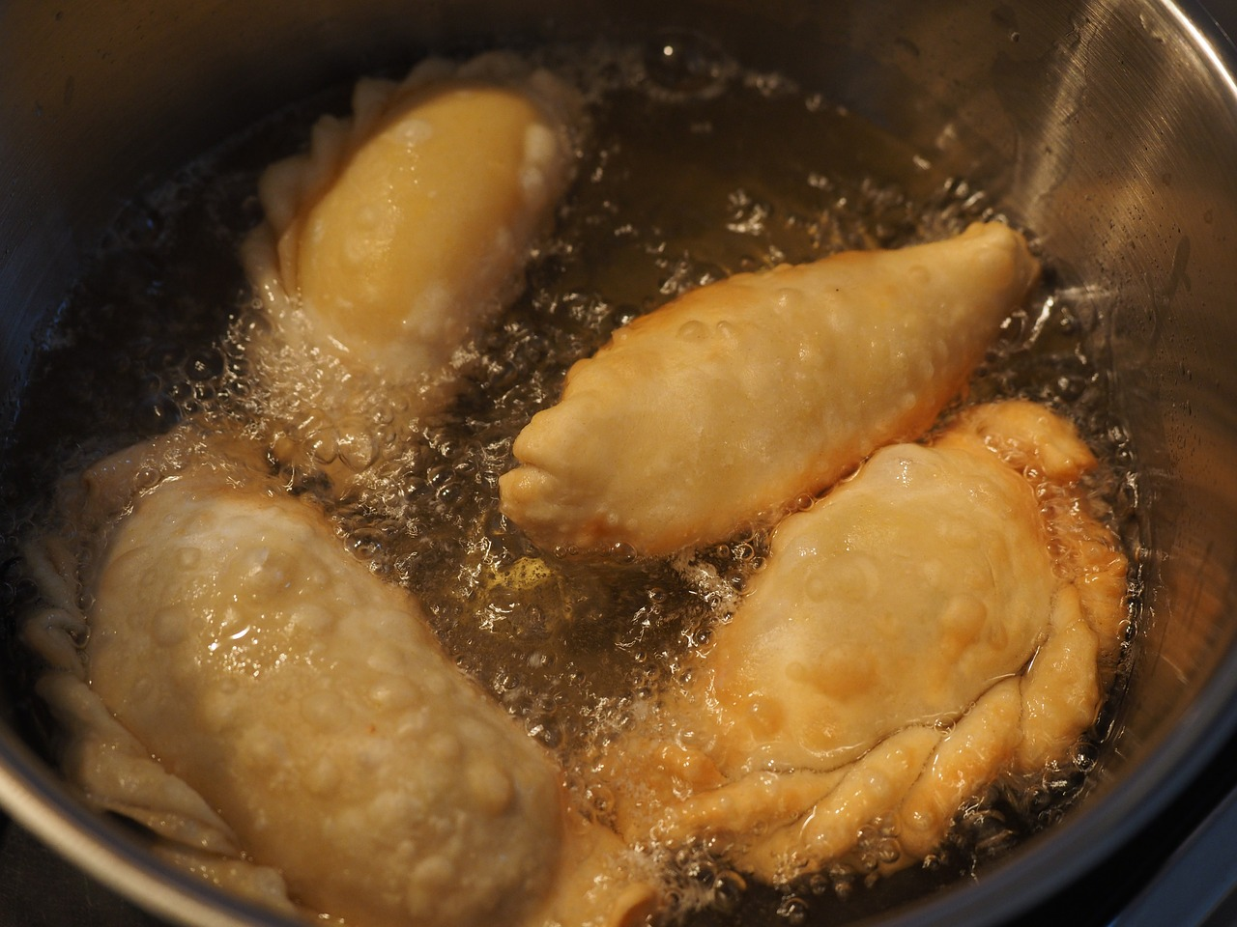
12. Everything is cooked in the same fryer oil

Slide 15
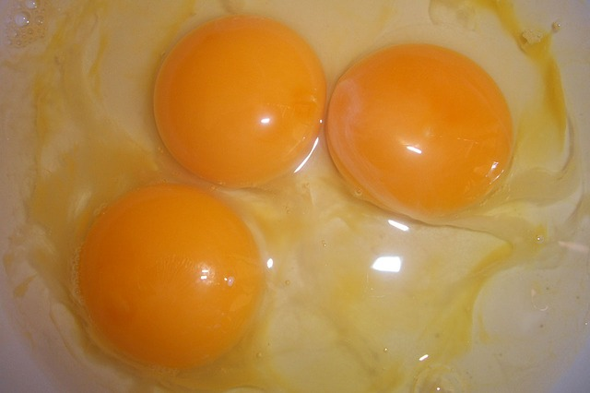
13. Shell eggs are pooled and kept by the oven during the breakfast shift of the day care.

Slide 16
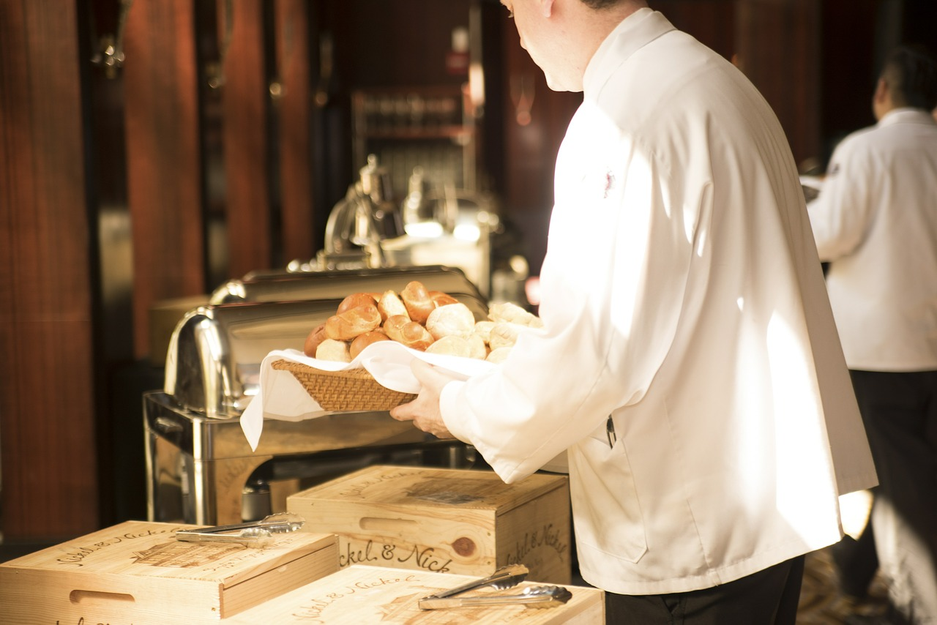
14. Workers were allowed to wear dirty aprons

Slide 17
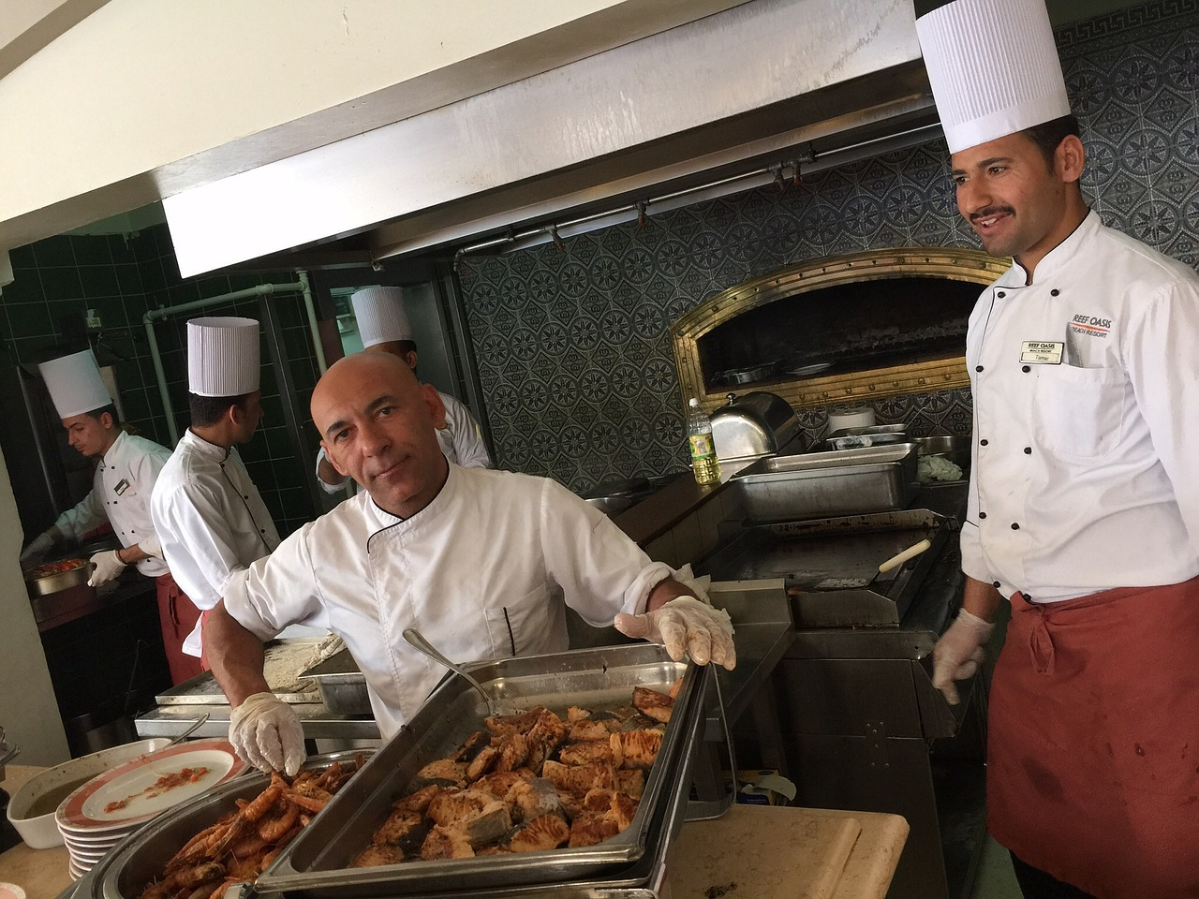
15. A manager continues to monitor all the workers

Slide 18
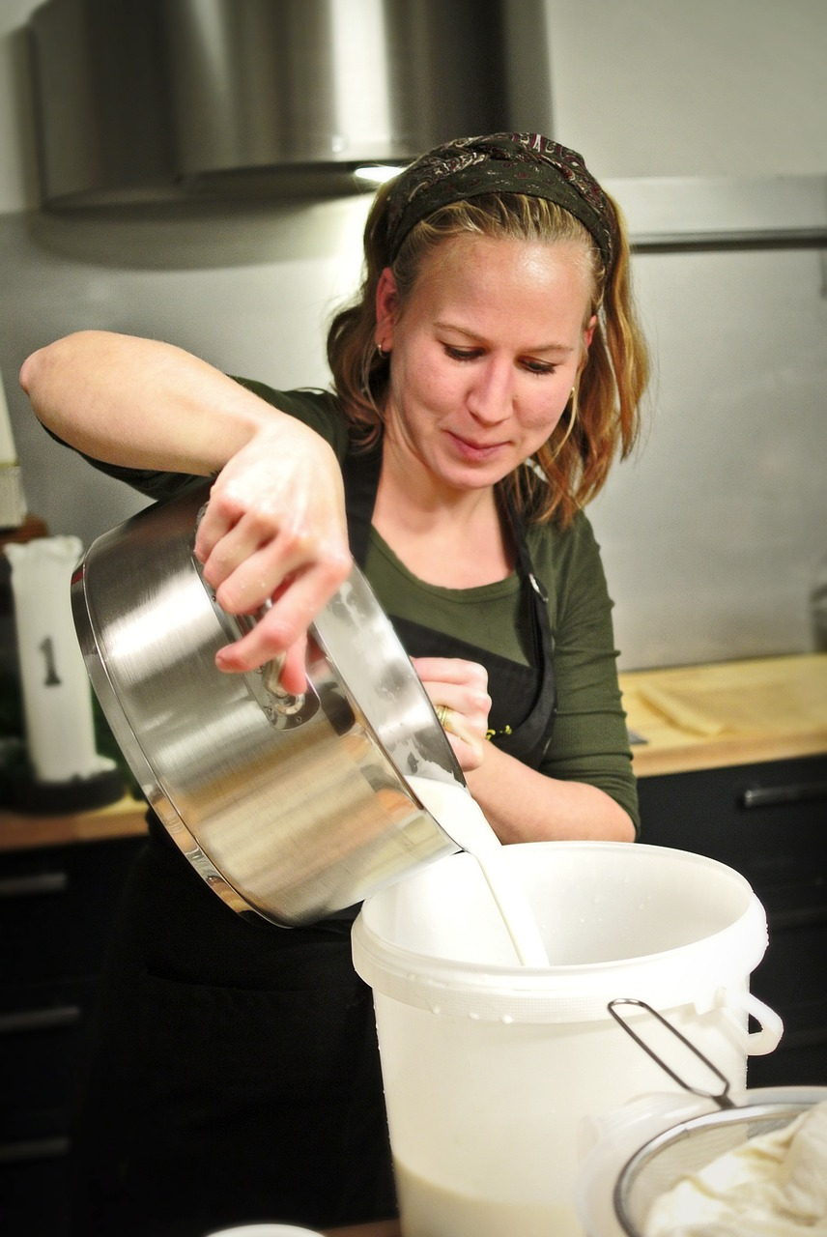
16. Workers use only headbands for their hair.

Slide 19
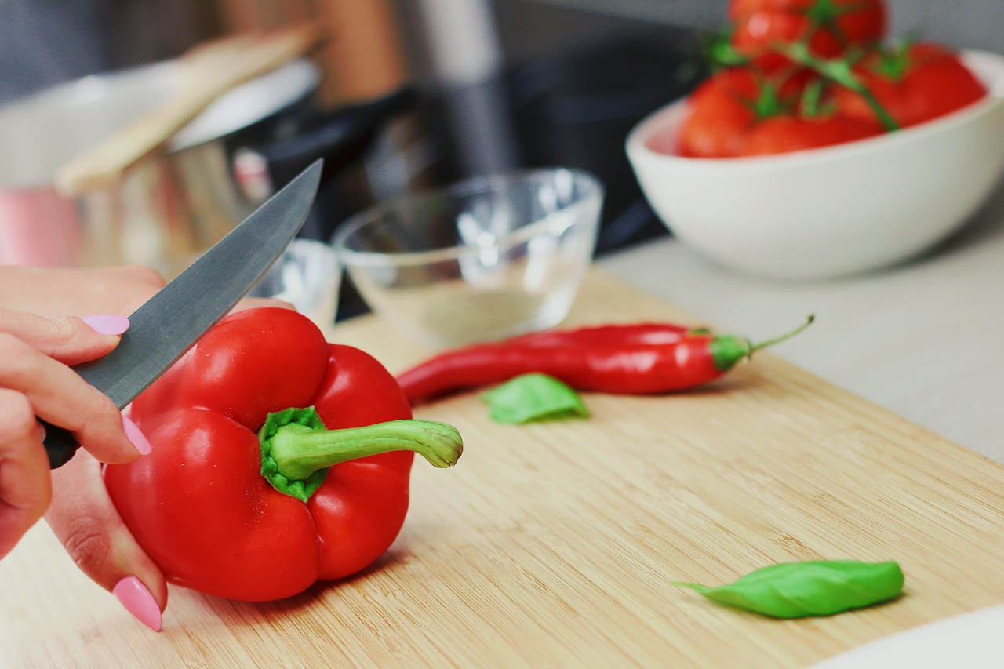
17. Workers are allowed to wear nail polish.

Slide 20
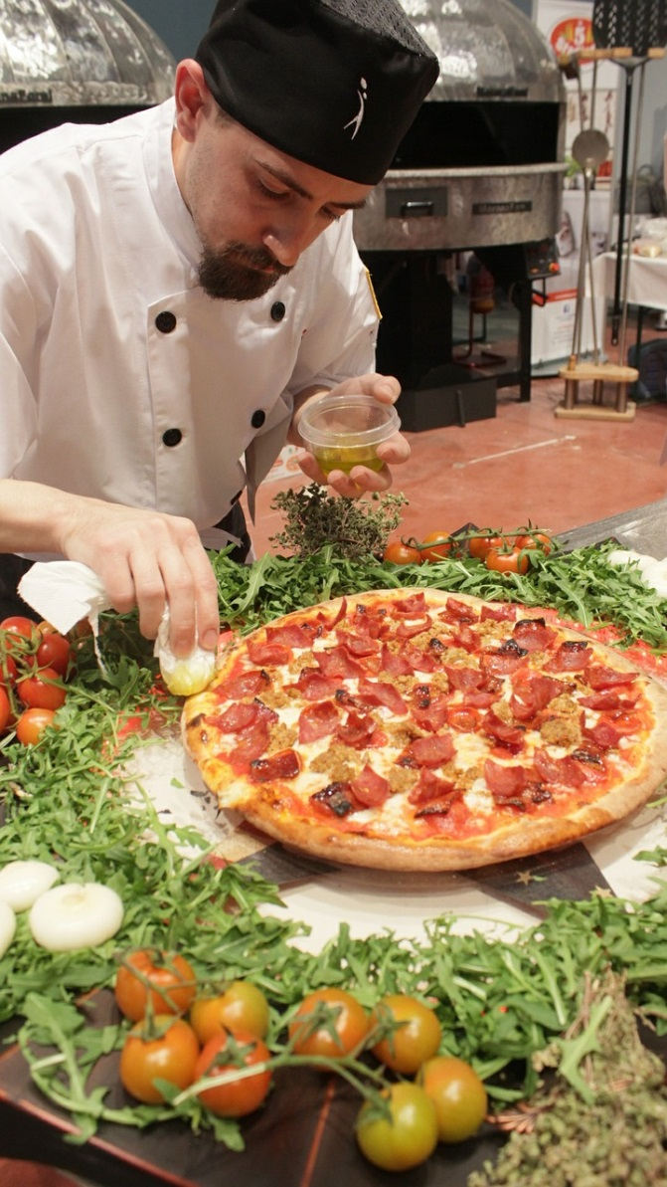
18. Beard restraints are not used in this pizza restaurant.

Slide 21
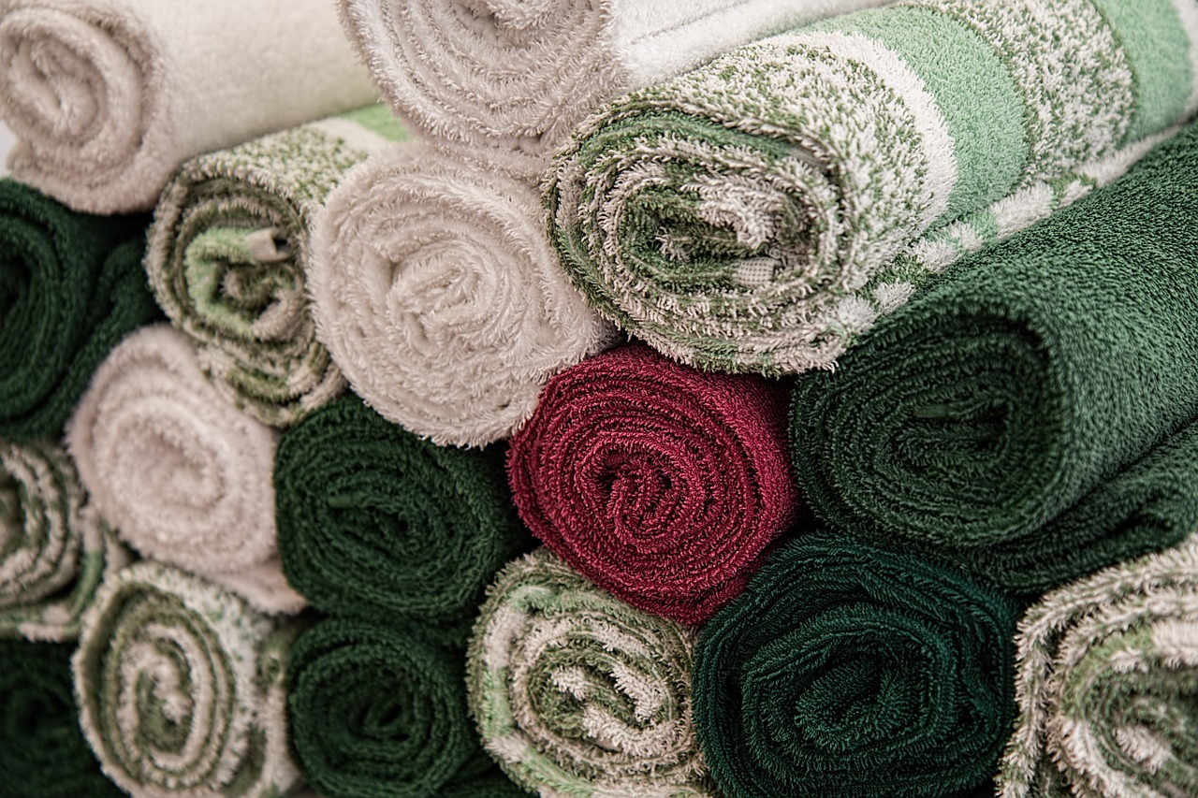
19. Hand towels are changed daily at the hand sink.

Slide 22
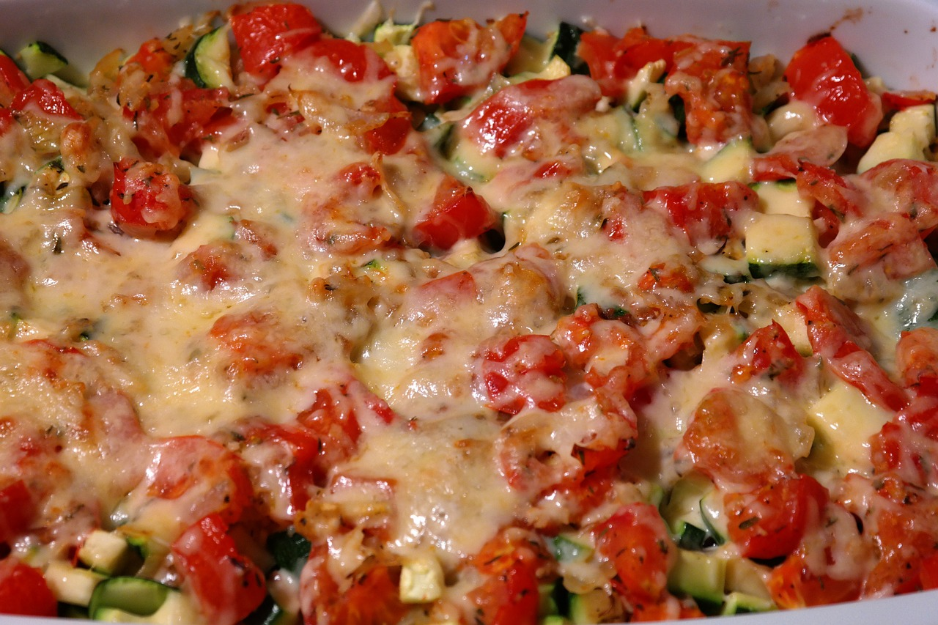
20. Hot food was held at 135°F

Slide 23
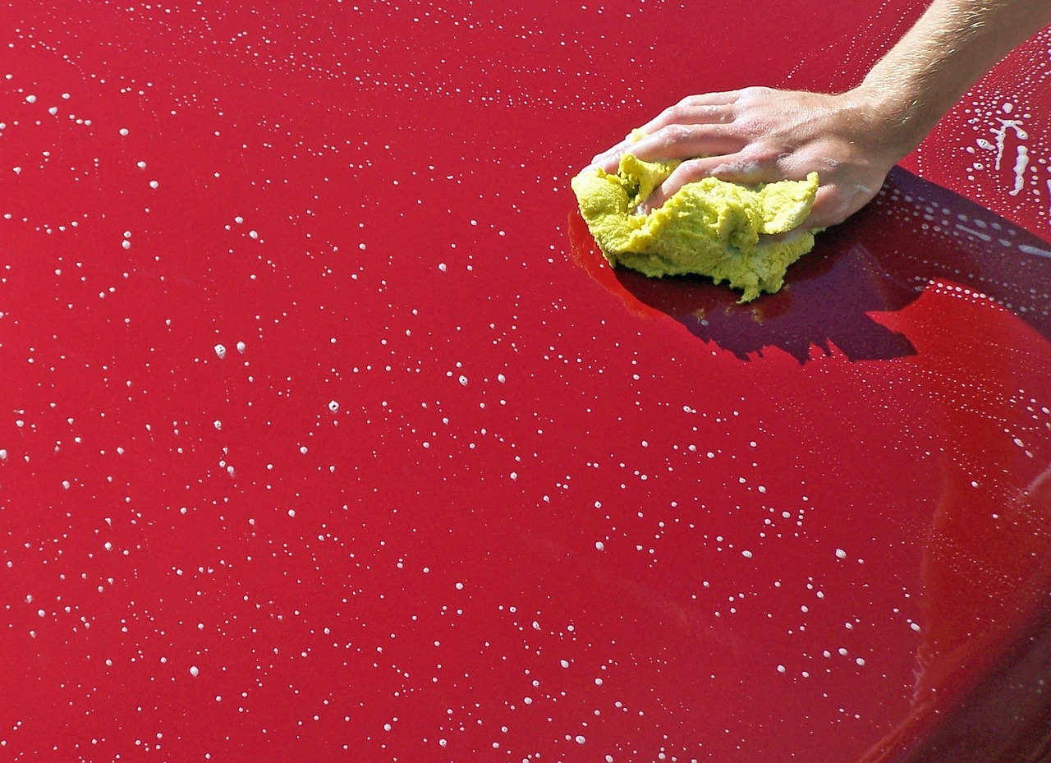
21. Someone washed and rinsed the prep area

Slide 24
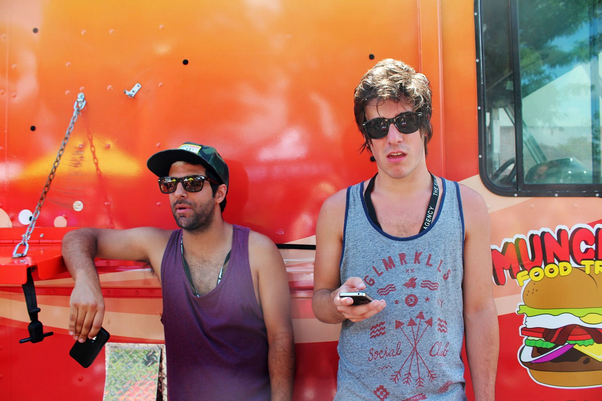
22. Food was purchased from an unsafe supplier

Slide 25
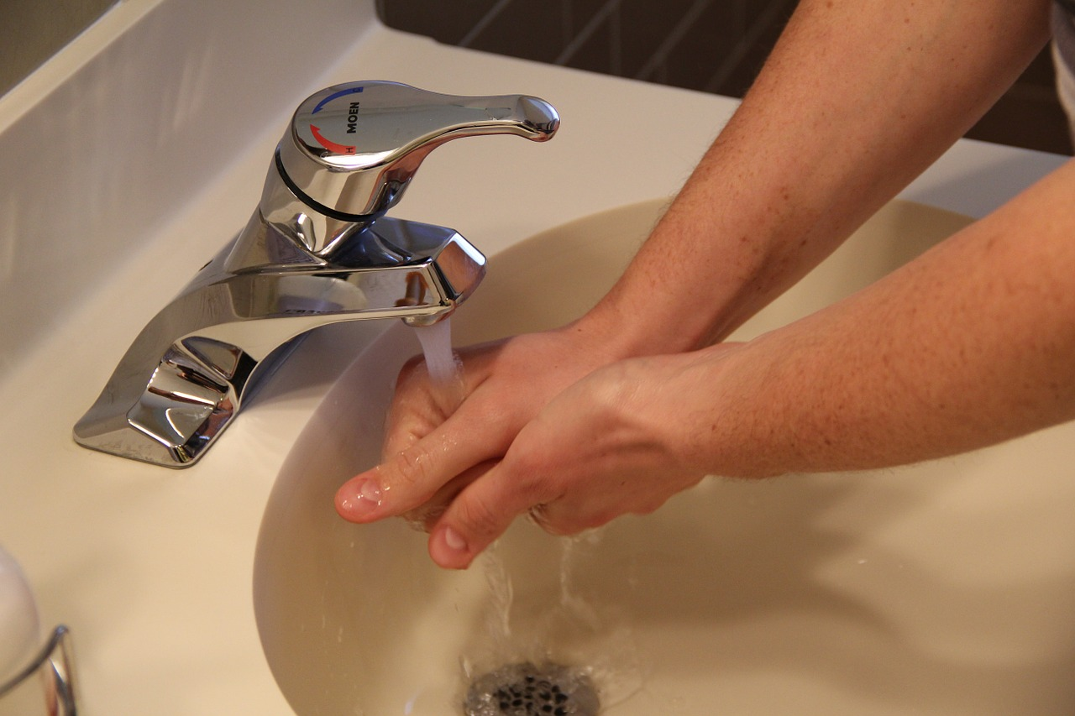
23. Workers always wash their hands before leaving the restroom.

Slide 26
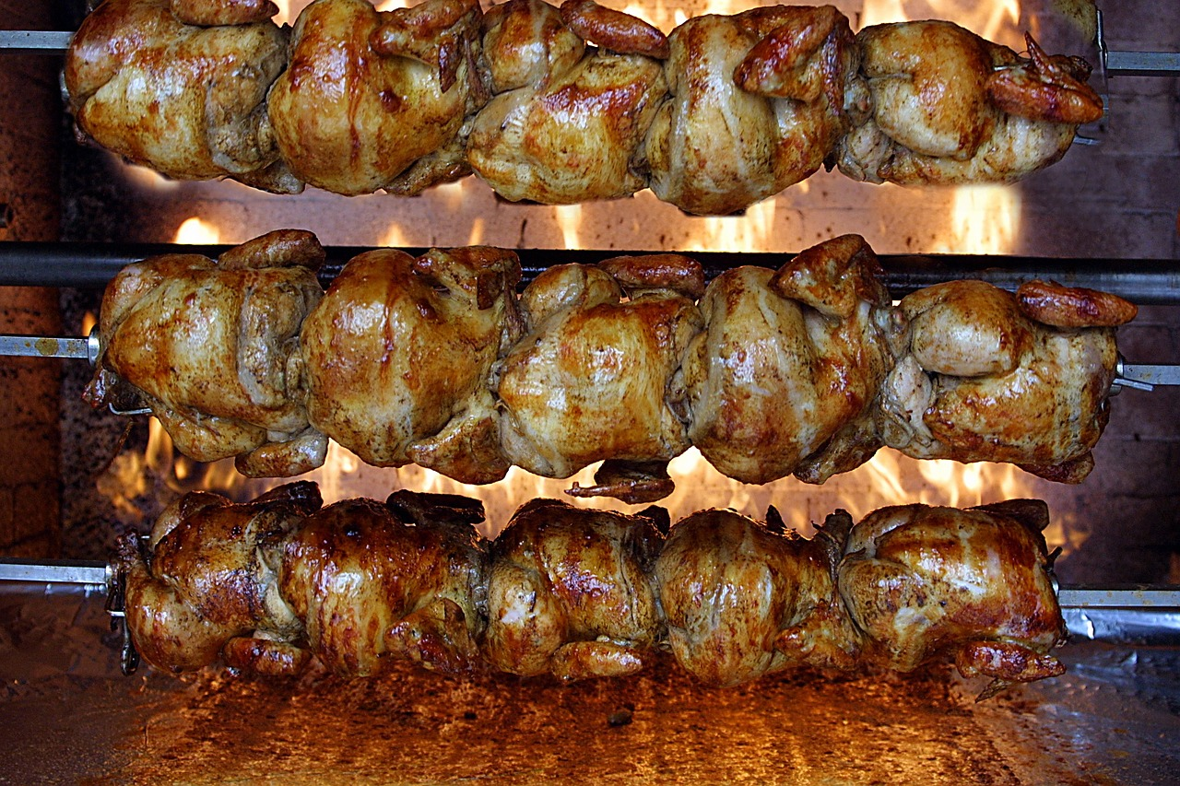
24. Chicken is cooked to 155°F

Slide 27
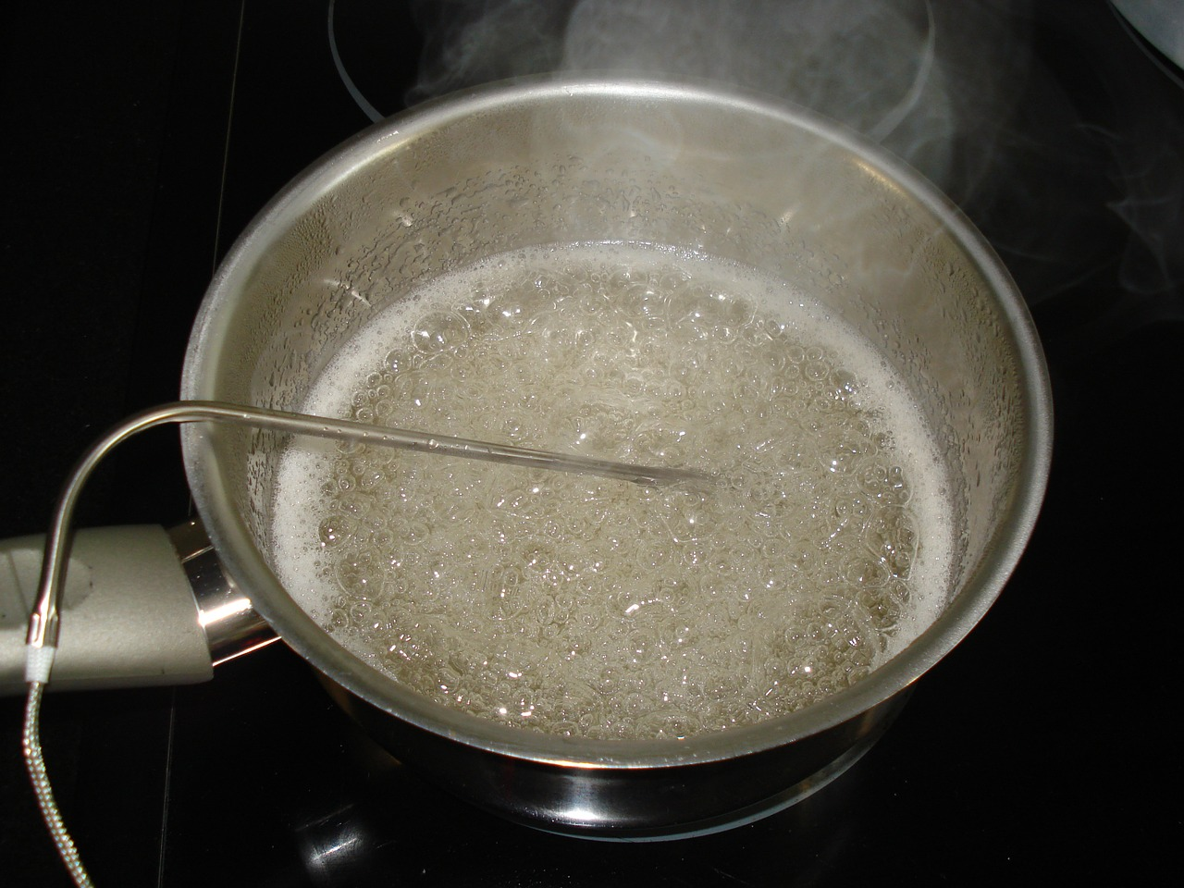
25. The thermometer has not been calibrated

Slide 28
26. Customers are allowed in the kitchen

Slide 29
All pictures came from Pixabay

