Slide 2
Food Safety Management Systems
Food safety management system:
  Group of practices and procedures intended to prevent foodborne illness
  Actively controls risks and hazards throughout the flow of food
8-2

Slide 3
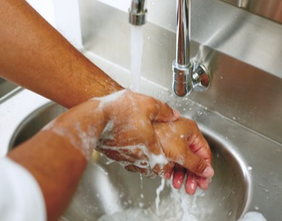
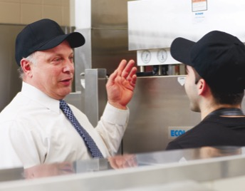
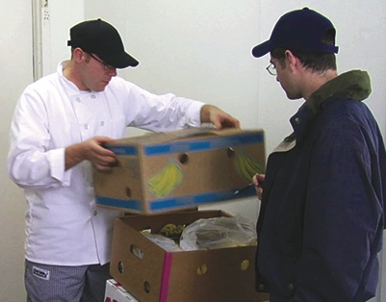
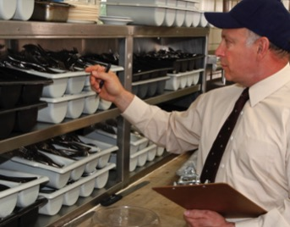
Food Safety Programs
These are the foundation of a food safety management system:
Personal hygiene program
Food safety training program
Supplier selection and specification program
Quality control and assurance program
8-3
Notes:
Instructor Notes
Having food safety programs already in place gives you the foundation for your system. The principles presented in the ServSafe program are the basis of these programs.

Slide 4
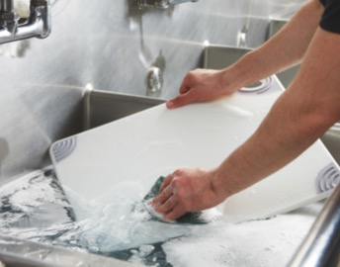
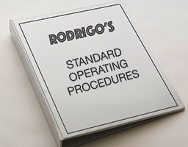
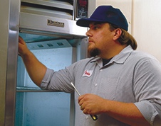
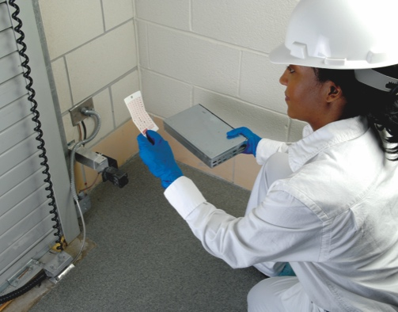
Food Safety Programs
These are the foundation of a food safety management system:
Cleaning and
sanitation program
Standard operating
procedures (SOPs)
Facility design and equipment maintenance program
Pest control program
8-4
Notes:
Instructor Notes
Having food safety programs already in place gives you the foundation for your system. The principles presented in the ServSafe program are the basis of these programs.

Slide 5
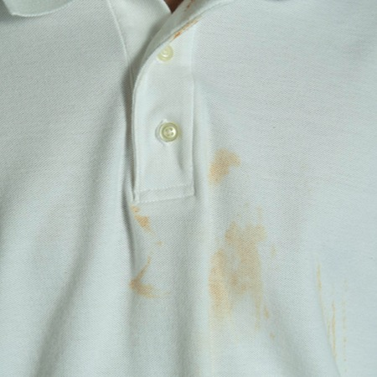
What Do You Think?
  A cook forgot to wash his uniform before starting work. Could this cause a foodborne illness?
A. Yes
B. No
Why?
This employee is practicing poor personal hygiene. This is a common risk for foodborne illness.
8-5
Notes:
Instructor Notes
The answer is A. The employee is practicing poor personal hygiene. This is a common risk for foodborne illness.

Slide 6
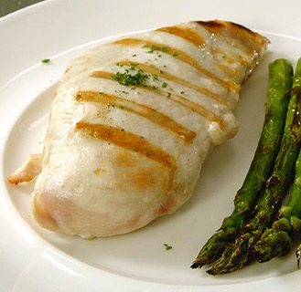
What Do You Think?
  A chicken breast was cooked to 165ºF (74ºC). Could this cause a foodborne illness?
A. Yes
B. No
Why?
Failing to cook food correctly is a risk for foodborne illness. But, this chicken was cooked to the correct temperature.
8-6
Notes:
Instructor Notes
The answer is B. Failing to cook food correctly is a risk for foodborne illness. But, this chicken was cooked to the correct temperature.

Slide 7
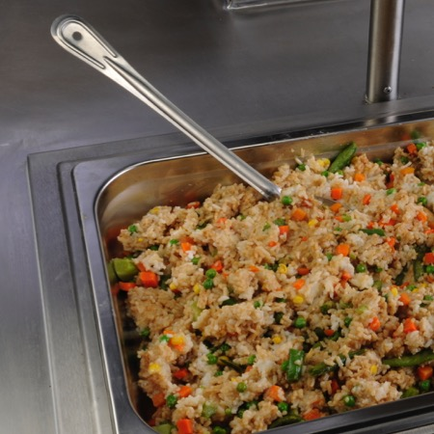
What Do You Think?
  A cook served rice at 120ºF (49ºC) from a holding unit. Could this cause a foodborne illness?
A. Yes
B. No
Why?
The rice should be held at 135ºF (57ºC) or higher. Holding food at incorrect temperatures is a risk for foodborne illness.
8-7
Notes:
Instructor Notes
The answer is A. The rice should be held at 135ºF (57ºC) or higher. Holding food at incorrect temperatures is a risk for foodborne illness.

Slide 8

What Do You Think?
  A manager bought steaks raised and sold from a private home.
  Could this cause a foodborne illness?
A. Yes
B. No
Why?
The steaks are not from an approved source. Purchasing food from unsafe sources is a risk for foodborne illness.
8-8
Notes:
Instructor Notes
The answer is A. The steaks are not from an approved source. Purchasing food from unsafe sources is a risk for foodborne illness.

Slide 9

What Do You Think?
  A cutting board was used to prep fish and then fruit salad. Could this cause a foodborne illness?
A. Yes
B. No
Why?
The cutting board may have become contaminated with pathogens from the fish. Using contaminated equipment is a risk for foodborne illness.
8-9
Notes:
Instructor Notes
The answer is A. The cutting board may have become contaminated with pathogens from the fish. Using contaminated equipment is a risk for foodborne illness.

Slide 10
Active Managerial Control
Focuses on controlling the five most common risk factors for foodborne illness:
  Purchasing food from unsafe sources
  Failing to cook food correctly
  Holding food at incorrect temperatures
  Using contaminated equipment
  Practicing poor personal hygiene
8-10
Notes:
Instructor Notes
It is the manager’s responsibility to actively control these and other risk factors for foodborne illness. This is called active managerial control. It is important to note that active managerial control is proactive rather than reactive. You must anticipate risks and plan for them.

Slide 11
Active Managerial Control
There are many ways to achieve active managerial control in
the operation:
  Training programs
  Manager supervision
  Incorporation of standard operating procedures (SOPs)
  HACCP
8-11
Notes:
Instructor Notes
There are many ways to achieve active managerial control in the operation. According to the Food and Drug Administration (FDA), you can use simple tools such as training programs, manager supervision, and the incorporation of SOPs. Active Managerial Control can also be achieved through more complex solutions, such as a HACCP program.

Slide 12
Active Managerial Control
To keep food safe:
  Practice active managerial control throughout the flow of food
  Anticipate potential foodborne-illness risk factors and control or
  eliminate them
  Apply what you have learned in ServSafe
  Monitor the flow of food
  Provide staff with the proper tools to make sure food is safe
  (e.g., procedures and training)
8-12

Slide 13
Implementing Active Managerial Control
To implement active managerial control:
  Identify risks
  Monitor
  Corrective action
  Management oversight
  Training
  Re-evaluation
8-13
Notes:
Instructor Notes
There are some important steps to take when implementing active managerial control in your operation. These are highlighted in the slide and will be discussed in the next several slides.

Slide 14
Active Managerial Control
1. Identify Risks:
  Find and document potential foodborne illness risks in the operation
  Identify the hazards that can be controlled or eliminated
2. Monitor:
  Food will be safe if managers monitor critical activities
  Identify where employees must monitor food safety requirements
    When temperatures must be taken
    How often sanitizer concentrations should be tested
8-14
Notes:
Instructor Notes
There are many ways to achieve active managerial control in the operation. According to the Food and Drug Administration (FDA), you can use simple tools such as training programs, manager supervision, and the incorporation of SOPs. Active Managerial Control can also be achieved through more complex solutions such as a HACCP program.

Slide 15
Active Managerial Control
3. Corrective Action:
  Take appropriate steps to correct improper procedures or behaviors
    If a sanitizer level is too low, increase the concentration level
4. Management oversight:
  Verify that all policies, procedures, and corrective actions are followed
8-15

Slide 16
Active Managerial Control
5. Training:
  Ensure employees are trained to follow procedures and retrained
  when necessary
6. Re-evaluation:
  Periodically assess the system to make sure it is working correctly
  and effectively
8-16

Slide 17

The FDA’s Public Health Interventions
The FDA provides recommendations for controlling the common risk factors for foodborne illness:
  Demonstration of knowledge
  Staff health controls
  Controlling hands as a vehicle
  of contamination
  Time and temperature parameters
  for controlling pathogens
  Consumer advisories
8-17
Notes:
Instructor Notes
The FDA provides specific recommendations for controlling the common risk factors for foodborne illness. These are known as public health interventions. They are designed to protect public health.
Demonstration of knowledge: As a manager, you must be able to show that you know what to do to keep food safe. Becoming certified in food safety is one way to show this.
Staff health controls: Procedures must be put in place to make sure staff are practicing personal hygiene. For example, staff must know that they must report illnesses and illness symptoms to management.
Controlling hands as a vehicle of contamination: Controls must be put in place to prevent bare-hand contact with ready-to-eat food. This might include requiring the use of tongs to handle ready-to-eat food.
Time and temperature parameters for controlling pathogens: Procedures must be put in place to limit the time food spends in the temperature danger zone. Requiring food handlers to check the temperature of food being hot-held every two hours is an example.
Consumer advisories: Notices must be provided to customers if you serve raw or undercooked menu items. These notices must include a statement about the risks of eating these foods.

Slide 18
HACCP
The HACCP approach:
  HACCP is based on identifying significant biological, chemical, or
  physical hazards at specific points within a product’s flow through
  an operation
  Once identified, hazards can be prevented, eliminated, or reduced
  to safe levels
8-18
Notes:
Instructor Notes
There are many systems you can implement to achieve active managerial control of foodborne-illness risk factors. Hazard Analysis Critical Control Point (HACCP) is one such system. HACCP (pronounced HASS-ip) is based on identifying significant biological, chemical, or physical hazards at specific points within a product’s flow. Once identified, the hazards can be prevented, eliminated, or reduced to safe levels.

Slide 19
HACCP
To be effective, a HACCP system must be based on a written plan:
  It must be specific to each facility’s menu, customers, equipment, processes, and operations
  A plan that works for one operation may not work for another
8-19
Notes:
Instructor Notes
Each HACCP plan is unique; a plan that works for one operation may not work for another.

