Slide 2
7-2
Notes:
Instructor Notes
Play the “Holding Food” and “Serving Food” sections from the Preparation, Cooking, and Serving DVD.

Slide 3
Additional Content
7-3
Notes:
Instructor Notes
Teach the additional content not included in the sections of the DVD just watched by using the next several PowerPoint slides.

Slide 4
What Do You Think?
      Can the temperature gauge on a holding unit be used to check the temperature of the food inside?
      A. Yes
      B. No
Why?
The temperature gauge does not check the internal temperature of the food.
7-4
Notes:
Instructor Notes
The answer is B. Never use the temperature gauge on a holding unit to check the food’s temperature. The gauge does not check the internal temperature of the food.

Slide 5
What Do You Think?
      Can you use a hot-holding unit to reheat food?
      A. Yes
      B. No
Why?
Most hot-holding units will not pass food through the TDZ quickly enough. Reheat the food correctly, then move it to a holding unit.
7-5
Notes:
Instructor Notes
The answer is B. Most hot-holding equipment does not pass food through the temperature danger zone quickly enough. Reheat food correctly. Then move it to the holding unit.

Slide 6
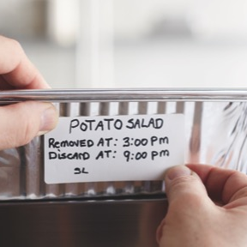
Holding Food without Temperature Control
Cold food can be held without temperature control for up to six hours if:
  It was held at 41ºF (5ºC) or lower before removing it from refrigeration
  It does not exceed 70ºF (21ºC) during service
    Throw out food that exceeds this temperature
  It has a label specifying:
    Time it was removed from refrigeration
    Time it must be thrown out
  It is sold, served, or thrown out within six hours
7-6
Notes:
Instructor Notes
Your operation may want to display or hold TCS food without temperature control. However, if you primarily serve a high-risk population, you cannot hold TCS food without temperature control.
If your operation displays or holds TCS food without temperature control, it must do so under certain conditions. Also note that the conditions for holding cold food are different from those for holding hot food. Before using time as a method of control, check with your local regulatory authority for specific requirements.
The discard time on the label must be six hours from the time you removed the food from refrigeration. For example, if you remove potato salad from refrigeration at 3:00 p.m. to serve at a picnic, the discard time on the label should be 9:00 p.m. This equals six hours from the time you removed it from refrigeration.

Slide 7
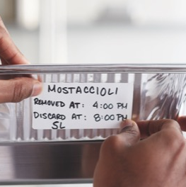
Holding Food without Temperature Control
Hot food can be held without temperature control for up to four hours if:
  It was held at 135ºF (57ºC) or higher before removing it from temperature control
  It has a label specifying when the item must be thrown out
  It is sold, served, or thrown out within four hours
7-7
Notes:
Instructor Notes:
Label the food with the time you must throw it out. The discard time on the label must be four hours from the time you removed the food from temperature control.

Slide 8
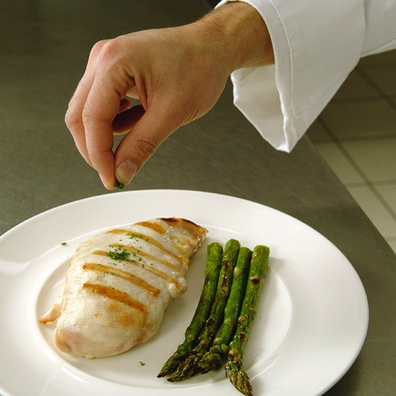
What Do You Think?
  Is this food item being handled safely?
A. Yes
B. No
Why?
Food handlers must wear single-use gloves when handling ready-to-eat food, such as this garnish.
7-8
Notes:
Instructor Notes
The answer is B. Food handlers must wear single-use gloves when handling ready-to-eat food, such as the garnish in the photo. As an alternative, food can be handled with spatulas, tongs, deli sheets, or other utensils. Keep in mind that there are some situations where it may be acceptable to handle ready-to-eat food with bare hands. These were discussed earlier.

Slide 9
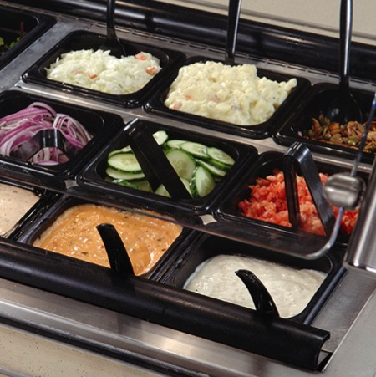
What Do You Think?
  Are these food items being handled safely?
A. Yes
B. No
Why?
Serving utensils should be stored in the food with the handle extended above the rim of the container.
7-9
Notes:
Instructor Notes
The answer is A. Store serving utensils in the food with the handle extended above the rim of the container

Slide 10
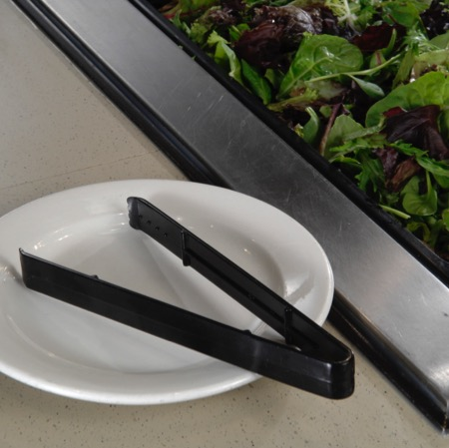
What Do You Think?
  Is this food item being handled safely?
A. Yes
B. No
Why?
Utensils used to handle TCS food must be stored in the food. If serving a non-TCS item, the utensil could be stored on a clean and sanitized surface such as a plate.
7-10
Notes:
Instructor Notes
The answer is B. Cut lettuce is a TCS food item. If you are serving a non-TCS food item, you can place serving utensils on a clean and sanitized food-contact surface. If the utensil is being used to handle a TCS item, the utensil must be stored in the food, with the handle extended above the rim of the container.

Slide 11
Kitchen Staff Guidelines
Spoons or scoops used to serve mashed potatoes or ice cream can be stored:
  Under running water
  In a container of water maintained at 135ºF (57ºC) or higher
7-11

Slide 12
Refilling Take-Home Containers
Take-home food containers brought back by guests can be refilled if they were:
  Designed to be reused
  Provided to the guest by the operation
  Cleaned and sanitized correctly
7-12

Slide 13
Refilling Take-Home Containers
Take-home beverage containers brought back by guests can be refilled if:
  The beverage is not a TCS food
  The container will be refilled for the same guest
  The container can effectively be cleaned at home and in the operation
  The container will be rinsed with fresh, hot water under pressure before refilling
  The container will be refilled by staff or the guest using a process that prevents contamination
7-13

Slide 14
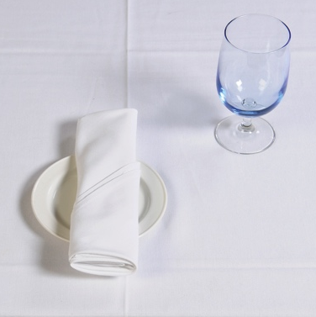
Preset Tableware
If you preset tableware:
  Prevent it from being contaminated; for example, you can wrap or cover the items
It is unnecessary to wrap or cover table settings if extra or unused settings are:
  Removed when guests are seated
  Cleaned and sanitized after guests have left
7-14

Slide 15
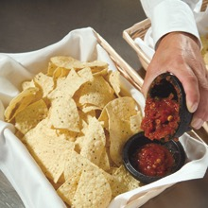
Re-serving Food
NEVER re-serve:
  Food returned by one customer to
  another customer
  Uncovered condiments
  Uneaten bread
  Plate garnishes
Generally, only unopened, prepackaged food
in good condition can be re-served:
  Condiment packets
  Wrapped crackers or breadsticks
7-15
Notes:
Instructor Notes
You must protect condiments from contamination. Serve them in their original containers or in containers designed to prevent contamination. Offering condiments in individual packets or portions can also help keep them safe.
Do NOT combine leftover condiments with fresh ones.
Throw away opened portions or dishes of condiments after serving them to guests. Salsa, butter, mayonnaise, and ketchup are examples.
You may re-serve bottles of ketchup, mustard, and other condiments.

Slide 16
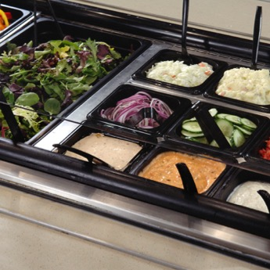
Self-Service Areas
To prevent contamination:
  Place food in display cases
  Package food to prevent contamination
  Stock food using the correct utensils
  Never use ice as an ingredient if it was used to cool food or beverages
Do not offer raw meat, seafood, or poultry unless:
  It is sushi or raw shellfish
  The portions will be cooked immediately on the premises (e.g., Mongolian BBQ)
  It is raw, frozen, shell-on shrimp or lobster
7-16
Notes:
Instructor Notes
Whole, raw fruits and vegetables and nuts in the shell that require peeling or hulling before eating do not need to be placed under sneeze guards or in display cases in self-service areas.

Slide 17
Labeling Bulk Food in Self-Service Areas
  When labeling bulk food in self-service areas:
  Make sure the label is in plain view of the guest
  Include the manufacturer or processor label provided with the food
    As an alternative, provide the information using a card, sign, or other
    labeling method
7-17

Slide 18
Labeling Bulk Food in Self-Service Areas
A label is not needed for bulk unpackaged food, such as bakery products, or unpackaged food portioned for customers if:
  The product makes no claim regarding health or nutrient content
  No laws requiring labeling exist
  The food is manufactured or prepared on the premises
  The food is manufactured or prepared at another regulated food operation or processing plant owned by the same person
7-18

Slide 19
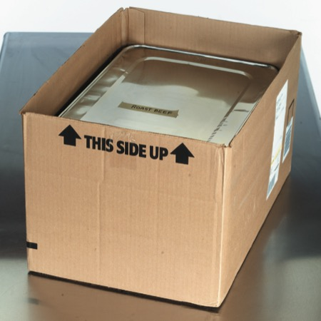
What Do You Think?
  Is this food being delivered safely?
A. Yes
B. No
Why?
  Food should be delivered in insulated, food-grade containers designed to stop food from mixing, leaking, or spilling.
7-19
Notes:
Instructor Notes
The answer is B. Pack food in insulated food containers. Use only food-grade containers. They should be designed so food cannot mix, leak, or spill. At the service site, use appropriate containers or equipment to hold food at the correct temperature.

Slide 20
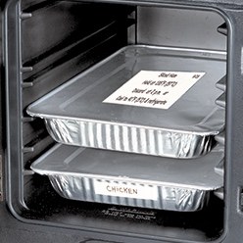
Off-Site Service
When delivering food off-site:
  Label food with a use-by date and time, and reheating and service instructions
  Clean the inside of delivery vehicles regularly
  Check internal food temperatures
7-20
Notes:
Instructor Notes
Delays from the point of preparation to the point of service increase the risk that food will be exposed to contamination or time-temperature abuse.
Check internal food temperatures. If containers or delivery vehicles are not holding food at the correct temperature, reevaluate the length of the delivery route or the efficiency of the equipment being used.

Slide 21
Off-Site Service
When delivering food off-site:
  Make sure the service site has the
  correct utilities
    Safe water for cooking, dishwashing,
    and handwashing
    Garbage containers stored away from
    food-prep, storage, and serving areas
  Store raw meat, poultry, and seafood, and
  ready-to-eat items separately
7-21

Slide 22
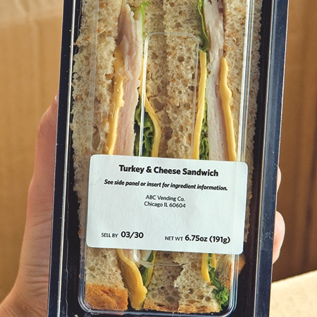
Vending Machines
To keep vended food safe:
  Check product shelf life daily
    Refrigerated food prepped on-site and not sold in seven days must be thrown out
  Keep TCS food at the correct temperature
  Dispense TCS food in its original container
  Wash and wrap fresh fruit with edible peels before putting it in the machine
7-22
Notes:
Instructor Notes
Handle food prepped and packaged for vending machines with the same care as any other food served to guests. Vending operators should protect food from contamination and time-temperature abuse during transport, delivery, and service.
Check product shelf life daily. Products often have a code date, such as an expiration or a use-by date. If the date has expired, throw out the food immediately. Throw out refrigerated food prepped on-site if not sold within seven days of preparation.
Keep TCS food at the correct temperature. It should be held at 41°F (5°C) or lower, or at 135°F (57°C) or higher. These machines must have controls that prevent TCS food from being dispensed if the temperature stays in the danger zone for a specified amount of time. This food must be thrown out.

Slide 23
Activity
What Did I Do Wrong?
7-23
Notes:
Instructor Notes
This activity can be downloaded from ServSafe.com. Directions for using the activity are included with it.

