Slide 2
6-2
Notes:
Instructor Notes
Play the Preparation, Cooking, and Serving DVD. Stop the DVD after the “Reheating” section has finished playing.

Slide 3
Additional Content
6-3
Notes:
Instructor Notes
Teach the additional content not included in the section of the DVD just watched by using the next several PowerPoint slides.

Slide 4
What Do You Think?
Is this food being prepared correctly?
A. Yes
B. No
Why?
You should only remove as much food from the cooler as you can prep in a short period of time.
6-4
Notes:
Instructor Notes
The answer is B. Only remove as much food from the cooler as you can prep in a short period of time. This keeps ingredients from sitting out for long periods of time.
Return prepped food to the cooler, or cook it, as quickly as possible.

Slide 5
Additives
Food and color additives:
Only use additives approved by your local regulatory authority
NEVER use more additives than are allowed by law
NEVER use additives to alter the appearance of food
Do NOT sell produce treated with sulfites before it was received in the operation
NEVER add sulfites to produce that will be eaten raw
6-5

Slide 6
Presenting Food Honestly
Do NOT use the following to misrepresent the appearance of food:
Food additives or color additives
Colored overwraps
Lights
Food that was not presented honestly must be thrown out.
6-6
Notes:
Instructor Notes
Food must be offered to customers in a way that does not mislead or misinform them. Customers must be able to judge the true appearance, color, and quality of food.
Food also must be presented the way it was described.

Slide 7
Corrective Actions
Food must be thrown out when it:
Is handled by staff who have been restricted or excluded due to illness
Is contaminated by hands or bodily fluids
Has exceeded time and temperature requirements designed to keep food safe
6-7
Notes:
Instructor Notes
• Food that has become unsafe must be thrown out unless it can be safely reconditioned. All food—especially ready-to-eat food—must be thrown out in the situations highlighted in the slide.
• Sometimes food can be restored to a safe condition. This is called reconditioning. For example, a hot food that has not been held at the correct temperature may be reheated if it has not been in the temperature danger zone for more than two hours. This can return food to a safe condition.

Slide 8
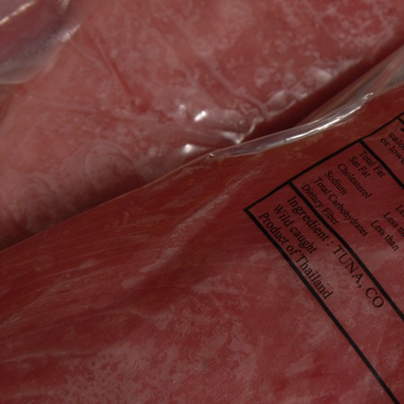
What Do You Think?
Is this vacuum-packed fish being thawed correctly?
A. Yes
B. No
Why?
Fish that must remain frozen until ready to be used must be removed from the package before thawing.
Fish left in the package and thawed in a cooler
6-8
Notes:
Instructor Notes
The answer is B. Frozen fish may be supplied in reduced-oxygen packaging (ROP). This fish should usually remain frozen until ready for use. If this is stated on the label, the fish must be removed from the packaging at the following times:
Before thawing it under refrigeration
Before or immediately after thawing it under running water

Slide 9
Prepping Produce
Produce can be treated to control pathogens
Using chemicals or water containing ozone
Check with your local regulatory authority
When soaking or storing produce in standing water or an ice-water slurry, do NOT mix:
Different items
Multiple batches of the same item
6-9
Notes:
Instructor Notes
Certain chemicals may be used to wash fruits and vegetables. Also, produce can be treated by washing it in water containing ozone. This treatment helps control pathogens. Check your local regulatory requirements.

Slide 10
What Do You Think?
Does this need to be refrigerated for safety?
A. Yes
B. No
Why?
Refrigerate and hold cut tomatoes at 41°F (5°C) or lower.
6-10
Notes:
Instructor Notes
The answer is A. Refrigerate and hold cut tomatoes at 41°F (5°C) or lower.

Slide 11
What Do You Think?
Does this need to be refrigerated for safety?
A. Yes
B. No
Why?
Refrigerate and hold sliced melons at 41°F (5°C) or lower.
6-11
Notes:
Instructor Notes
The answer is A. Refrigerate and hold sliced melons at 41°F (5°C) or lower.

Slide 12
What Do You Think?
Does this need to be refrigerated for safety?
A. Yes
B. No
Why?
Refrigerate and hold cut leafy greens at 41°F (5°C) or lower.
6-12
Notes:
Instructor Notes
The answer is A. Refrigerate and hold cut leafy greens at 41°F (5°C) or lower.

Slide 13
Ice
NEVER:
Use ice as an ingredient if it was used to keep food cold
Hold or carry ice in containers that held raw meat, seafood, or poultry, or chemicals
Touch ice with hands or use a glass to scoop ice
ALWAYS:
Store ice scoops outside of the ice machine in a clean, protected location
6-13
Notes:
Instructor Notes
Make ice from water that is safe to drink.
Never use ice as an ingredient if it was used to keep food cold. For example, if ice is used to cool food on a salad bar, it cannot then be used in drinks.

Slide 14
Preparation Practices That Have Special Requirements
You need a variance if prepping food in these ways:
Packaging fresh juice on-site for sale at a later time, unless the juice has a warning label
Smoking food to preserve it but not to enhance flavor
Using food additives or components to preserve or alter food so it no longer needs time and temperature control for safety
Curing food
6-14
Notes:
Instructor Notes
You will need a variance when prepping food in certain ways. A variance is a document issued by your regulatory authority that allows a regulatory requirement to be waived or changed.
When applying for a variance, your regulatory authority may require you to submit a HACCP plan. The plan must account for any food safety risks related to the way you plan to prep the food item.

Slide 15
Preparation Practices That Have Special Requirements
You need a variance if prepping food in these ways:
Custom-processing animals for personal use (e.g., dressing a deer)
Packaging food using a reduced-oxygen packaging (ROP) method
Sprouting seeds or beans
Offering live shellfish from a display tank
6-15
Notes:
Instructor Notes
Clostridium botulinum and Listeria monocytogenes are risks to food packaged using a reduced-oxygen packaging method. This includes MAP, vacuum-packed, and sous vide food.

Slide 16
Cooking Requirements for Specific Types of Food
Required minimum internal cooking temperature:
165ºF (74ºC) for 15 seconds
Stuffing made with fish, meat, or poultry
Dishes that include previously cooked TCS ingredients
155ºF (68ºC) for 15 seconds
Mechanically tenderized meat
Ratites (including ostrich and emu)
Ground seafood
6-16
Notes:
Instructor Notes
Present these additional cooking temperatures to students.

Slide 17
Cooking Requirements for Specific Types of Food
Minimum internal cooking temperature:
145ºF (63ºC) for 15 seconds
Shellfish and crustaceans
Commercially raised game
135ºF (57ºC)
Fruit, vegetables, grains (e.g., rice, pasta), and legumes (e.g., beans, refried beans) that will be hot held for service
6-17
Notes:
Instructor Notes
Present these additional cooking temperatures to students.

Slide 18
Cooking Requirements for Specific Food
Alternate cooking temperature for roasts:
130ºF (54ºC) 112 minutes
131ºF (55ºC) 89 minutes
133ºF (56ºC) 56 minutes
135ºF (57ºC) 36 minutes
136ºF (58ºC) 28 minutes
138ºF (59ºC) 18 minutes
140ºF (60ºC) 12 minutes
142ºF (61ºC) 8 minutes
144ºF (62ºC) 5 minutes
6-18

Slide 19
Partial Cooking During Preparation
If partially cooking meat, seafood, poultry, eggs, or dishes containing these items:
NEVER cook the food longer than 60 minutes during initial cooking
Cool the food immediately after initial cooking
Freeze or refrigerate the food after cooling it
Stored away from ready-to-eat refrigerated food
Heat the food to the required minimum internal temperature before selling or serving it
Cool the food if it will not be served immediately or held for service
6-19
Notes:
Instructor Notes
Some operations partially cook food during prep and then finish cooking it just before service. You must follow the steps in the slide if you plan to partially cook meat, seafood, poultry, eggs, or dishes containing these items.
Your local regulatory authority will require you to have written procedures that explain how the food cooked by this process will be prepped and stored. These procedures must be approved by the regulatory authority and describe the following:
How the requirements will be monitored and documented
Which corrective actions will be taken if requirements are not met
How these food items will be marked after initial cooking to indicate that they need further cooking
How these food items will be separated from ready-to-eat food during storage, once initial cooking is complete

Slide 20
Consumer Advisories
If your menu includes raw or undercooked TCS items, you must:
Note it on the menu next to the items
Asterisk the item
Place a footnote at the menu bottom indicating the item is raw, undercooked, or contains raw or undercooked ingredients
Advise customers who order this food of the increased risk of foodborne illness
Post a notice in the menu
Provide this information using brochures, table tents, or signs
Disclosure
Reminder
6-20
Notes:
Instructor Notes
If your menu includes TCS items that are raw or undercooked, you must note it on the menu next to these items. This can be done by placing an asterisk next to the item that points customers to a footnote at the bottom of the menu. The footnote must include a statement that indicates the item is raw or undercooked, or contains raw or undercooked ingredients.
You must advise customers who order food that is raw or undercooked of the increased risk of foodborne illness. You can do this by posting a notice in your menu. You can also provide this information using brochures, table tents, signs, or other written methods.

Slide 21
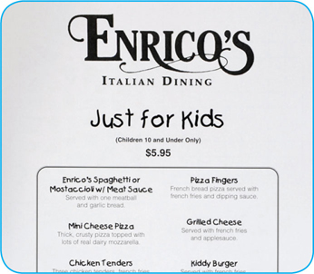
Children’s Menus
The FDA advises against offering these items on a children’s menu if they are raw or undercooked:
Meat
Poultry
Seafood
Eggs
6-21
Notes:
Instructor Notes
The Food and Drug Administration (FDA) advises against offering raw or undercooked meat, poultry, seafood, or eggs on a children’s menu. This is especially true for undercooked ground beef, which may be contaminated with Shiga toxin-producing E. coli O157:H7.

Slide 22
Operations That Mainly Serve High-Risk Populations
NEVER serve:
Raw seed sprouts
Raw or undercooked eggs, meat, or seafood
Over-easy eggs
Raw oysters on the half shell
Rare hamburgers
Unpasteurized milk or juice
6-22
Notes:
Instructor Notes
Examples of operations that mainly serve high-risk populations include nursing homes and day-care centers.

Slide 23
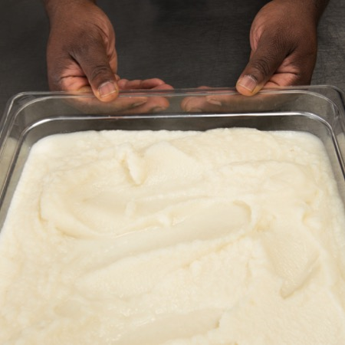
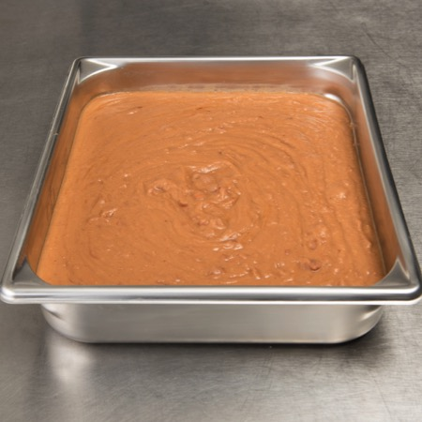
What Do You Think?
Which food will cool quicker?
A.
B.
Mashed potatoes
Refried beans
Stainless steel transfers heat away from food faster than plastic.
6-23

Slide 24
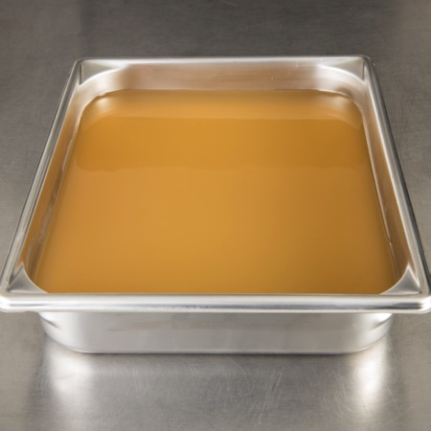
What Do You Think?
Which food will cool quicker?
A.
B.
Chicken broth
Refried beans
The chicken broth is less dense. The denser the food, the more slowly it will cool.
6-24

Slide 25
Methods for Cooling Food
Food can be cooled by adding ice or cold water as an ingredient.
Can be used when cooling soups or stews
The recipe is made with less water than required
Cold water or ice is added after cooking to provide the remaining water and cool the food
6-25

Slide 26
Storing Food for Further Cooling
When storing food for further cooling:
Loosely cover food containers before storing them
Food can be left uncovered if protected from contamination
Storing uncovered containers above other food, especially raw seafood, meat, and poultry, will help prevent cross-contamination
6-26

Slide 27
What Do You Think?
What temperature should a beef sandwich for immediate service be reheated to?
A. 145ºF (63ºC)
B. 165ºF (74ºC)
C. Any temperature
Why?
Food that will be served immediately can be reheated to any temperature.
6-27
Notes:
Instructor Notes
The answer is C. Food that will be served immediately can be reheated to any temperature.

Slide 28
Reheating Food
Commercially processed and packaged ready-to-eat food:
Reheat to an internal temperature of at least 135ºF (57ºC)
This includes items like cheese sticks and deep-fried vegetables
6-28

