Slide 2
Hazards in the Flow of Food
To keep food safe throughout the flow of food:
Prevent cross-contamination
Prevent time-temperature abuse
4-2
Notes:
Instructor Notes
The flow of food is the path that food takes through your operation. It begins when you buy the food and ends when you serve it. Detailed practices for each phase are covered in later chapters.
You are responsible for the safety of the food at every point in this flow—and many things can happen to it.

Slide 3
What Do You Think?
Can this prevent cross-contamination?
A. Yes
B. No
Why?
The food handler is using a yellow-colored cutting board for preparing raw poultry. Using separate equipment for raw and ready-to-eat food can prevent cross-contamination.
4-3
Notes:
Instructor Notes
The answer is A. Each type of food should have separate equipment. For example, use one set of cutting boards, utensils, and containers for raw poultry. Use another set for raw meat. Use a third set for produce.
Colored cutting boards and utensil handles can help keep equipment separate. The color tells food handlers which equipment to use with each food item. You might use yellow for raw chicken, red for raw meat, and green for produce.

Slide 4
What Do You Think?
Can this prevent cross-contamination?
A. Yes
B. No
Why?
Cleaning and sanitizing surfaces before and after tasks can prevent cross-contamination.
4-4
Notes:
Instructor Notes
The answer is A. Clean and sanitize all work surfaces, equipment, and utensils before and after each task. When you cut up raw chicken, for example, you cannot get by with just rinsing the equipment. Pathogens such as nontyphoidal Salmonella can contaminate food through cross-contamination. To prevent this, you must wash, rinse, and sanitize equipment. See chapter 10 for more information on cleaning and sanitizing.

Slide 5
What Do You Think?
Can this prevent cross-contamination?
A. Yes
B. No
Why?
Prepping raw and ready-to-eat food on separate prep tables can prevent cross-contamination. So can prepping these foods at different times.
4-5
Notes:
Instructor Notes
The answer is A. If you need to use the same prep table for different types of food, prep raw meat, fish, and poultry at a different time than ready-to-eat food. You must clean and sanitize work surfaces and utensils between each type of food. Also, by prepping ready-to-eat food before raw food, you can reduce the chance for cross-contamination.

Slide 6
What Do You Think?
Can this prevent cross-contamination?
A. Yes
B. No
Why?
Buying prepared food can prevent cross-contamination.
4-6
Notes:
Instructor Notes
The answer is A. Buy food that does not require much prepping or handling. For example, you could buy precooked chicken breasts or chopped lettuce.

Slide 7
Preventing Time-Temperature Abuse in the Flow of Food
Time-temperature control:
Food held in the range of 41ºF to 135ºF (5ºC to 57ºC) has been time-temperature abused
Most pathogens grow much faster between 70ºF and 125ºF (21ºC and 52ºC)
Food has been time-temperature abused whenever it is handled in the following ways:
Cooked to the wrong internal temperature
Held at the wrong temperature
Cooked or reheated incorrectly
4-7
Notes:
Instructor Notes
Most foodborne illnesses happen because TCS food has been time-temperature abused. Remember, TCS food has been time-temperature abused any time it remains between 41°F and 135°F (5°C and 57°C). This is called the temperature danger zone because pathogens grow in this range. But most pathogens grow much faster between 70°F and 125°F (21°C and 52°C).
Food is being temperature abused whenever it is handled in the following ways:
Cooked to the wrong internal temperature
Held at the wrong temperature
Cooled or reheated incorrectly
The longer food stays in the temperature danger zone, the more time pathogens have to grow. To keep food safe, you must reduce the time it spends in this temperature range. If food is held in this range for four or more hours, you must throw it out.

Slide 8
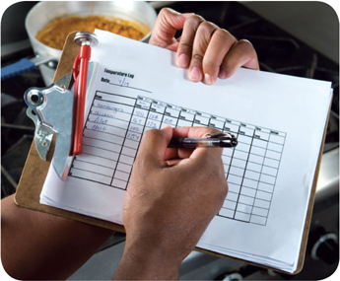
Preventing Time-Temperature Abuse in the Flow of Food
Avoid time-temperature abuse:
Monitor time and temperature
Make sure the correct kinds of thermometers are available
Regularly record temperatures and the times they are taken
Minimize the time that food spends in the temperature danger zone
Take corrective actions if time-temperature standards are not met
4-8
Notes:
Instructor Notes
Learn which food items should be checked, how often, and by whom.
Use timers in prep areas to check how long food is in the temperature danger zone.
A policy limiting the amount of food that can be removed from a cooler when prepping it can limit the time food spends in the temperature danger zone.
Make sure food handlers know what to do when time and temperature standards are not met.

Slide 9
Monitoring Time and Temperature
Bimetallic stemmed thermometers
4-9
Notes:
Instructor Notes
A bimetallic stemmed thermometer can check temperatures from 0˚F to 220˚F (–18˚C to 104˚C).
This thermometer measures temperature through its metal stem. When checking temperatures, insert the stem into the food up to the dimple. You must do this because the sensing area of the thermometer goes from the tip of the stem to the dimple. This trait makes this thermometer useful for checking the temperature of large or thick food. It is usually not practical for thin food, such as hamburger patties.
The calibration nut is used to adjust the thermometer to make it accurate.
The indicator head must have easy-to-read markings. Clear markings reduce the chance that someone will misread the thermometer. The thermometer must be scaled in at least two-degree increments.

Slide 10
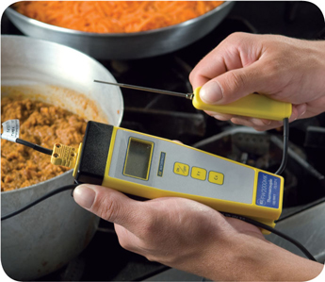
Monitoring Time and Temperature
Thermocouples and thermistors:
Measure temperature through a metal probe
Display temperatures digitally
Have a sensing area on the tip of their probes
4-10
Notes:
Instructor Notes
The sensing area on thermocouples and thermistors is on the tip of their probes. This means you don’t have to insert them into the food as far as bimetallic stemmed thermometers to get a correct reading. Thermocouples and thermistors are good for checking the temperature of both thick and thin food.
.

Slide 11
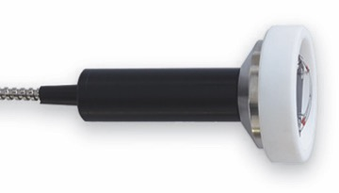
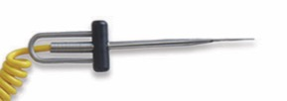
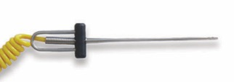
Monitoring Time and Temperature
Immersion Probe
Surface Probe
Penetration Probe
Air Probe
4-11
Notes:
Instructor Notes
Thermocouples and thermistors come in several styles and sizes. Many come with different types of probes.
Immersion probes are used to check the temperature of liquids such as soups, sauces, and frying oil.
Surface probes are used to check the temperature of flat cooking equipment such as griddles.
Penetration probes are used to check the internal temperature of food. Small-diameter probes should be used to check the internal temperature of thin food such as meat patties and fish fillets.
Air probes are used to check the temperature inside coolers and ovens.
.

Slide 12
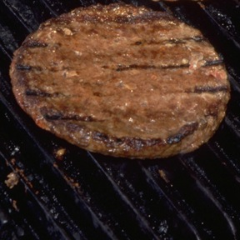
What Do You Think?
Which thermometer(s) should be used?
A. Bimetallic stemmed
B. Thermocouple
C. Infrared
Hamburger patty
4-12
Notes:
Instructor Notes
The answer is B. Thermocouples and thermistors are good for checking the temperatures of thin food since they do not need to be inserted very far into the food to get an accurate reading. Bimetallic stemmed thermometers are not practical for checking the temperature of thin food, such as hamburger patties. That’s because they have to be inserted into the food from the tip of the stem to the sensing area.

Slide 13
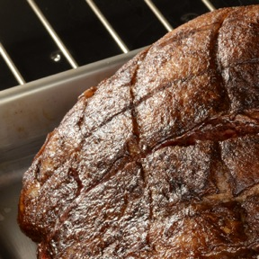
What Do You Think?
Which thermometer(s) should be used?
A. Bimetallic stemmed
B. Thermocouple
C. Infrared
Roast
4-13
Notes:
Instructor Notes
The answers are A and B. Bimetallic stemmed thermometers are good for checking the temperature of large or thick food, like this roast. Thermocouples and thermistors are good for checking the temperature of thick and thin food. An infrared thermometer is not a good choice because it can only check the surface temperature of the product.

Slide 14
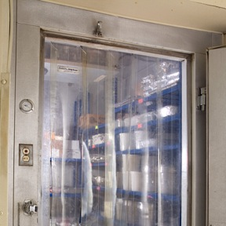
What Do You Think?
Which thermocouple probe should be used?
A. Immersion probe
B. Surface probe
C. Penetration probe
D. Air probe
Cooler temperature
4-14
Notes:
Instructor Notes
The answer is D. An air probe is good for checking the temperature inside coolers and ovens.

Slide 15
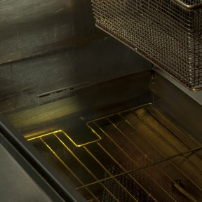
What Do You Think?
Which thermocouple probe should be used?
A. Immersion probe
B. Surface probe
C. Penetration probe
D. Air probe
Fryer oil
4-15
Notes:
Instructor Notes
The answer is A. Immersion probes are used to check the temperature of liquids such as soups, sauces, and frying oil.

Slide 16
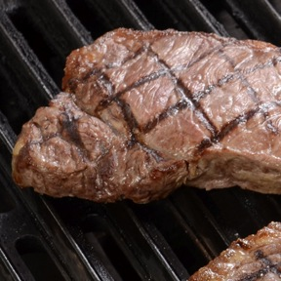
What Do You Think?
Which thermocouple probe should be used?
A. Immersion probe
B. Surface probe
C. Penetration probe
D. Air probe
Steak
4-16
Notes:
Instructor Notes
The answer is C. Penetration probes are used to check the internal temperature of food, such as this steak.

Slide 17
Monitoring Time and Temperature
Infrared (laser) thermometers:
Use to measure the surface temperature of food and equipment
Hold them as close to the food or equipment as possible
Remove anything between the thermometer and the food, food package, or equipment
Follow the manufacturer’s guidelines
4-17
Notes:
Instructor Notes
These thermometers cannot measure air temperature or the internal temperature of food.
Hold the thermometer as close as possible to the food, food package, or equipment without touching it.
Following the manufacturer’s guidelines should give you the most accurate readings.

Slide 18
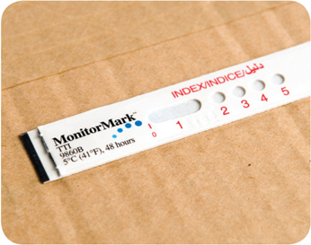
Monitoring Time and Temperature
Maximum registering thermometer:
Indicates the highest temperature reached during use
Used where temperature readings cannot be continuously observed
Time-temperature indicators (TTI):
Monitor both time and temperature
Are attached to packages by the supplier
A color change appears on the device when time-temperature abuse has occurred
4-18
Notes:
Instructor Notes
Other tools are available that can help you monitor temperature. A maximum registering thermometer is one type. This thermometer indicates the highest temperature reached during use and is used where temperature readings cannot be continuously observed. It works well for checking the final rinse temperature of dishwashing machines.
Some devices monitor both time and temperature. The time-temperature indicator (TTI), as shown in the photo, is an example. These tags are attached to packaging by the supplier. A color change appears in the window if the food has been time-temperature abused during shipment or storage. This color change is not reversible, so you know if the food has been abused.
Some suppliers place temperature-recording devices inside their delivery trucks. These devices constantly check and record temperatures. You can check the device during receiving to make sure food was at safe temperatures while it was being shipped.

Slide 19
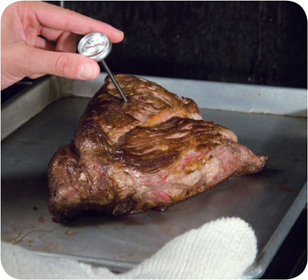
General Thermometer Guidelines
When using thermometers:
Wash, rinse, sanitize, and air-dry thermometers before and after using them
Make sure thermometers used to measure the temperature of food are accurate to +/- 2ºF or +/- 1ºC
Only use glass thermometers if they are enclosed in a shatterproof casing
4-19
Notes:
Instructor Notes
Thermometers should be washed, rinsed, sanitized, and air-dried before and after each use to prevent cross-contamination. Be sure the sanitizing solution you use is for food-contact surfaces.
Glass thermometers, such as candy thermometers, can be a physical contaminant if they break. They can only be used when enclosed in a shatterproof casing.

Slide 20
What Do You Think?
When should you calibrate a thermometer?
A. If you dropped it
B. If you left it in the freezer
C. Before each shift
D. All of these times
4-20
Notes:
Instructor Notes
The answer is D. Thermometers can lose their accuracy. When this happens, the thermometer must be calibrated, or adjusted, to give a correct reading. Make sure your thermometers are accurate by calibrating them regularly.
Calibrate thermometers at these times:
• After they have been bumped or dropped
• After they have been exposed to extreme temperature changes
• Before deliveries arrive
• Before each shift

Slide 21
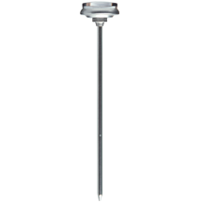
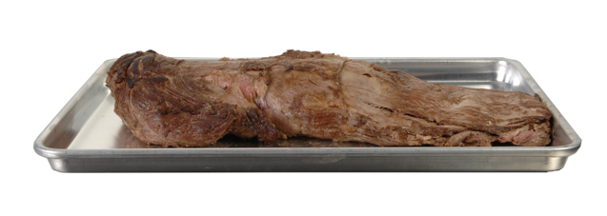
What Do You Think?
Where should you stick the thermometer?
C
B
A
4-21
Notes:
Instructor Notes:
The answer is C. When checking the temperature of food, insert the probe into the thickest part of the food. This is usually the center. Also, take another reading in a different spot. The temperature may vary in different areas.
Before recording a temperature, wait for the thermometer reading to steady. While digital thermometers are capable of displaying the temperature instantly, bimetallic stemmed thermometers will take more time. Allow at least 15 seconds after you insert the thermometer stem into the food.

Slide 22
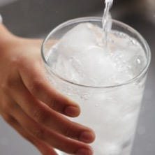
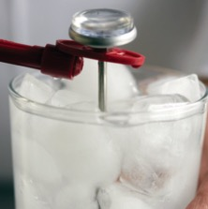
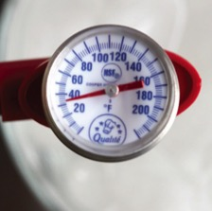
Calibrating Thermometers
1. Fill a large container with ice.
2. Put the thermometer stem or probe into the ice water.
3. Adjust the thermometer so it reads 32ºF (0ºC).
4-22
Notes:
Instructor Notes
There are two ways to calibrate a thermometer:
The boiling-point method involves adjusting the thermometer to the temperature at which water boils (212°F [100°C], depending on your elevation).
The ice-point method involves adjusting the thermometer to the temperature at which water freezes (32°F [0°C]). The ice-point method is easier and safer.
Fill a large container with ice. Use crushed ice if you have it. Add tap water until the container is full. Note: Stir the mixture well.
Put the thermometer stem or probe into the ice water. Make sure the sensing area is submerged. Wait 30 seconds or until the indicator stops moving. Note: Do not let the stem or probe touch the container.
Adjust the thermometer so it reads 32°F (0°C). Note: To calibrate a bimetallic stemmed thermometer, adjust it by holding the calibration nut with a wrench or other tool. To calibrate a thermocouple or thermistor, follow the manufacturer’s directions.

Slide 23
Activity
Stump the Trainer
4-23
Notes:
Instructor Notes
Do the Stump the Trainer activity. This activity can be downloaded from ServSafe.com. Directions for using the activity are included with it.

